Slide 1
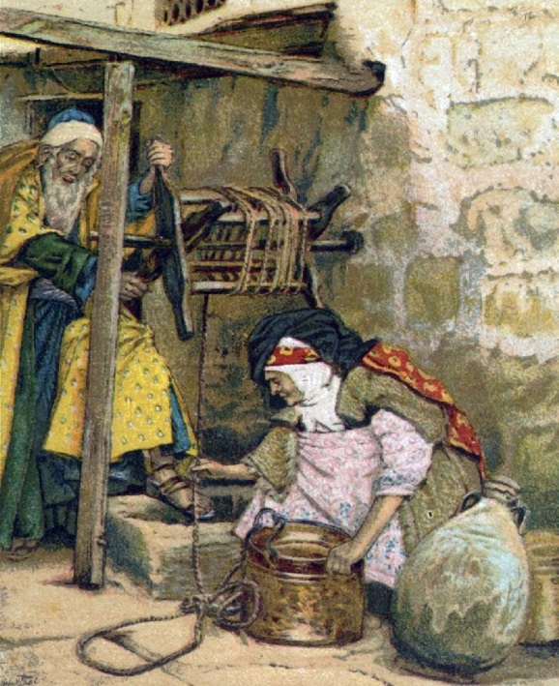
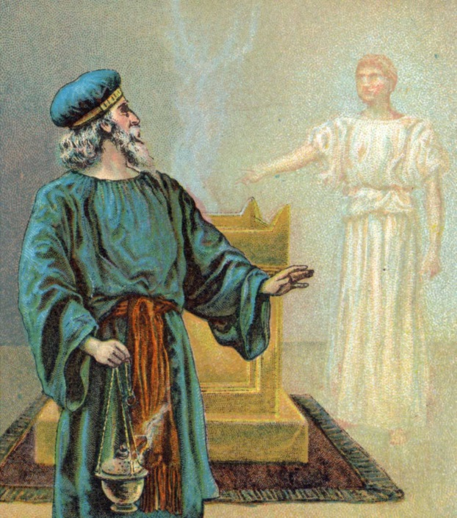
Cards 25-32
PARENTS OF JOHN THE BAPTIST
Some little time before Jesus was born; there lived an old priest of the temple named Zacharias. (sometimes written Zachariah). His wife was named Elisabeth and she was related to Mary, Jesus’ mother. Both were good people, obeying God’s laws, but they did not have any children and would have liked one very much. They had prayed for a child, but felt they were now too old.
Once a year Zacharias had to go to the temple at Jerusalem for two weeks to carry out his special duties as a priest. In this particular year, he received an honor which only occurred once in a lifetime. He was chosen to offer the incense in the temple, the most solemn part of the day’s service. It was done every morning and evening on the golden altar of incense which stood before the veil of the Holy of
Holies inside the temple. The priest, whose duty and privilege it was, went alone within the temple to offer the incense, and the other priest and people worshipped outside in the temple courts during the hour when the incense was burnt.
As Zacharias was doing his turn of duty, he suddenly looked up and saw an angel at the right-hand side of the altar. He was alarmed and afraid at this strange sight.
“Don’t be afraid, Zacharias,” said the angel, “God has heard your prayers and you and Elizabeth will have a son. You will name him John and he will be a great man in God’s sight, filled with the Holy Spirit. How happy you and many other will be when he is born! He will go before the Lord, full of power, like the mighty prophet Elijah. He will prepare the way for the coming of the Lord.”

Slide 2
PARENTS OF JOHN THE BAPTIST
A. Mary and Joseph
B. Abraham and Sarah
C. Zacharias and Elisabeth
Zacharias was an old priest of the T______________?
Elisabeth was a relative of M__________mother of Jesus?
Did they have any children?
Who appeared to Zacharias as he was offering the incense in the Holy of Holies?
What did this angel tell him?
What did the angel tell him the name of his son would be?
What was the special duty his son would do for the Lord?

Slide 3
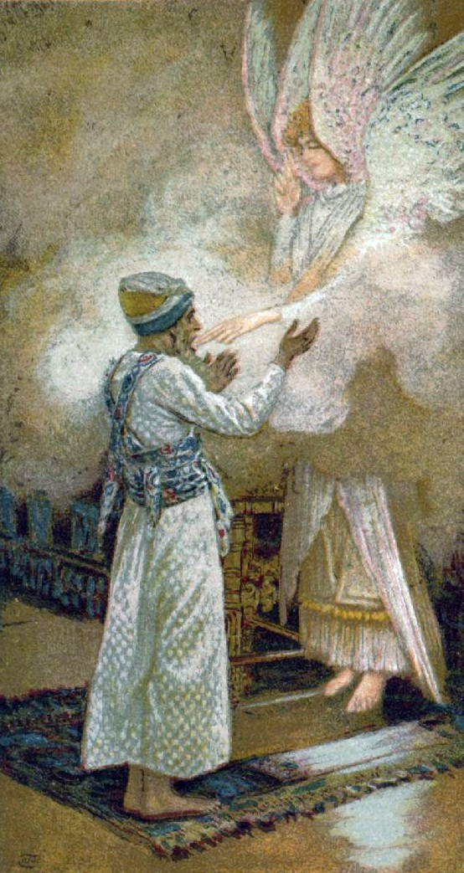
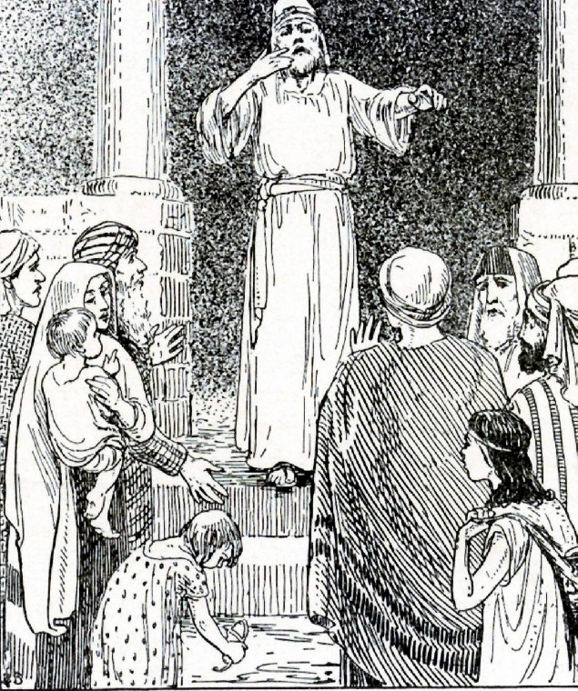
SIGN TO ZACHARIAS
After the angel told Zacharias that he and Elizabeth would have a son, he questioned the angel. “But I am an old man,” said Zacharias, “and my wife is old too. How can I know that what you say is so?
“I am Gabriel,” the angel answered. “I stand in God’s presence, and it is He who has sent me to bring you this good news. However, since you have not believed me you will remain dumb, unable to speak, until the day when these things which God has promised come true.”
Meanwhile, the people were waiting outside for Zacharias to come out of the temple, and they were wondering why he took so long.
When at last he did come out, he was unable to speak and to give the people his priestly blessing; he could only make signs to them, and so they realized that something had happened to him in the temple.
In due time, Elisabeth had a baby boy, just as God had promised through the angel. All her relatives and friends were delighted that God had been so good to her and had sent her a son in her old age, and they all rejoiced with her.
The time came for the baby to be given his name. Everyone thought he would be called Zachariah, after his father, and they were very surprised when Elisabeth shook her head and said, “No, he is going to be named John.”
“John?” questioned the relatives and friends. “But why? There is no one in your family called by that name.” Then they made signs to Zacharias, who was still dumb, asking him what he would like the baby to be called. Zacharias signaled back, asking for a writing tablet and, when it was brought to him, he wrote on it, “His name is John.” Immediately he found he was dumb no longer and could speak again.

Slide 4
SIGN TO ZACHARIAS
A. Rainbow in the sky
B. Unable to speak until John was born
C. Cloud from Heaven
After Zacharias was told by the angel that he and Elisabeth would have a son, what did he do?
What was the angel’s name that spoke to Zacharias?
Since he did not believe the angel what happened to him?
When Elisabeth had a baby boy and it came time to name him what did she tell everyone?
Did the relatives and friends questioned the name?
What did Zacharias ask for when they ask him what he would like the baby to be called?
What did he write on the tablet?
Immediately what was changed for him?

Slide 5
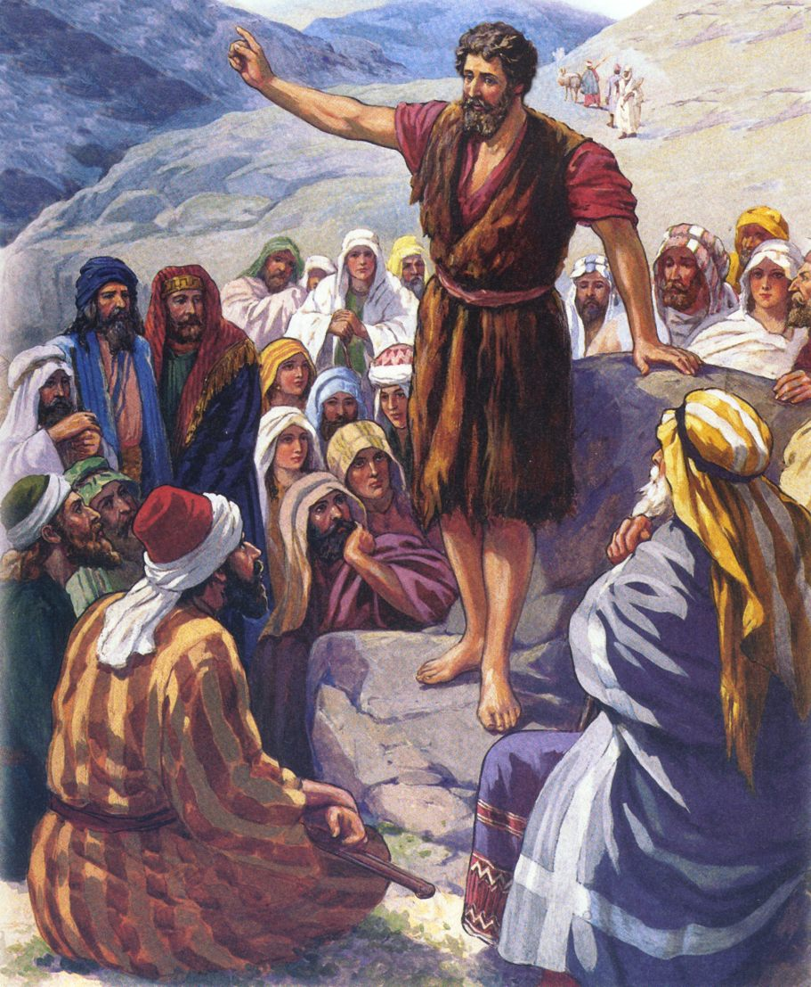
JOHN’S WORK
As the boy John grew up he lived in the desert until the time came for him to begin his special work as a prophet among the people of Israel; the work for which God had sent him.
He was a strange, rugged-looking man, dressed in a garment made of cloth woven from camel’s hair, with a leather belt round his waist. His food was strange too, for he ate locusts and wild honey. In that land the poorer people often ate locusts, after the wings and legs had been removed and the remaining parts either boiled or roasted. Honey was plentiful in the desert, being found in honey combs in the crevices of rocks.
Out of the desert came John, a stern, fiery prophet, calling upon the people to repent, to turn away from their sins and to begin a new way of life, because the Kingdom of God was near. News of him travelled fast, and crowds flocked to hear this strange new preacher. They came from Jerusalem and from all the surrounding country of Judea.
“Prepare the way of the Lord,” cried John. “Make a straight path for Him; fill up the valleys and level off the hill-tops; make the crooked places straight and the rough places smooth. Then everyone will see God’s salvation.”
This was a colorful way of saying, “Get rid of unbelief and the things you have neglected to do (valleys); fill the spaces with new grace; get rid of pride and haughtiness (hills), cast them down and become humble; straighten out all deceit and untruthfulness (crooked places), and get rid of anger, hatred and malice (rough places).”
“Confess your sins, be truly sorry and come and be baptized,” called John, and hundreds of people came out to be baptized in the River Jordan.

Slide 6
JOHN’S WORK
A. Forerunner of Jesus
B. A beekeeper
C. A fisherman
Where did John live?
Describe his clothes
What did he eat?
John cried to the people==“Prepare the way of the __________?”
After John preached to the people to confess their sins what did they do?
In what river were they baptized?

Slide 7
PURPOSE OF JOHN’S BAPTISM
As stated on the last slide John told the people to; “Confess your sins, be truly sorry and come and be baptized, and hundreds of people came out to be baptized in the River Jordan. Being baptized meant being “washed” and was a symbol of the cleaning up of the previous life—For remission of sins (Mark 1:4). This was a sign that all earlier wrongs were washed away and that a new and better life could be started. Because of this baptizing work, John came to be known as John the Baptist.
People began to wonder about this new prophet. Was he perhaps the expected Messiah? The Jewish authorities in Jerusalem sent some priests and Levites to ask John who he was.
But John answered, “No, I am not the Messiah. I baptize with water, but there is One coming who is much greater than I am. I am not even good enough to untie His sandals. He will baptize you with the Holy Spirit and with fire.” By “fire” John meant holy fervor and zeal in God’s service.”

Slide 8
PURPOSE OF JOHN’S BAPTISM
A. To wash the dirt off
B. Have fun in the water
C. For remission of sins
John told the people to confess their s_______?
John also told them to come and be b___________?
Because of this baptizing work, John came to be known as John the B__________?
What was John’s answer when some priests and Levites ask John if he was the Messiah?
John said “I am not good enough to untie Jesus’ s_____________?
Jesus will baptize with the H________S_________?
Where there many people who came to be baptized by John in the River Jordan?

Slide 9
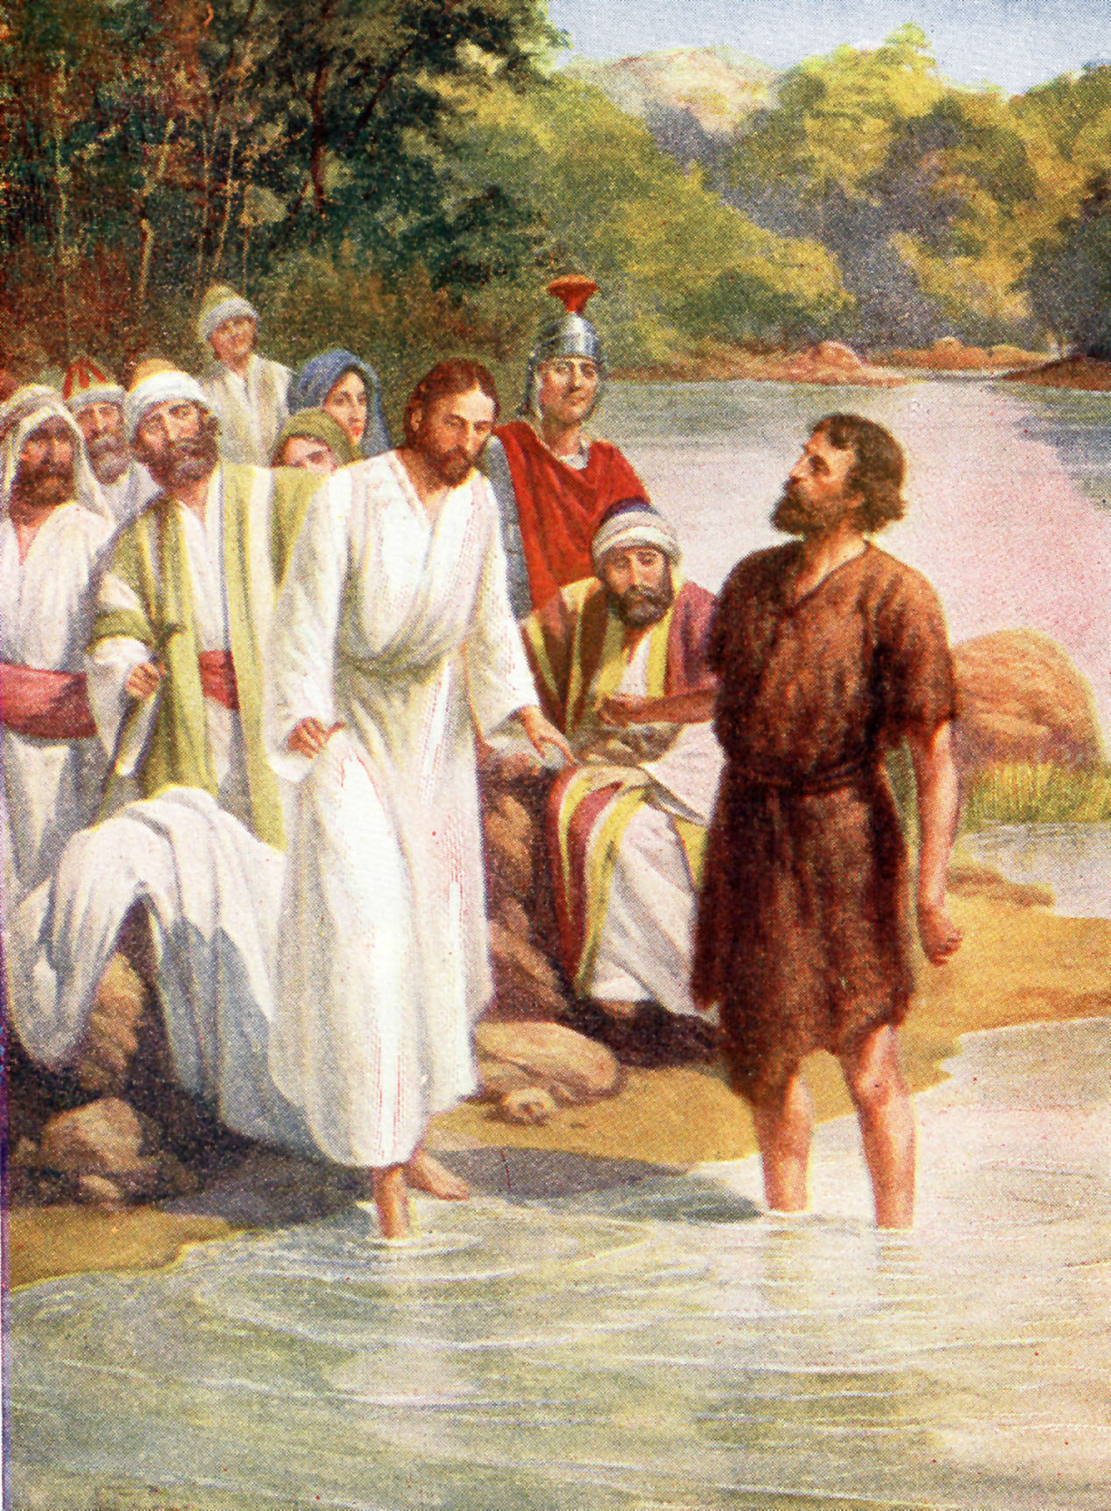
WHO BAPTIZED JESUS?
The next day after talking with the priests and Levites John saw Jesus coming toward him. John pointed Him out to the people and said, “Look, there He is! That is the One who will take away the sins of the world. It was He whom I was talking about when I said there was One coming who was much greater than me. I did not know who He was, but I came to baptize you with water, so that He might be known to the Israel.”
John called Jesus “the Lamb of God”. This is a phrase which comes from Old Testament sacrifices. Sin meant that people were separated from God and therefore under a death-sentence. In Old Testament days it was customary to offer, as a sacrifice, the death of an animal in place of the death of a person, and often this was a lamb. But when Jesus came, He came to save the world. He was to die, giving His life once and for all, on behalf of sinners, just like a lamb being sacrificed for human sin.
John was very surprised when Jesus came forward to the river to be baptized and felt that this was something which he could not do. Surely Jesus should be baptizing him instead, he thought. So he tried to prevent Jesus from being baptized, but Jesus told him it was God’s will.
John agreed, and went into the river with Jesus to baptize Him. John devoted all his energy from youth to prepare himself to honor Jesus. In sprite of his greatness, he humbled himself before Jesus.

Slide 10
BAPTIZED JESUS
A. A priest
B. A Levite
C. John the Baptist
John pointed Jesus out to the people as the one who will take away our s_______?
Was Jesus the one John referred to as the “One much greater than me”?
John called Jesus “the L________of G_________?
Was John surprised when Jesus came forward to the river to be baptized?
Did John feel that this was something he could not do?
John felt the Jesus should be baptizing him? True or False
Did John baptize Jesus?

Slide 11
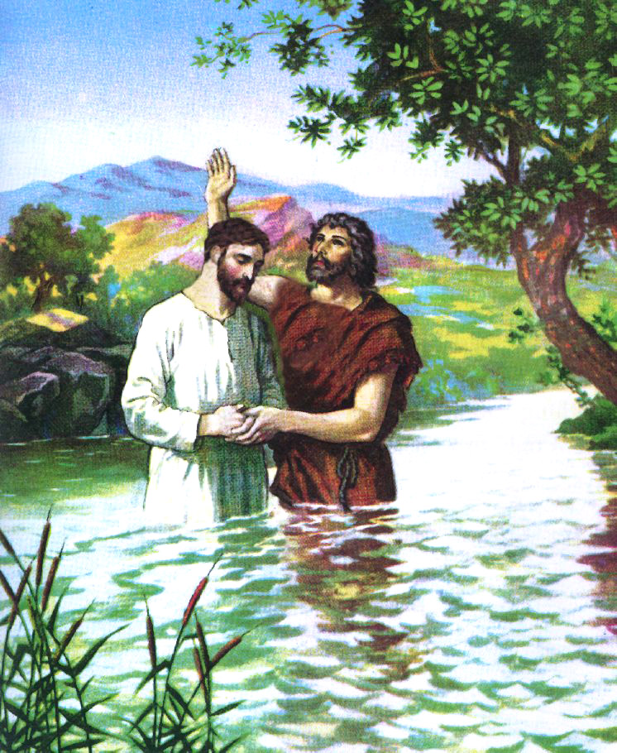
WHY JESUS WAS BAPTIZED
In being baptized, Jesus showed that He was ready to do His Father’s work. TO FULFILL ALL RIGHTEOUSNESS

Slide 12
WHERE WAS JESUS BAPTIZED?
After talking to Jesus, John agreed to baptize Him, so they went down into the river Jordan. In Bible times this was the best place available.

Slide 13
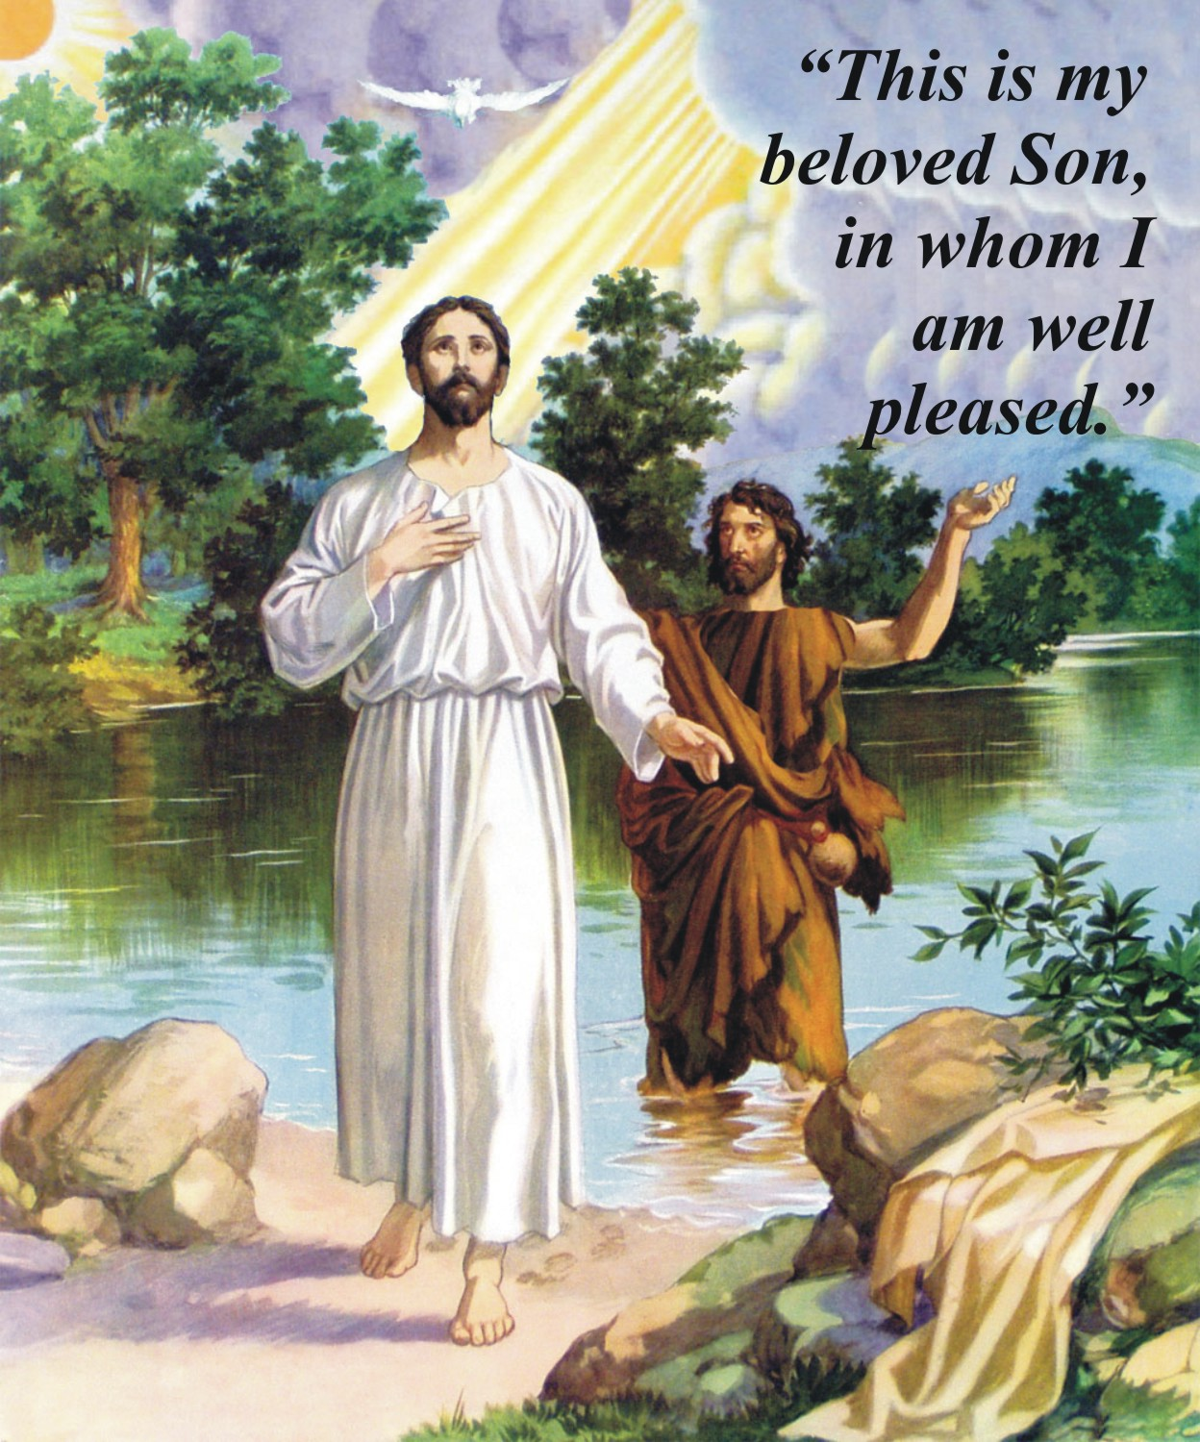
EVENTS FOLLOWING JESUS’ BAPTISM
THE FATHER SPOKE FROM HEAVEN, THE HOLY SPIRITY DESCENDED LIKE A DOVE UPON JESUS
As soon as Jesus came up out of the river Jordan, it seemed that the heavens opened, and John saw the Holy Spirit in the form of a dove, come down and alight on Jesus. At the same time a voice from heaven was heard saying. “This is my beloved Son, in whom I am well pleased.”
These words showed that the baptism of Jesus did not mean that Jesus was a sinner who needed baptizing to wash away former sins like everyone else. God’s words showed that Jesus was without sin but that He was now ready to identify Himself will all men and to take on the responsibility for their sin.

