Slide 1
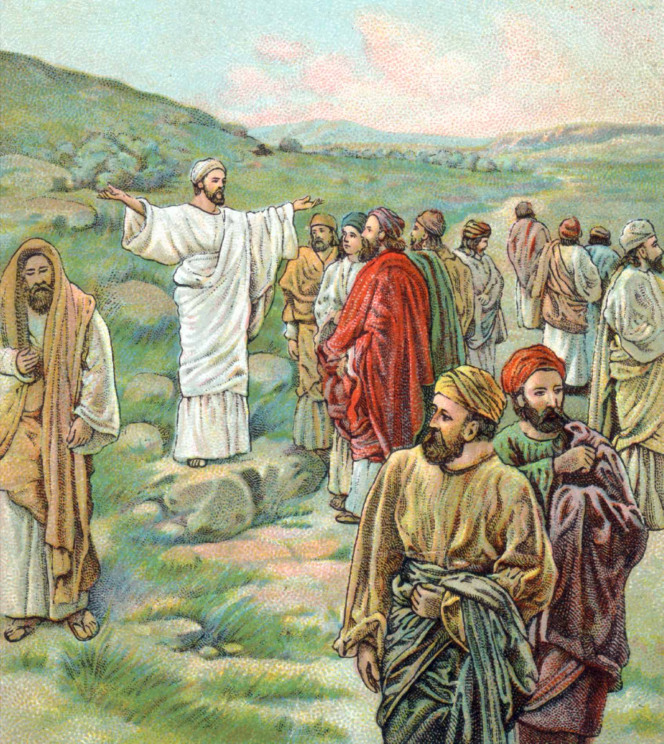
Cards 49-52
THE LIMITED COMMISSION
As we learned on our last card Jesus sent His Apostles on a mission. Jesus called His twelve apostles to Him, and gave them authority to cast out evil spirits and to heal every kind of sickness and disease.
Here are the names of His twelve apostles:
Simon (also called Peter),
Andrew (Peter’s brother),
James (Zebedee’s son),
John (James’ brother),
Philip
Bartholomew,
Thomas,
Matthew (the tax collector),
James (Alphaeus’ son),
Thaddaeus,
Simon (a member of “The Zealots,”
A subversive political party),
Juda Iscariot (the one who betrayed Him)
Jesus sent them out with these instructions: Don’t go to the Gentiles or the Samaritans, but only to the people of Israel (Jews)—God’s lost sheep. Go and announce to them that the Kingdom of Heaven is near. Heal the sick, raise the dead, cure the lepers, and cast out demons. Give as freely as you have received!

Slide 2
LIMITED COMMISION
A. Just preach to the Gentiles
B. Just preach to the Samaritans
C. Go preach to the people of Israel (Jews) God’s lost sheep
Name the 12 Apostles
Jesus gave them authority to cast out evil s_________ and to heal every find of d___________?
Jesus sent them out with specific instructions they were not to go the G________or S_________?
Jesus told them to go to Israel and announce to them what?
Jesus told them to heal the sick, raise the dead, and cast out demons? True or False
Jesus told them to give as freely as they had received? True or False

Slide 3
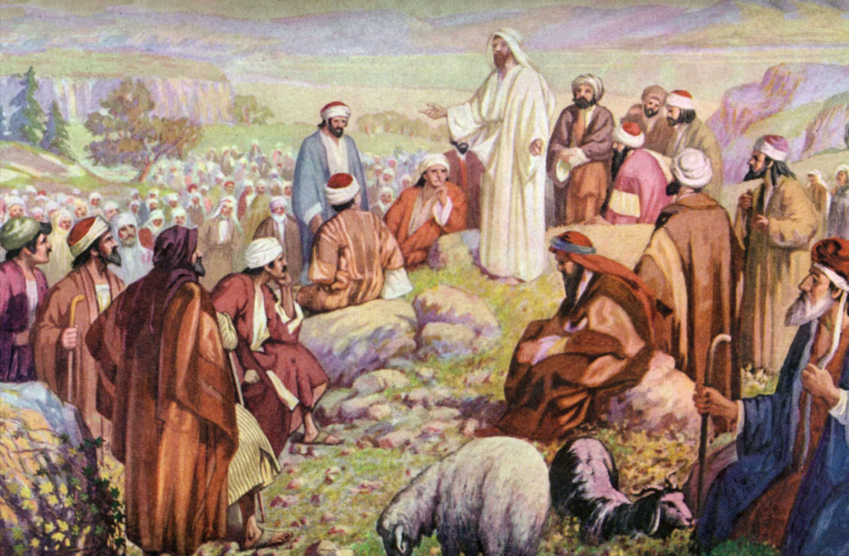
SERMON ON THE MOUNT
Jesus visited the towns scattered through the countryside of Galilee, speaking in each about the kingdom of heaven. News of Jesus spread, and people traveled long distances, bringing the sick to be healed.
But as Jesus looked into the faces gathered around Him, He saw much more than sickness and disease. He saw the fear and sin that kept people from feeling close to God. He wanted to tell them how to live so that each day might be filled with joy and contentment. So Jesus went up on a hillside and began to speak. A huge crowd gathered. The people stayed to listen for hours.
“Don’t worry all the time,” Jesus said. “How you live your life is much more important than what you eat or what you wear. If you think first of what God wants, He will take care of you, just as He takes care of the flowers and the birds.
“God is more important than money. Don’t pile up money here on earth where robbers can steal it. Make serving God your treasure, and He will store it in heaven for you.”
These teachings are part of Jesus’ Sermon on the Mount. The words are as true today as they were for the people on that hillside in Galilee so many years ago. God told Matthew, who had been a tax-collector when Jesus called him, to write down Jesus’ words, so that this wonderful Sermon on the Mount would not be forgotten. God helped him to write it without a mistake. So, you see Jesus spoke those words not only to the great crowd of people who were sitting on the mountain-side before him, but to us and to all the people in the world

Slide 4
SERMON ON THE MOUNT
A. Matthew 5-7
B. Genesis 1:1
C. Revelation 22:21
Did Jesus visit towns through the country side of Galilee speaking in each?
He talked to them about the k______________of H_____________?
Did news of Jesus spread?
Who did the people bring to Jesus?
Jesus not only wanted to heal the sick but tell them how to live? True or False
Where did Jesus go to talk to the people?
Did a huge crowd gather?
How long did they stay and listen to Jesus?
Did Jesus tell them not to worry about what they eat and wear?
Jesus told them if you think first of what God wants, He will do what?
Does Jesus take care of the flowers and the birds?
Is God more important than money ?
What happens to money on the earth?
Jesus said we should make serving God our t_______________?
Are these words still true today?
God told Matthew to write down Jesus’ words, so that this wonderful Sermon on the Mount would not be forgotten! T or F

Slide 5
THE LORD’S PRAYER
Matthew 6:5-18
When Jesus was on the earth, he showed his love for people by healing and teaching them. He also taught them how to pray. He said, “Don’t pray where everyone can see you.” Jesus told the people to go into a room, shut the door, and pray privately. He also told them, “When you pray, do not babble on.”
Jesus taught the people the words of a special prayer that we still pray today. It is called the Lord’s Prayer.
Our Father in heaven,
Hallowed be your name,
Your kingdom come,
Your will be done,
On earth as it is in heaven.
Give us today our daily bread.
Forgive us our debts,
As we also have forgiven our debtors.
And lead us not into temptation,
But deliver us from the evil one.
Jesus also said that if we forgive people who sin against us, God will forgive us; if we refuse to forgive others, God will not forgive us.
Jesus said the way to pray is to ask and keep on asking. “For everyone who asks receives; he who seeks finds; and to him who knocks, the door will be opened.”

Slide 6
The Lord’s Prayer
Matthew 6:5-18
Our Father which a________in H_____________
H_____________be thy n_______________
Thy K___________come thy will be d_________
On e___________as it is in H______________
Give us this d_______our daily b____________
F____________us our d____________
As we also have forgiven our d______________
And lead us not into t_________________
But deliver us from the e__________one
For thine is the k_____________and the p___________
And the g__________forever, Amen
Are we to pray so everyone can see us?
Jesus said the way to pray is to ask and keep on asking? True or False

Slide 7
A SECRET VISIT BY NIGHT JOHN 3:3
Nicodemus was one of the Pharisee leaders in Jerusalem. Passing through a crowd one day, he heard Jesus speak about the new life God wants for each of us. This idea troubled Nicodemus. He did not dare to speak to Jesus openly, for fear the other Pharisees would scorn him. But he did want to know more about this teacher who talked so much about God and the Kingdom of God. He waited until night would hide where he was going and went to see Jesus.
He said to Jesus, “Teacher, we know that God sent you, for no one could do these miracles that you do unless God were with him,”
Jesus said to him, “No one can see the Kingdom of God unless he is born again.”
That was a strange answer. Nicodemus did not understand. Surely, he would like to see the kingdom of God. But he was a grown man. Must he be born again? Must he be a baby again?
Jesus said, “Verily, verily, except one be born of water and the Spirit, he cannot enter the Kingdom of God.”
We all have a spirit. It must be brought to life by the water of baptism and by the Holy Spirit. If a person does not have two births—body and spirit—he cannot enter God’s kingdom.
MESSAGE TO
NICODEMUS

Slide 8
MESSAGE TO NICODEMUS
A. Love your neighbor as your self
B. Lead us not into temptation
C. Must be born again
Nicodemus was one of the P_____________leaders in Jerusalem?
Did Nicodemus understand what Jesus said about the new life God wants for each of us?
Did he speak to Jesus openly?
Why did he come to Jesus by night?
Jesus told Nicodemus he must be b__________ a__________?
Was this a strange answer to Nicodemus?
Did he understand what Jesus meant?
Could he be born again as a grown man?
Jesus told him he must be born of w_________and the Spirit, or he cannot enter the Kingdom of God?
We all have a spirit, it must be brought to life by the water or b____________and by the Holy Spirit?
If a person does not have two births—b_________and s_________--you canot enter God’s kingdom?

