Slide 1
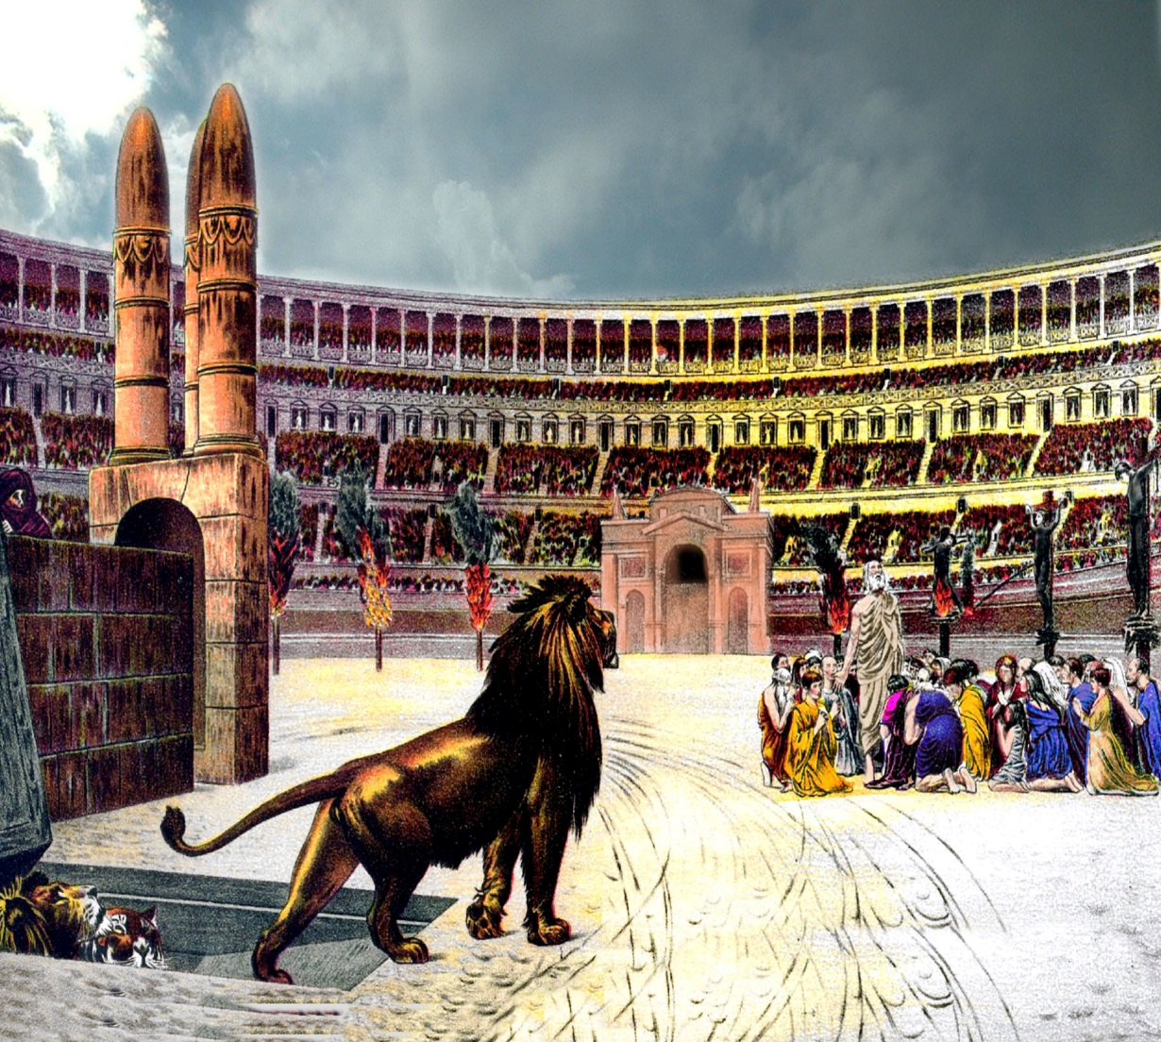
Cards 100-103
I PETER TELLS ABOUT
SUFFERING FOR CHRIST
What advice would you give Christians about to undergo persecution? The apostle Peter took up that challenge just as threatening rumblings from Rome were striking fear in every Christian community. Half-crazed Nero had seized on believers as scapegoats for the ills of his empire.
Should the persecuted Christians flee or resist? Should they tone down their outward signs of faith? Give up? Peter’s readers, their lives in danger, needed clear advice on suffering.
They also wanted explanations of the meaning suffering. Why does God allow it? Can good result? Does God care? In short, they were asking the questions that occur to any Christian who goes through great trial.
According to Peter, suffering should not catch a Christian off guard. We are “strangers” (1:17) in a hostile world, and where Christians thrive, storm clouds may gather. Suffering is an expected part of life of sincere faith.

Slide 2
I PETER TELLS ABOUT
A. THE ARK THAT NOAH BUILT
B. SUFFERING FOR CHRIST
C. PETERS FAMILY
1. Because evil men hate the right, Christians will always be persecuted? True or False
Christ is an example of how to deal with suffering? True or False
To suffer as a Christian is an honor and an opportunity to glorify God? True or False
Suffering is an expected part of a life of sincere faith? True or False
If a gunman came into our church and said he would kill all who believed in God, what would your
response be if he asked you with a gun pointed at your head if you believed in God?

Slide 3
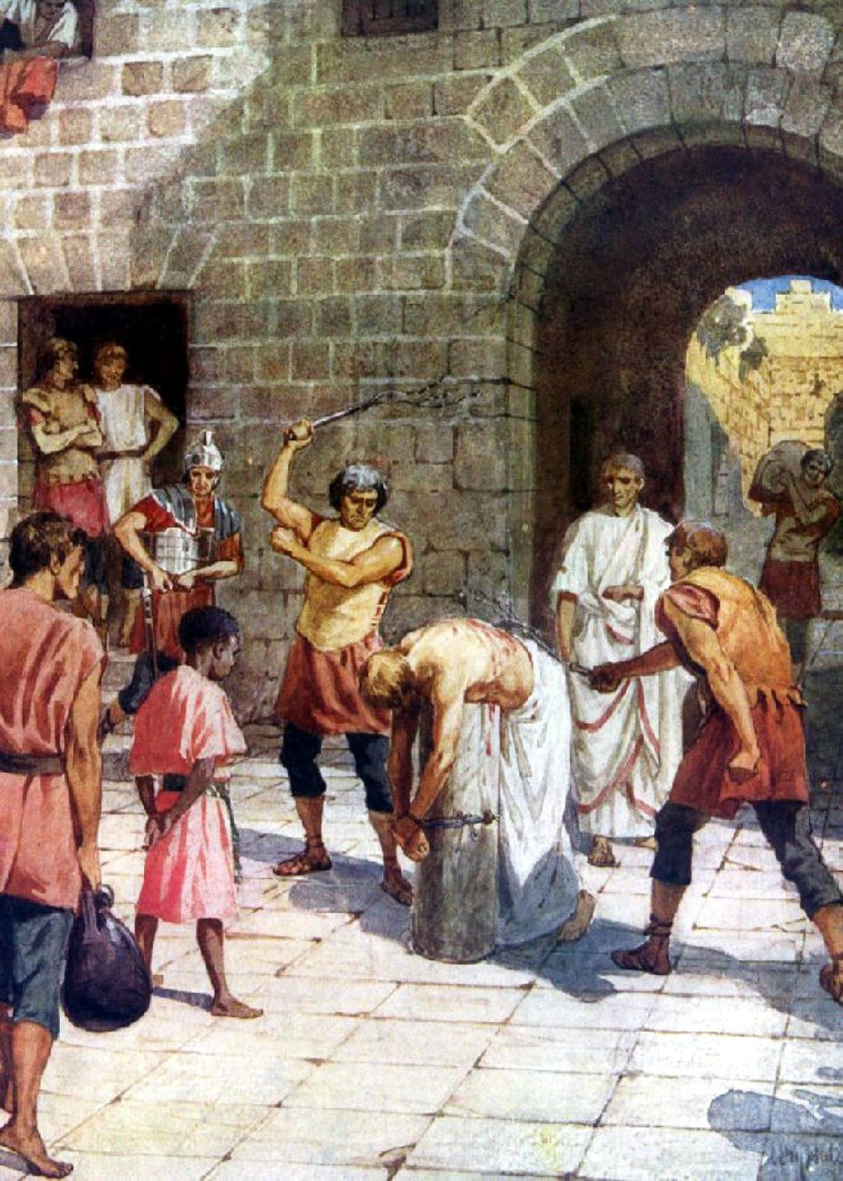
EXAMPLE FOR SUFFERING CHRISTIANS
CHRIST
On the subject of suffering, Peter makes an ideal counselor, for readers then and now. He had been flogged and imprisoned for his own faith, once even expecting execution (Acts 12). Also Peter had personally watched Jesus endure suffering, and in this letter he points to him as an example of how to respond.
Suffering can refine believers and give us an opportunity to prove our faith, the result thus working out for our benefit.
According to I Peter, our hope that suffering will one day cease is not a mirage but a “living hope” (1:3) in the One who has conquered death.

Slide 4
EXAMPLE FOR SUFFERING CHRISTIANS
A. MARY
B. DORCUS
C. CHRIST
1. Had Peter been flogged as a Christian?
2. Had Peter been cast into prison?
3. Had Peter watched Jesus endure suffering?
4. Can suffering prove our faith?
5. Do you think that suffering will ever stop?
6. Can you name a way that you or a friend has suffered?

Slide 5
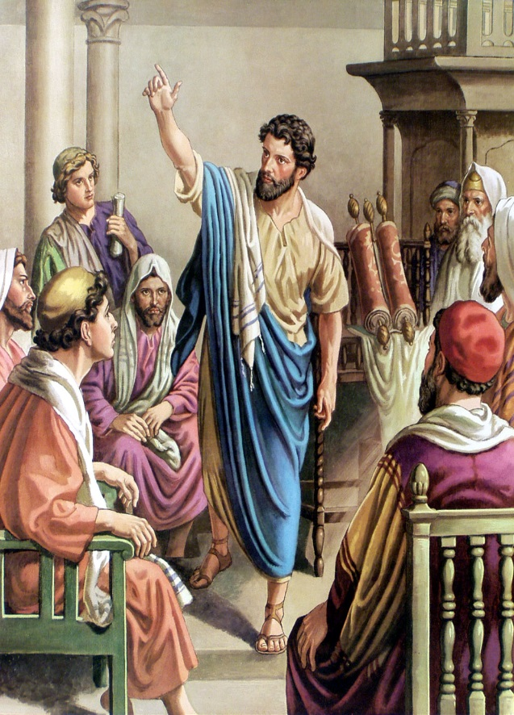
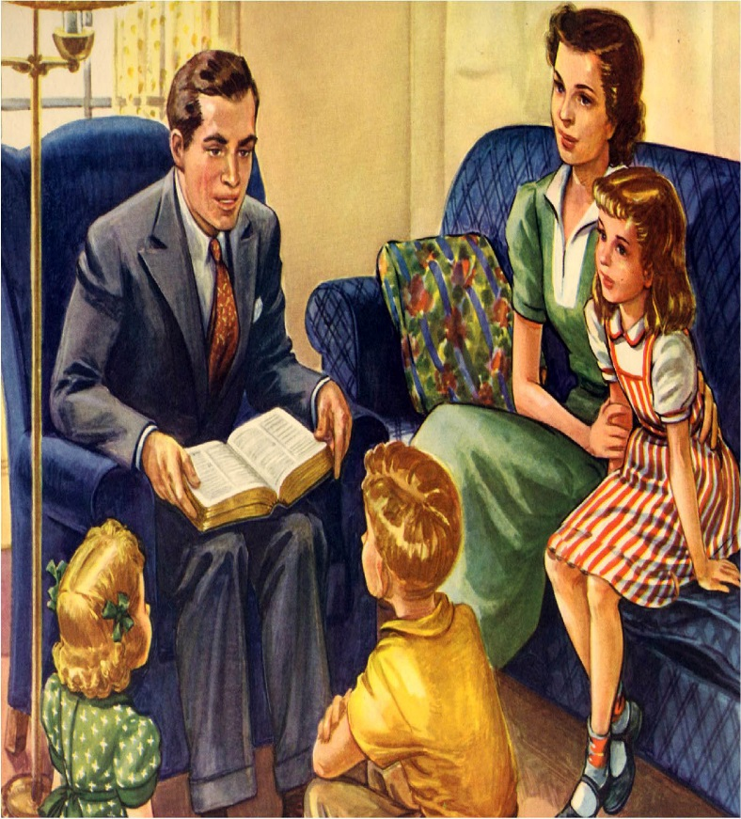
“IF ANY MAN SPEAK, LET HIM……
SPEAK AS THE ORACLES OF GOD…..”
The oracles here referred to were divine utterances delivered through the recognized agencies of the early church—the apostles, prophets, and inspired teachers. The meaning is that these gifts were properly exercised only when that which was said was in harmony with the oracles of God. When one allegedly spoke by inspiration it was to be done in such fashion that the utterance was to be readily recognizable as of divine origin. In this, as in all matters pertaining to the “manifold grace of God,” the speaker was to discharge his obligation as a “good steward.” He must speak not his own words, but speak as though they ere God’s words!!

Slide 6
“IF ANY MAN SPEAK, LET HIM….
A. JUST SAY ANY THING HE THINKS SOUNLDS GOOD
B. TELL PEOPLE WHAT THEY WANT TO HEAR
C. SPEAK AS THE ORACLES OF GOD
1. The oracles here referred to divine utterances delivered by the apostles, prophets and inspired teachers? True or False
Was these oracles properly exercised only when what they said was in harmony with the oracles of God?
Were the apostles to speak their own words, or speak as though they were God’s words?
The only acceptable way for a man to speak is as God speaks? True or False
Can men use any creed book or manual to speak as God speaks?
What is the only acceptable book that ministers should speak from?
If one cannot speak as the oracles of God should he keep silent?

Slide 7
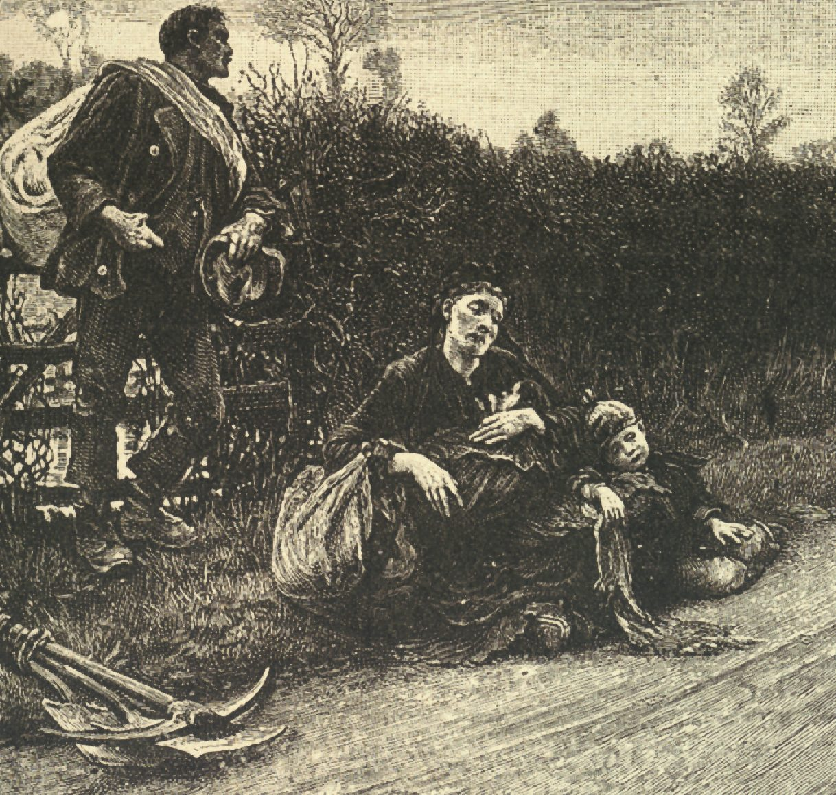
A MAN IS NOT TO BE ASHAMED IF
HE SUFFERS AS A CHRISTIAN
The name Christian was now (in I Peter) widely known, and good men suffered only because they are Christians. Peter is warning them to be Armed for Suffering. It was a time of Persecution. The special exhortation of this Epistle was for Christians to be ready for it. But there is comfort here for Christians like us, who live in normal times; for very few people get through life without a good deal of Suffering of one kind or another: physical suffering, mental suffering, heart suffering. One of the strange ways of Providence is that many people have to suffer in the very way in which they would rather not have to suffer, have to go through life denied the one thing that most of all they would rather not be denied. Such people may very properly comfort themselves in the assurance that when God is bearing down extra hard in His grinding, it is that the finished diamond may be extra bright and beautiful.
To suffer “as a Christian” is to suffer persecution for being a Christian; and those thus suffering are not to be ashamed, but are to “glorify God” in this name.

Slide 8
A MAN IS NOT BE ASHAMED IF
A. HE TELLS LOTS OF LIES
B. HE GOSSIPS ABOUT OTHERS
C. HE SUFFERS AS A CHRISTIAN
The name Christian was now widely known in I Peter? True or False
Were good men suffering because they were Christians?
The special emphases of I Peter was for Christians to be ready for suffering? True or False
When people have to suffer weather it be physical, mental, or heart suffering should we be comforted that God is shaping us to be extra bright for Him?
Those that suffer as a Christian should not be ashamed, but are to “glorify God” in this time? True or False
Can you name a time you or a friend or family member has suffered?

