Slide 1
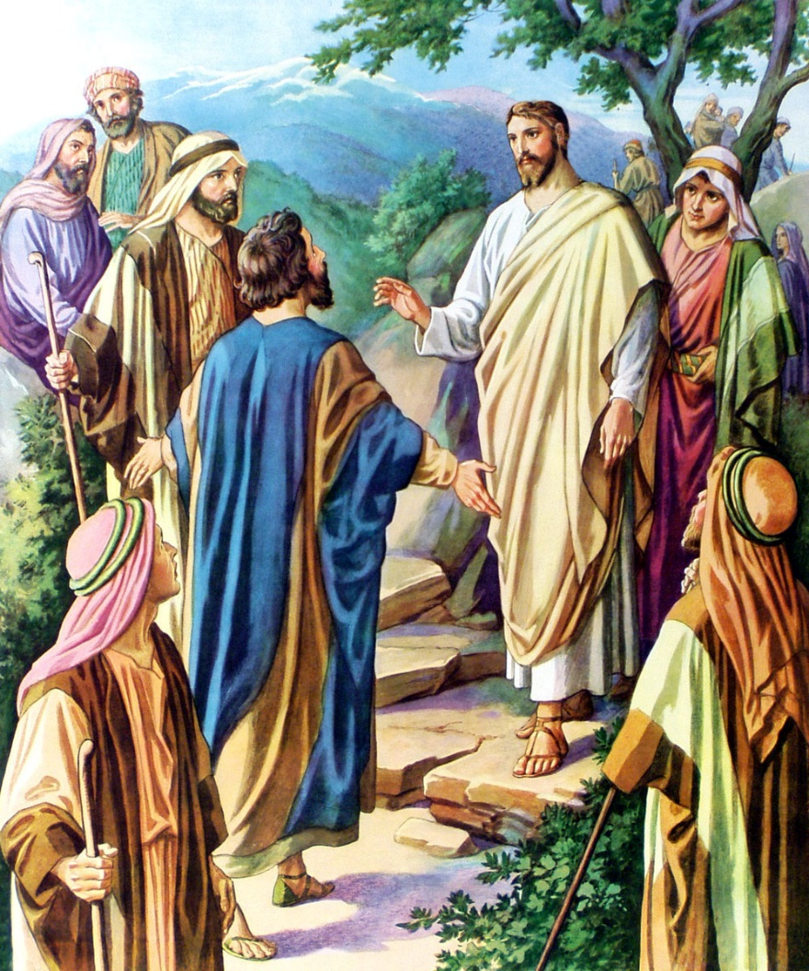
Cards 11-15
QUOTE Matthew 16:18
“…UPON THS ROCK I WILL BUILD MY CHURCH; AND THE GATES OF HELL SHALL NOT PREVAIL AGAINST IT.”
Before Peter became one of Jesus’ disciples, his name was Simon. But Jesus changed his name to Peter, meaning Rock, because Peter’s faith was rock-like. When Jesus has been teaching and healing for many months, He asked the disciples, “Who do people day that I am?”
The men gave several answers: John the Baptist, Elijah, Jeremiah.
Then Jesus ask, “But who do you say that I am?”
Peter immediately replied, “You are the Christ, the Son of the Living God.”
Jesus answered, “Only God could show you this! I will call you Peter, and on this rock I will build my church!”

Slide 2
QUOTE MATTHEW 16:18
“Upon this _____________ I will ____________my ________________and the _____________of hell shall ________________prevail
__________________it.”
What was Peter’s name before he became one of Jesus’ disciples?
What does the name Peter mean
When Jesus ask the disciples “Who do people day that I am?” What was their reply?
It was J_________the ______________, El________________and Je_______________
When Jesus ask, “But who do you day that I am?” What was Peter’s reply?
It was You are the C______________, the S________of the Living ___________.
When told them that only God could show you this what did he tell them next?
He said “I will call you P___________, and on this r___________I will b____________my
c_____________
6. Did Jesus build more than one church?

Slide 3
TWO COMMISSIONS IN MATTHEW AND LUKE
The Great Commission (To Both Jews and Gentiles)
After Jesus had risen from the dead the eleven followers went to Galilee to the mountain where Jesus told them to go. On the mountain the followers saw Jesus. They worshiped Him. But some of the followers did not believe that it was really Jesus.
MATTHEW 10:5-7
LUKE 10:1-9
MATTHEW 28:18-20
LUKE 24:44-48
THE LIMITED COMMISSION
(TO JEWS ONLY)
THE GREAT COMMISSION
BOTH JEWS AND GENTILES
(TO EVERY CREATURE)
The limited commission (to Jews only)
After the disciples had been with Jesus for a time, He called them together. “I give you My power,” He said. “God to the people of Israel, (Jews only). Be good shepherds to them for they are like lost sheep. Heal the sick. Give dead people life again. And tell people that the kingdom of heaven is coming soon!”
So He came to them and said, “All authority in heaven and on earth is given to me. So go and make followers of all people in the world. Baptize them in the name of the Father and the Son and the Holy Spirit. Teach them to obey everything that I have told you to do. And surely I am with you always, even to the very end of the age.”

Slide 4
TWO COMMISSIONS IN MATTHEW AND LUKE
The limited Commission (to Jews only)
The Great commission (to every creature)
Both of the above
What are the two NT books that these commissions are found in?
Was the limited commission to all the people?
What group of people was the limited commission for?
What did Jesus want the disciples to tell them---the k_____________of h___________
is coming s__________!”
What group of people was the GREAT COMMISSION for?
When did this commission come into effect?----after J_________ had risen from the
d___________
Did all the disciples believe it was really Jesus on the mountain where Jesus told
them to go?
Jesus told them to go where and make followers
What did Jesus tell them to do after they were made followers?
In whose name were they the baptize the followers?
How long did Jesus tell them he would be with them?

Slide 5
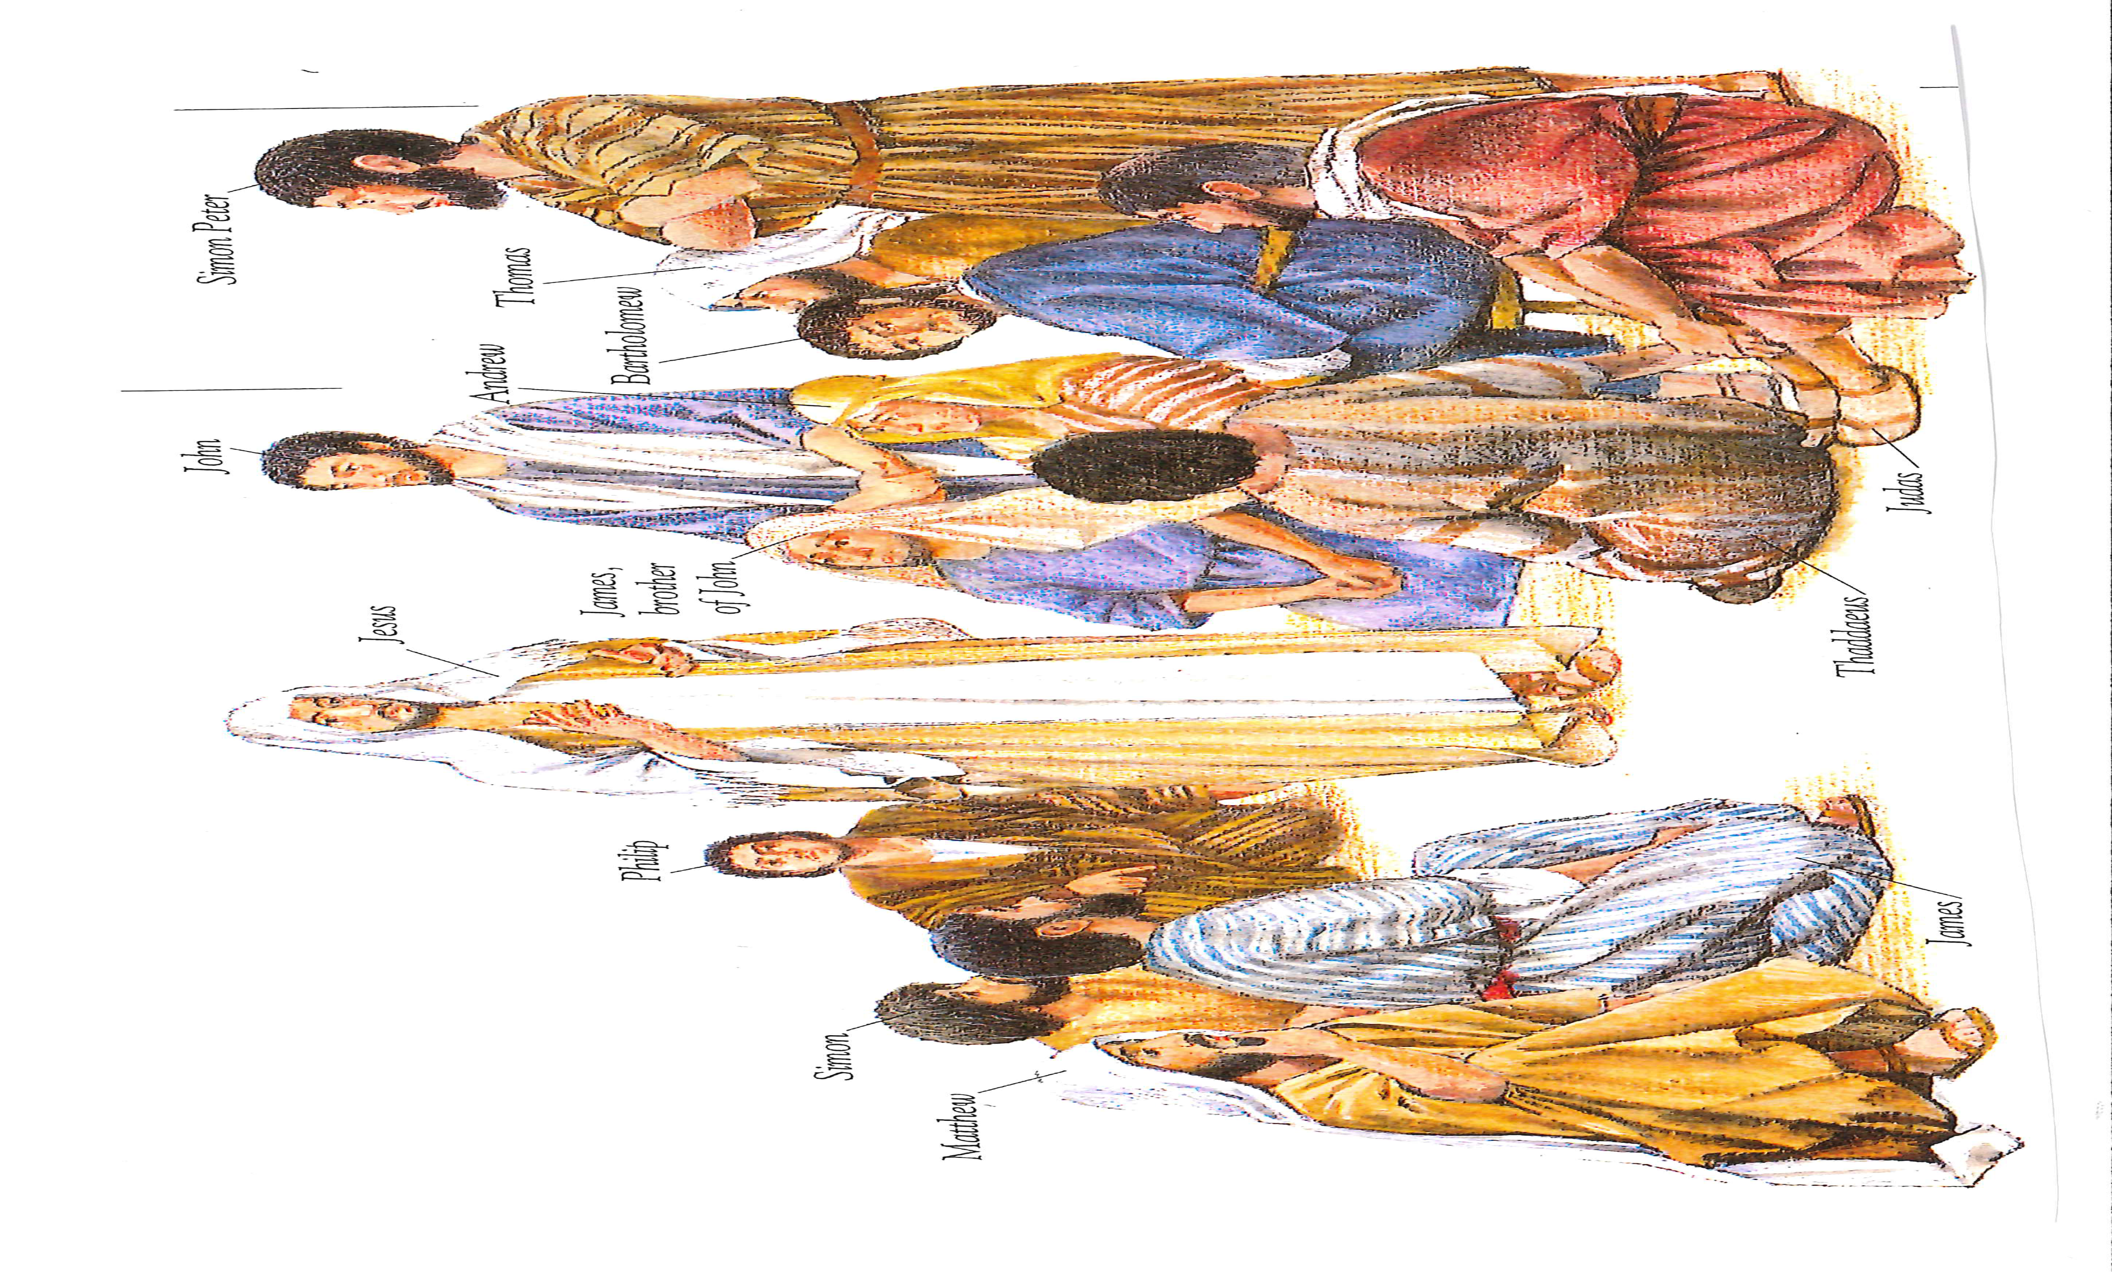
IN WHAT NEW TESTAMENT BOOK AND CHAPTER ARE THE NAMES OF THE
APOSTLES FOUND IN?
MATTHEW 10:2-4
Jesus called his twelve followers together. He game them power over evil spirits and power to heal every kind of disease and sickness. These are the names of the twelve apostles:
Peter
Andrew, (brother of Peter)
James, (son of Zebedee)
John, (brother of James)
Philip
Bartholomew
Thomas
Matthew, (tax collector)
James, (son of Alphaeus)
Thaddaeus
Simon (the Zealot)
Judas Iscariot (one who
betrayed Jesus)

Slide 6
SING THE APOSTLE SONG
JESUS CALLED THEM ONE BY ONE
Tune: (Jesus Loves Me)
Jesus called them one by one,
Peter, Andrew, James, and John,
Then came Philip, Thomas too,
Matthew and Bartholomew,
James the one they call the less,
Simon also Thaddaeus,
The twelfth disciple Judas’ made,
Jesus was by him betrayed.
Yes, Jesus call them,
Yes, Jesus call them,
Yes, Jesus call them,
THE BIBLE TELLS US SO

Slide 7
NAMES OF APOSTLES FOUND IN WHAT BOOK OF NEW TESTAMENT?
Romans
Hebrews
Matthew
More facts about the Apostles:
The word apostle means one sent
The twelve apostles were men who were especially sent by Jesus to bear witness of His resurrection
The apostles were part of the foundation of the church
It was only through the laying on of an apostle’s hands that spiritual gifts were given
Since obviously no apostles are alive today there can be no spiritual gifts today.

Slide 8
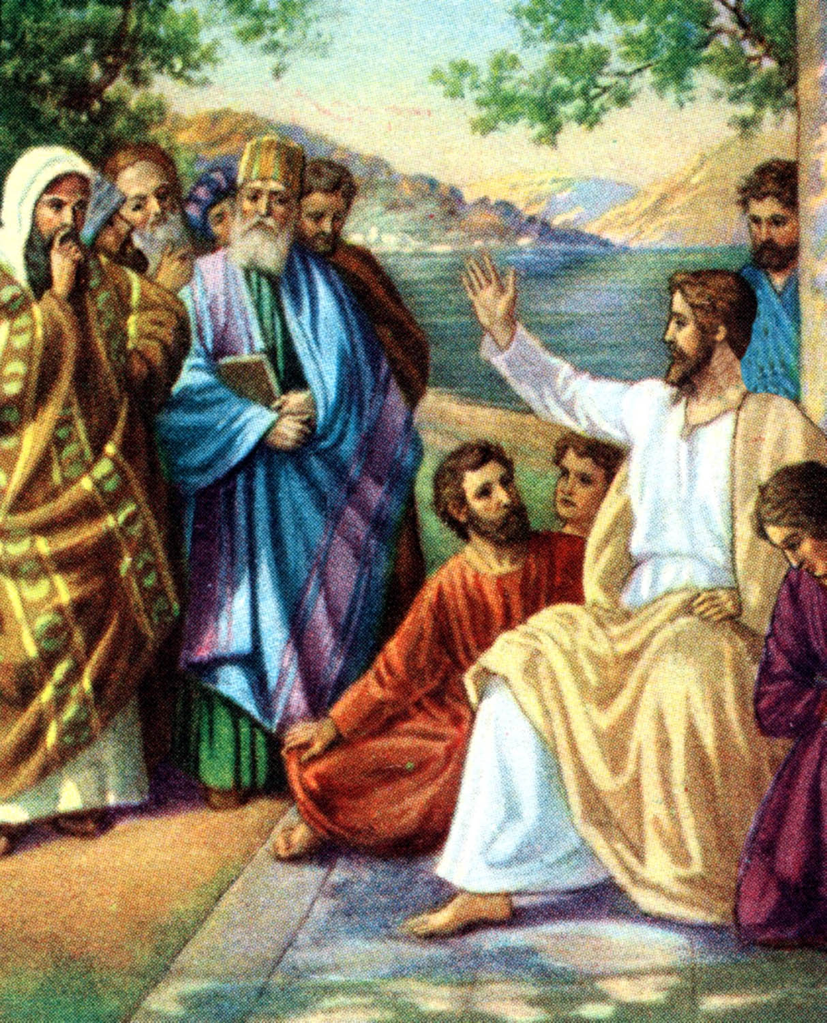
LOCATION OF JESUS’ TEACHING ON MARRIAGE AND DIVORCE
MATTHEW 19
After Jesus finished talking to his apostles he left Galilee. He went into the area of Judea on the other side of the Jordan River.
Some Pharisee came to Jesus. They tried to make him say something wrong. They asked him, “Is it right for a man to divorce his wife for any reason he chooses?”
Jesus answered, “Surely you have read this in the Scriptures: When God made the world, he made people male and female. And God said, “That is why a man will leave his father and mother be joined to his wife. And the two people will become one. So they are no longer two but one. God had joined them together, so no one should separate them.”
God intends that two people be joined for a lifetime.

Slide 9
WHAT NEW TESTAMENT BOOK TELLS US OF THE TEACHING OF JESUS ON MARRIAGE AND DIVORCE?
A. Psalms 19
B. Proverbs 19
C. Matthew 19
Jesus left Galilee and went into the area of Judea on the other side of the
J____________River.
Some P_______________tried to make Jesus say something wrong.
What questions did they ask Jesus---Is it r______________for a man to d_______________
his wife for any reason he chooses?
What scripture did Jesus quote---When G______made the world, He made people
M_________and F___________.
And God said, “That is why a m__________will leave his f____________and m____________
and be j____________to his wife.
How long does God intend for us to be joined to our husband or wife?
Is it very important to make sure you choose the right mate in the beginning?

Slide 10
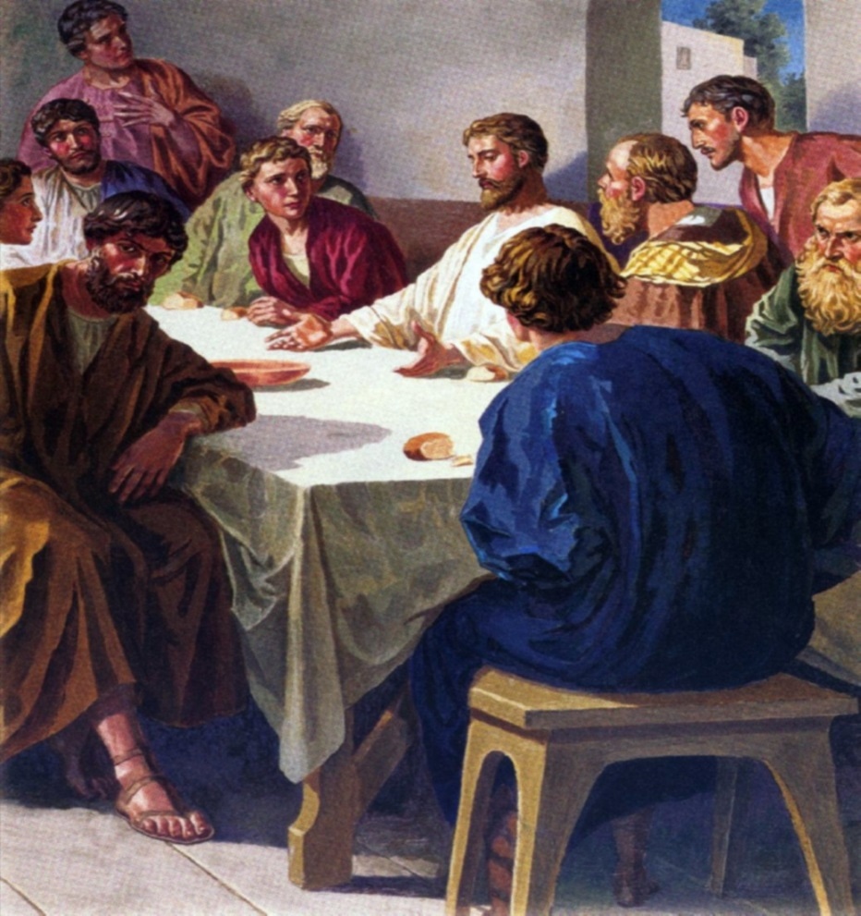
QUOTE MARK 16:15,16 (THE GREAT COMMISSION)
“Go ye into all the world, and preach the gospel to every creature. He that believeth and is baptized shall be saved; but he that believeth not shall be damned.”
“Go ye into all the world, and preach the gospel to every creature. He that believeth and is baptized shall be saved; but he that believeth not shall be damned.”
Several months before His death Jesus sent out the twelve apostles and the seventy disciples on a commission limited to the Jews.
Later, Jesus showed himself to the eleven followers while they were eating. He criticized them because they had so little faith. They were stubborn and refused to believe the people who said Jesus had risen from death.
Just before His ascension Jesus commissioned His apostles to preach the gospel to very creature (bot Jew and Gentile). This commission promises salvation to those who believe and are baptized.
He said to them, “Go everywhere in the world. Tell the Good News” to everyone. Whoever believes and is baptized will be saved. But those who do not believe will be judged guilty.

Slide 11
QUOTE MARK 16:15,16 (THE GREAT COMMISSION)
Fill in the blanks
“Go ye into all the w______________and p____________the g________________to every c______________.
He that b_______________and is b_________________shall be s________________; but he that
believeth n____________shall be d_______________.
Is the above commission the limited, or great commission?
Who was Jesus talking to above?
Jesus gave this commission just before His what?
Where were the apostle to go to take this commission?
Who were the apostles to preach the gospel to?
First the people they preach to had to bel_______________
After they believed they had to be B_________________.
Is this still true today?

