Slide 1
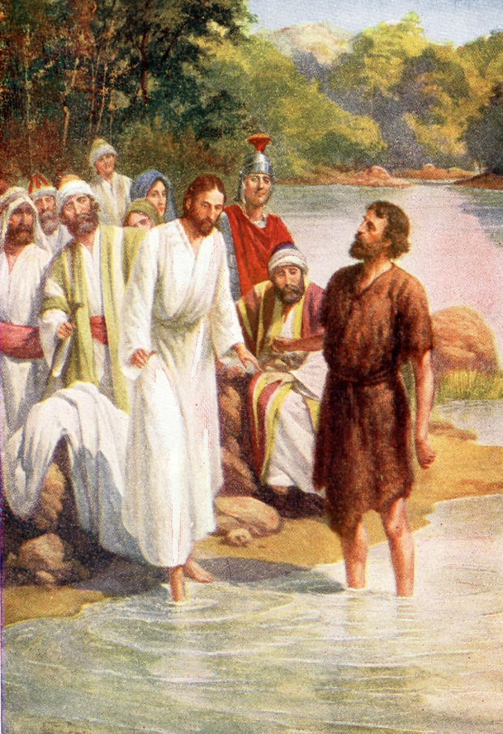
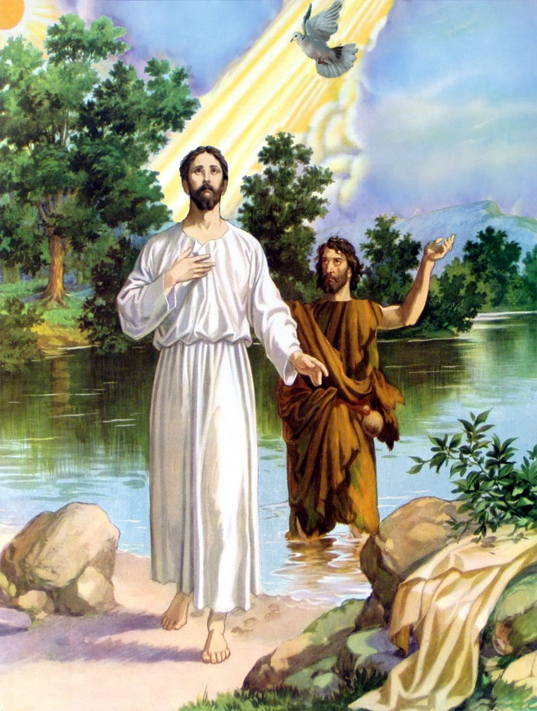
MATTHEW 3 AND LUKE 3
DETAILS OF JESUS’ BAPTISM FOUND IN?
Matthew 3 and Luke 3
One day, Jesus came out to the wilderness to be baptized. John stared into His face. “Lord, why do You come to me? I should be baptized by You!!”
But Jesus answered, “Let us do this, John, to be right in all things.
So John baptized Jesus in the Jordan River.
MATTHEW 3 AND LUKE 3
In being baptized, Jesus showed that He was ready to do His Father’s work. As He came up out of the water, the sky above opened. Jesus saw the Holy Spirit coming down in the form of a dove.
The dove rested on Jesus, and a voice from heaven said, “This is My beloved Son, in whom I am well pleased.”

Slide 2
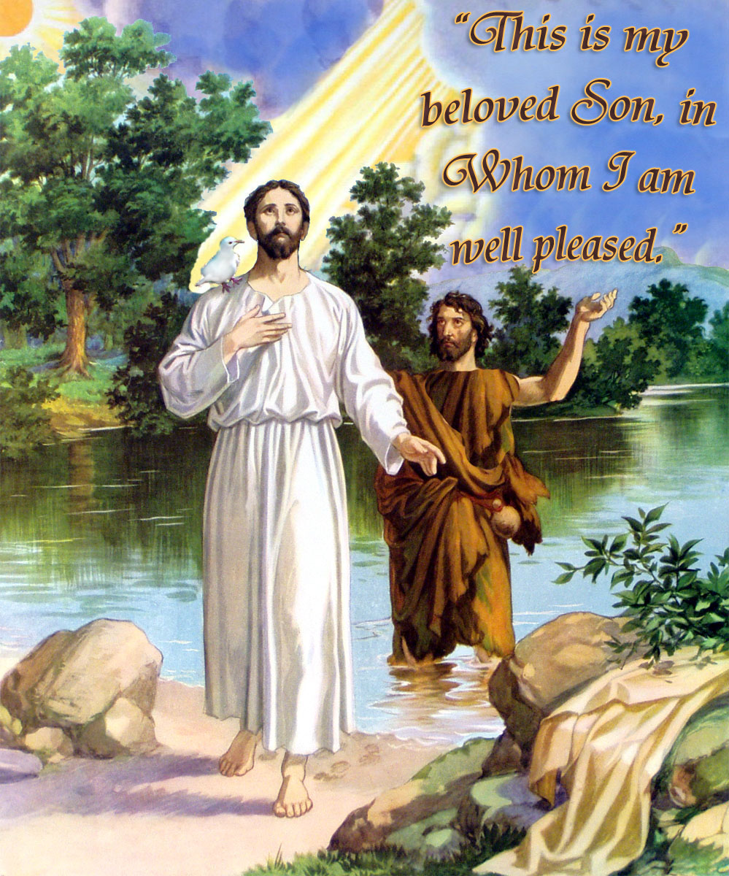
Details of Jesus’ Baptism is found in?
A. Acts 3 and Roman 3
B. Hebrews 3 and Jude 3
C. Matthew 3 and Luke 3
1. Who baptized Jesus?
2. What river was he baptized in?
3. Why was Jesus baptized?
As he came up out of water what did the sky
above do?
5. What did Jesus see coming down?
6. What did the voice from Heaven say?

Slide 3
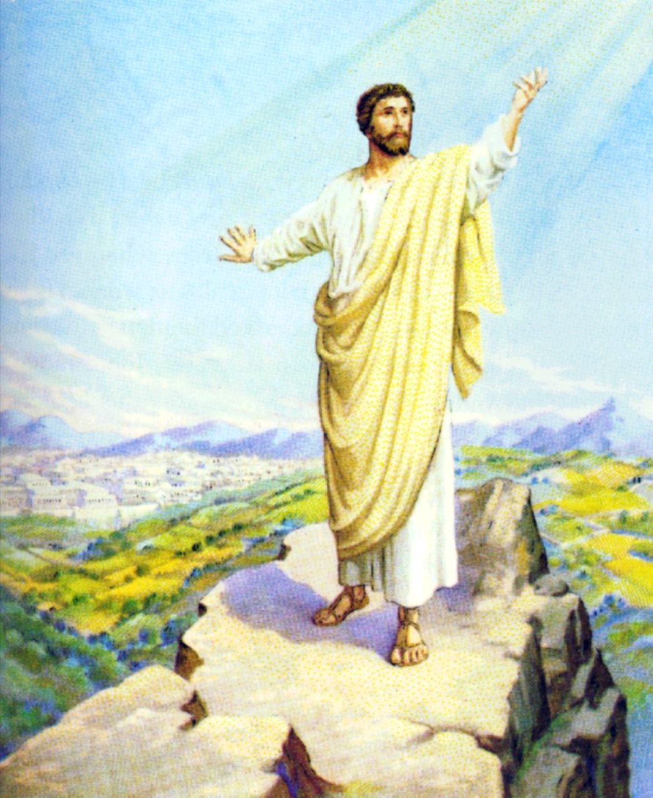
TEMPTATIONS OF JESUS ARE FOUND WHERE?
Matthew 4 and Luke 4
MATTHEW 4 AND LUKE 4
Immediately after Jesus was baptized, He went off by Himself into the desert to pray and to think about what God wanted Him to do. For forty days and nights, Jesus went without food.
Just when Jesus’ hunger was the worst, Satan came to Him, “If you truly are the Son of God, why should You go hungry? One word and You could turn these stones into bread!”
But Jesus did not listen. Instead, He repeated a verse of Scripture: “Man shall not live by bread alone, but by every word out of the mouth of God.”
Then the devil took Jesus to the top of the Temple, “Jump! Satan said. “If you are the Son of God, the angels will catch you.”
Jesus answered, “The Scripture says, ‘Do not test the Lord your God.’”
But Stan tried one more time to turn Jesus away from His work. He led Him to a high mountain peak, where He could see all the kingdoms of the world, “I will give you these nations,” Satan said. “Just bow down and worship me, and they will be yours.”
“God away, Satan!” Jesus cried. “It is written in the Scripture, ‘Worship the Lord. Serve only Him.’”
So Satan left, to wait until a better time to work against the Lord.

Slide 4
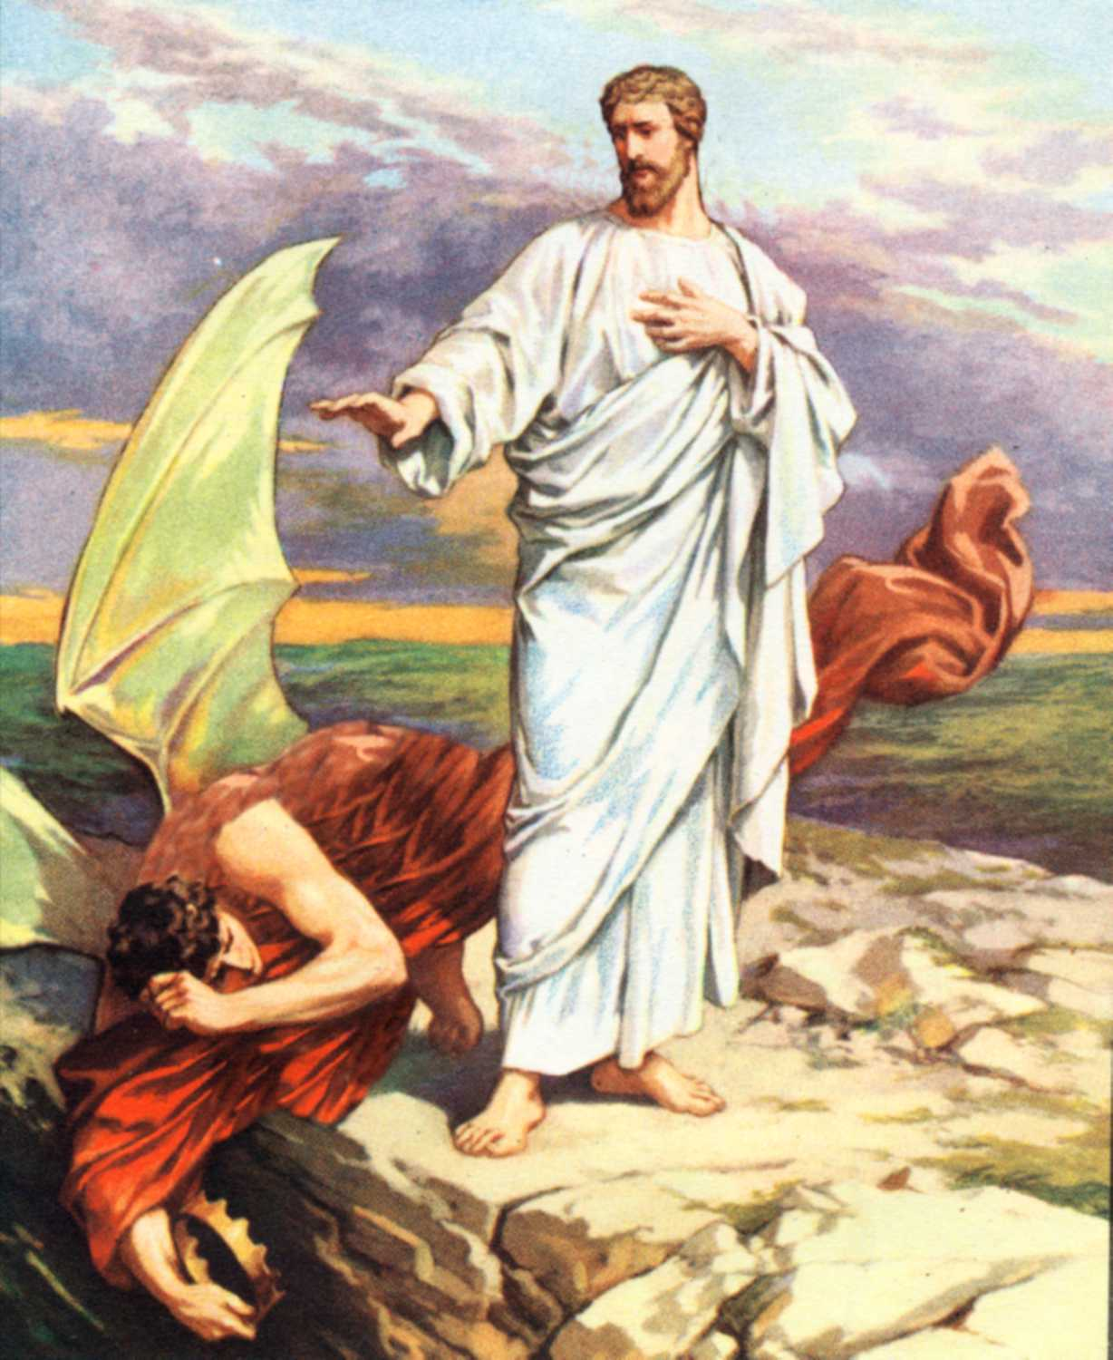
THE TEMPTATIONS OF JESUS ARE FOUND?
Genesis 4 and Leviticus 4
Hebrews 4 and Revelation 4
Matthew 4 and Luke 4
Where did Jesus go after he was baptized?
How long was Jesus without food?
Who came to Jesus when His hunger was the worst?
What did he tell Jesus to do to solve his hunger?
What was Jesus’ reply?
Then the devil took Jesus to the top of the
T______________?
What did he tell Jesus then?
What was Jesus’ reply?
Satan tried one more time—he led Jesus to a high mountain peak and said “I will give you all of these nations” just bow down and W_______________me.
What was Jesus’ reply?

Slide 5
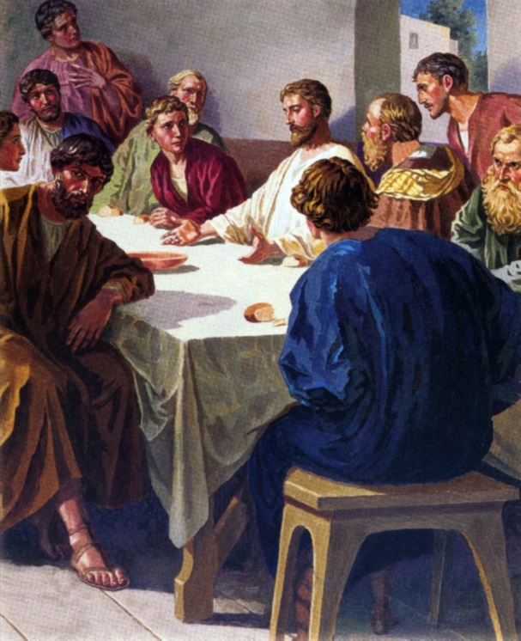
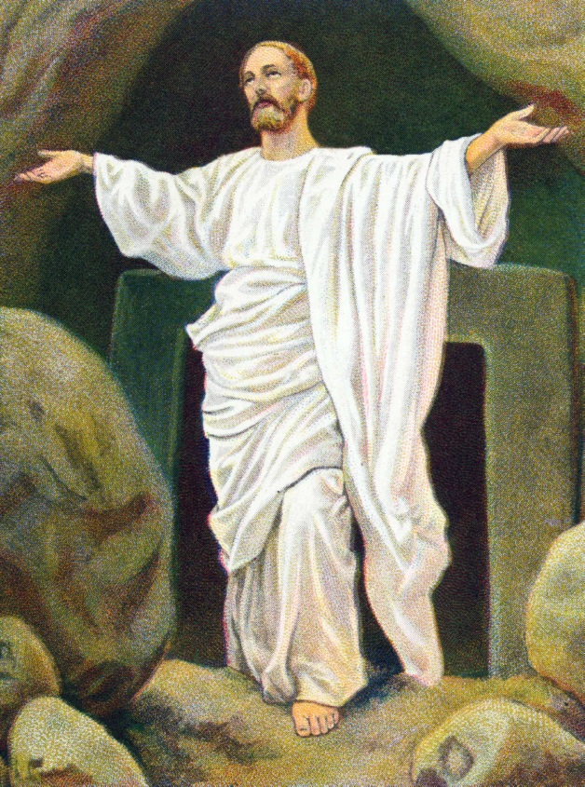
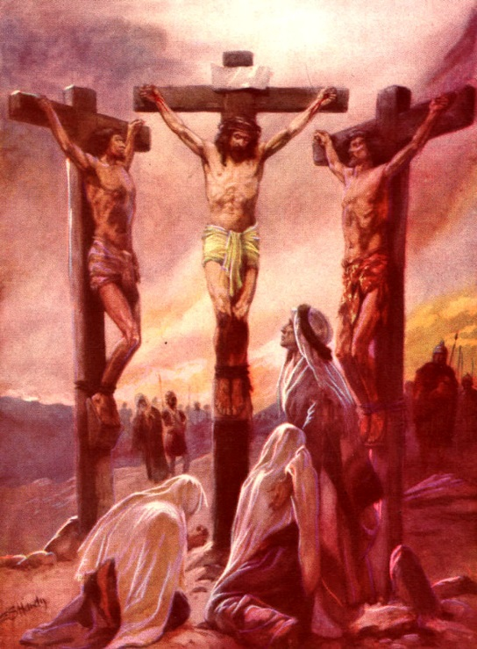
THE LAST CHAPETERS OF MATTHEW, MARK AND LUKE TELL OF WHAT?
LORD’S SUPPER
From Gethsemane He was taken and tried before the Jewish Council, Pilate and Herod.
He was then take to Golgotha where He was crucified.
JESUS’ DEATH
After instituting the Lord’s Supper Jesus went to Gethsemane where he was betrayed.
RESURRECTION
Jesus was buried in a borrowed tomb for three days and early on Sunday morning He arose!

Slide 6
THE LAST CHAPERS OF MATTHEW, MARK AND LUKE TELL OF WHAT?
Jesus’ birth
The creation of the world
Lord’s Supper; Jesus’ Death; Resurrection
Are the first three Gospels similar in content?
Is much of the material in one found in all three?
Who were these first three gospels written by?
Which one of these three men was a doctor?
Did each gospel writer tell the story of Jesus in his own way?
Matthew 2 and Luke 2 tells about Jesus’ Bir_______________?
Matthew 3 and Luke 3 tells of Jesus’ Bap_________________?
Mark 6 and John 6 tells about Jesus feeding the ______________?
Matthew 4 and Luke 4 tells about Jesus’ tem___________________?

Slide 7
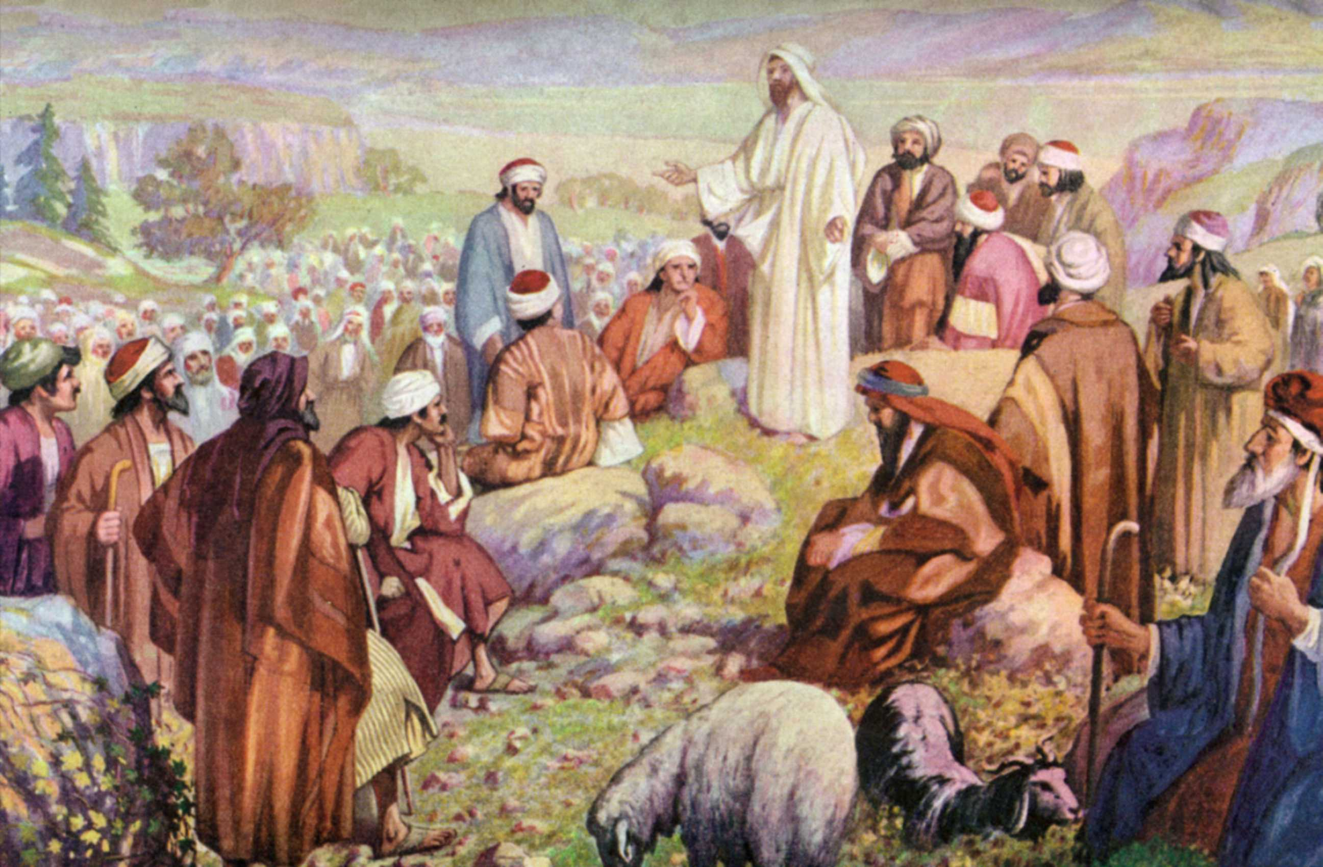
SERMON ON THE MOUNT MATTHEW 5-7
Jesus visited the towns scattered through the countryside of Galilee, speaking in each about the kingdom of heaven. News of Jesus spread, and people traveled long distances, bringing the sick to be healed.
But as Jesus looked into the faces gathered around Him, He saw much more than sickness and disease. He saw the fear and sin that kept people from feeling close to God. He wanted to tell them how to live so that each day might be filled with joy and contentment. So Jesus went up on a hillside and began to speak. A huge crowd gathered. The people stayed to listen for hours.
“Don’t worry all the time,” Jesus said. “How you live your life is much more important than what you eat or what you wear. If you think first of what God wants, He will take care of you, just as He takes care of the flowers and the birds.”
“God is more important than money. Don’t pile up money here on earth were robbers can steal it. Make serving God your treasure, and He will store it in heaven for you.”
These teachings are part of Jesus’ Sermon on the Mount. The words are as true today as they were for the people on that hillside in Galilee so many years ago.
SERMON ON MOUNT
MATTHEW 5-7

Slide 8
THE SERMON ON THE MOUNT IS FOUND IN WHAT BOOK OF THE NEW TESTAMENT?
A. Matthew
B. Mark
C. Luke
D. John
Where did Jesus do the Sermon?
Did Jesus send any of the large multitude away?
How long did the huge crowd listen?
As Jesus looked into the faces gathered around Him what did he see other than sickness and disease? He saw fe___________ and s____.
Did Jesus tell them how to live in the sermon?
Are we to worry about what we eat?
Are we to worry about what we wear?
Are we to pile up money here on earth?
What can happens to money we have on earth?
Did Jesus tell the crown not to worry all the time?
The most important thing to Jesus is how we li__________our life!
Are the words Jesus spoke that day as true today?

