Slide 1
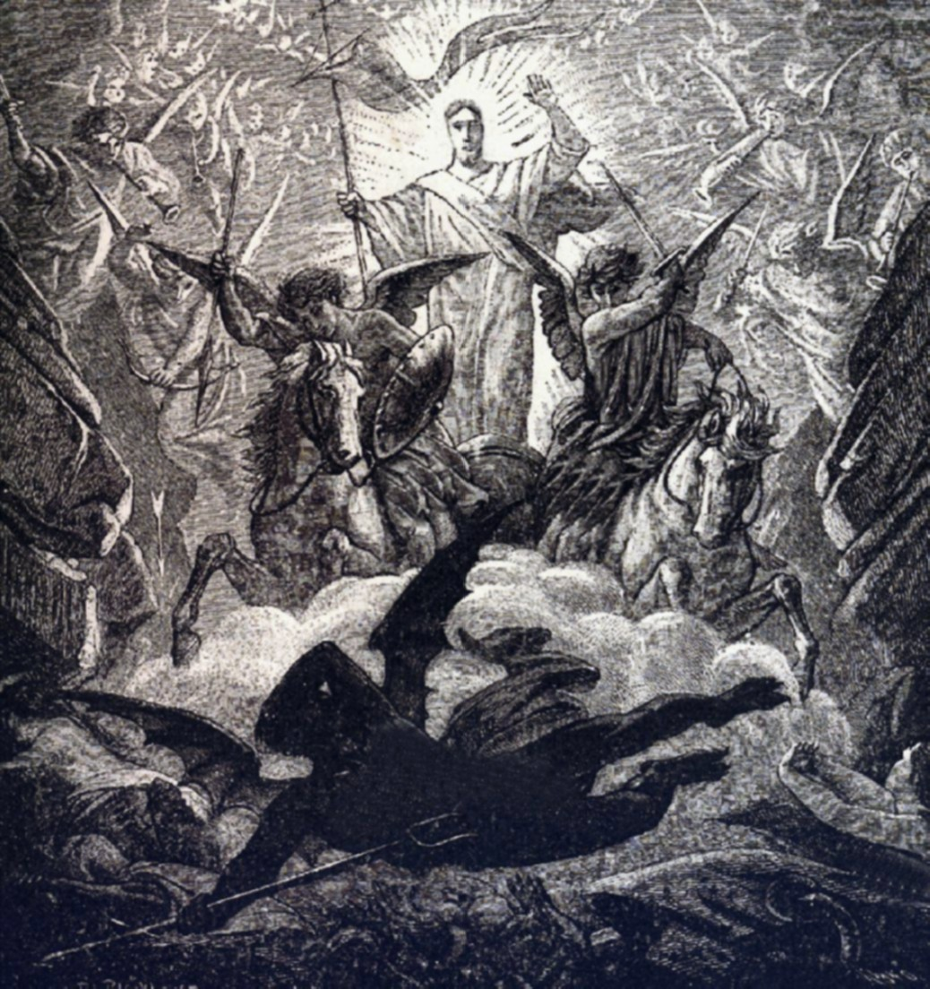
Cards 66-71
THE DAY OF THE LORD SHALL COME AS
A THIEF IN THE NIGHT (1st Thessalonians 5:2)
They had been taught by the apostles that the coming of the Lord would be as a thief in the night. This Jesus taught: “But of that day and hour knoweth no one, not even the angels of heaven, neither the Son, but the Father only. And as were the days of Noah, so shall be the coming of the Son of man. For as in those days which were before the flood they were eating and drinking, marrying and giving in marriage, until the day that Noah entered into the ark and they knew not until the flood came and took them all away; so shall be the coming of the Son of man…
Watch therefore: for ye know not on what day your Lord cometh. You, by a righteous and pure life, can be ready for His coming. We should not only be ready for Him, but should also love his appearing and desire earnestly the day of His coming.

Slide 2
THE DAY OF THE LORD SHALL COME AS
The time when we have a warning and get ready?
The time when we die?
A thief in the night?
Does any man know the day or hour that Jesus will return?
Do the angels know?
Does Jesus know?
Who is the only person that knows?
Did the people in Noah’s day know the flood was coming?
When did the people in Noah’s day know?
Since we don’t know what day the Lord cometh we should w_____________?
We can be ready by a r______________and p__________ life.
We should not only be ready for Him, but we should also love what?
We should also desire what?

Slide 3
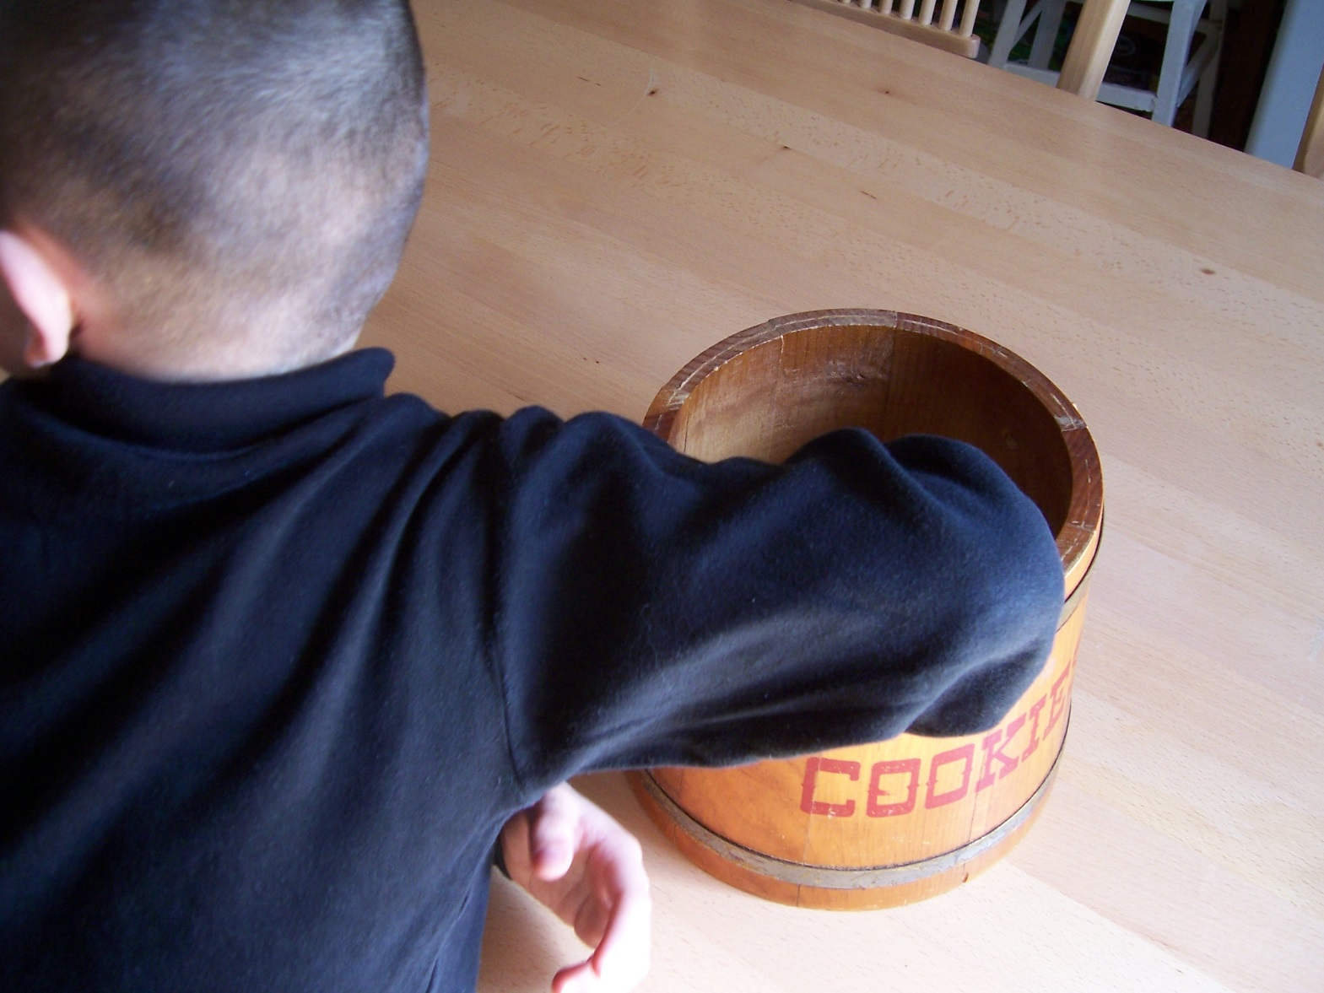
“ABSTAIN FROM…”
ALL APPEARANCE OF EVIL”
1ST Thessalonians 5:22
Paul’s final instructions to the Thessalonians was to avoid every kind of evil. They were not only to abstain from doing evil, but from the “form of evil”—the likeness of evil. This accords with: “Let not then your good be evil spoken.” (Rom. 14:16) Do not do good in such a way as to make people think you rendered evil purposes. This is frequently done. Some people do many good things in such a way that others think they are put in action by evil motives and troubling designs. Many do things to get others in trouble.
As a young person---RUN FROM EVIL!!!!!!
Do not get caught in the wrong crowd. Choose your friends wisely!!!!!!!

Slide 4
“ABSTAIN FROM…”
Going to church
Helping other people
All appearance of evil
Paul’s final instructions to the Thessalonians was to avoid every kind of what?
They were not only to abstain from doing evil, but from all f___________of evil?
Are we to do the same?
Should we do good just so man can see us?
Should we not do good when no one is looking?
Should we do things to get others in trouble?
As a young person we should run from what?
Should we hang around with the wrong crowd?
If we are with someone who is doing wrong what should we do?
Should we choose our friends wisely?
What are some things you have seen others do that God would not pleased with?
12. If we are with the person that is breaking the law, does it make us just as guilty?

Slide 5
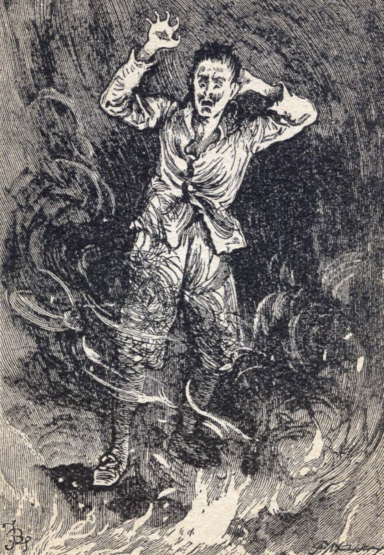
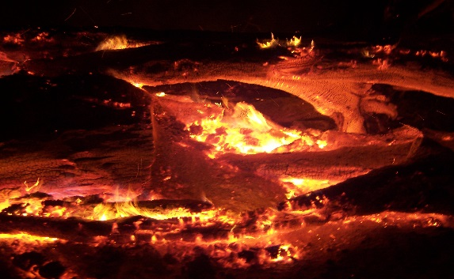
AT HIS COMING CHRIST WILL TAKE HIS VENGEANCE ON THOSE THAT
-KNOW NOT GOD (2nd THESSONIANS 1:7,8)
God will send His angels to execute His wrath on all who know not Him. God’s wrath is consistent with His holiness, righteousness, and justice. When all is said and done, we have no right to question how God upholds His justice. The Gentiles gave way to the gratification of every lust and evil desire. Paul declares that this ignorance of God was willful, and that wickedness was shown by the horrible depravity of morals it produced. It was, therefore, blamable in vengeance, being that the ignorance of men who “refused to have God in their knowledge, God gave them up into a reprobate mind, to do those things which are not fitting: being filled with all unrighteousness, wickedness, covetousness, maliciousness: full of envy, murder, strife, deceit, malignity, whispers, backbiters, hateful to God, arrogant, haughty, boastful, inventors of evil things, disobedient to parents, without understanding, covenant-breakers, without natural affection, unmerciful: who, knowing the ordinance of God, that they that practice such things are worthy of death, not only do the same, but also consent with them that practice them.” (Rom. 1:28-32) Such is the sentence that Paul pronounces on heathenism in view of its general character and fruits. In this Paul had before his mind those Gentiles who refused the knowledge of God and showed their hatred toward his children.
–OBEY NOT THE GOSPEL (2nd THESSONIANS 1:7,8)
These are all, whether Jews or Gentiles, to whom the gospel of Christ is brought and who reject the message. Obedience is faith in practice, the submission of heart and life to the demands of the gospel of Christ.

Slide 6
AT HIS COMING CHRIST WILL TAKE HIS
VENGEANCE ON THOSE THAT
Are good people and live according to His will?
The children and the babies?
Those that know not God and obey not the gospel?
Who will God send to execute His wrath on all who know not Him?
Do we have a right to question how God upholds His justice?
If anyone does not know God does this produce bad morals?
Does God excuse our ignorance of His knowledge?
What about those who refuse the knowledge of God?
Where can we find the knowledge we need to know God?
If we have that knowledge but refuse to obey the gospel will God save us?
Obedience is f__________in practice.
What should we do if someone wants to tell us something really bad about another?
Name some of the things God said was unfitting for us to do.
Is disobedient to parents one of those unfitting things?

Slide 7
IF ONE DOES NOT BELIEVE THE TRUTH GOD WILL SEND HIM
A STRONG DELUSION THAT HE
SHOULD BELIEVE A LIE (2nd Thes. 2:11)
When one knows the truth and refuses to obey it, he is a fit subject for following any false belief that sweeps over the land. When men know the truth, refuse to receive it in love, refuse to obey it, or hold it in a wise manner, then God allows them to accept what is false and then they will believe a lie.
So few men are willing to stand on their convictions. Few are willing to have convictions on any subject that will interfere with their worldly success. But truth can never be maintained, save by those who are willing to honor their own convictions, cherish a keen sense of right, are not afraid of the least participation in that which is wrong, and will honor and maintain the truth, even though it cost what it may of popularity or private prosperity. Let us then maintain the spirit of Christ. Without it the Christian religion cannot exist.

Slide 8
IF ONE DOES NOT BELIEVE THE TRUTH GOD WILL SEND HIM
A. An angel to protect us
B. Happiness all the time
A strong delusion (allow us to accept that which is false)that he should believe
a lie
If one knows the truth and refuses to obey it, will this person follow false doctrine?
Are few people willing to stand on their convictions?
Are you willing to stand up and speak up when you know something wrong is being said?
Should we be afraid to maintain God’s truth?
What if this cost you your friends?

Slide 9
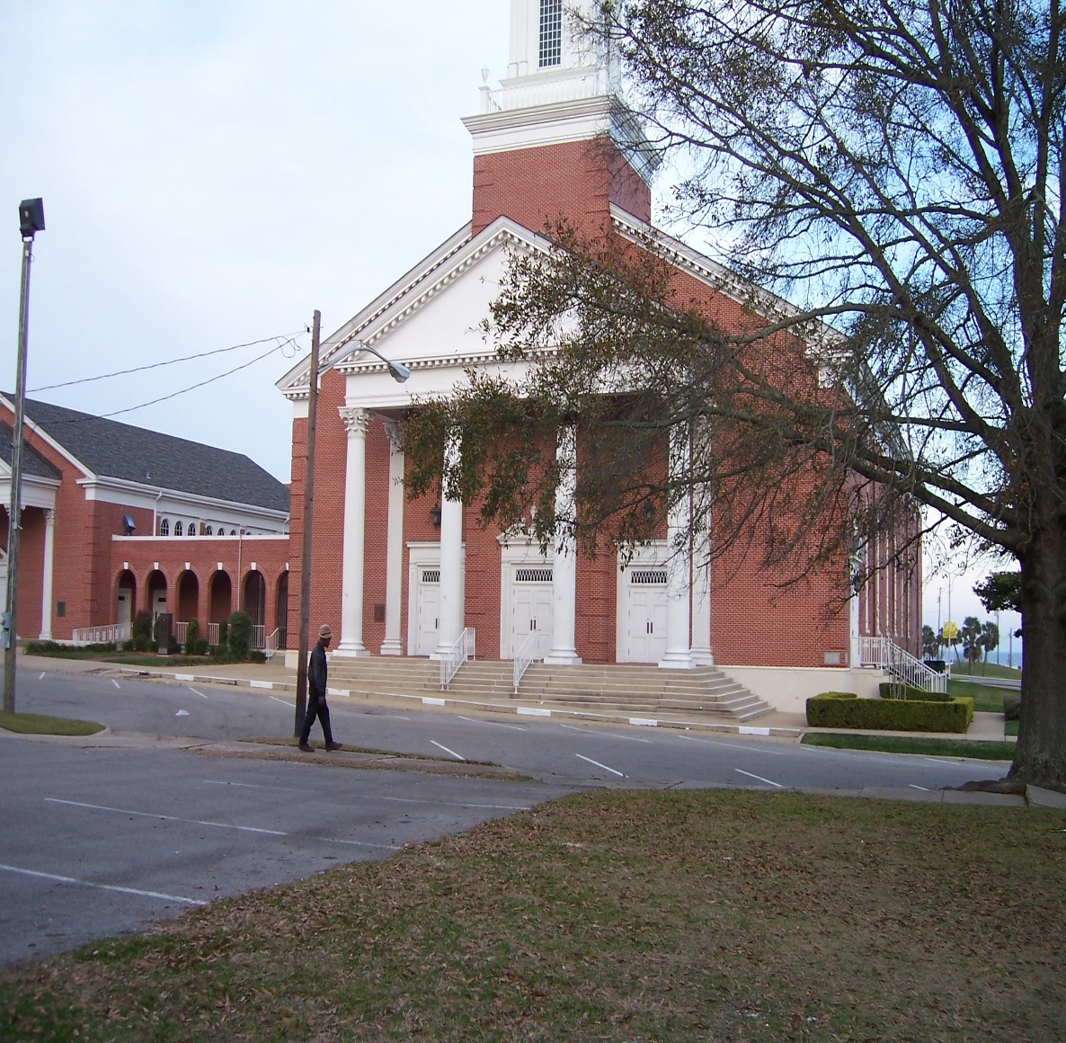
WE ARE TO WITHDRAW FROM
EVERY BROTHER THAT WALETH DISORDELY
The church must break fellowship with any who walk in a disorderly manner. To walk disorderly was to violate any of the teachings they had heard from the apostles. They had been given the true teachings of God, and any other walk was disorderly. From these disorderly persons he commands all Christians to withdraw themselves. (Verse 14) The withdrawing from them meant more than a public announcement from the elders—that “ye withdraw” from them. Paul commands the Thessalonians to break fellowship with those who refuse to obey his instructions in this letter.

Slide 10
WE ARE TO WITHDRAW FROM:
The ones we don’t like
The ones who are poor
Every brother that walketh disorderly
Do you become a member of the church when you are baptized?
Does this mean you can do anything you want and God will be pleased?
If you are bringing shame on the church what should the elders do?
Is this to be public by the elders?
Is this withdrawing meant to save the erring brother?
Is this withdrawing meant to save the church from his influences?
Is this withdrawing meant to teach the person he is wrong, that he should change his ways and ask for God to forgive him?
If he does this should we forgive and accept him back?

Slide 11
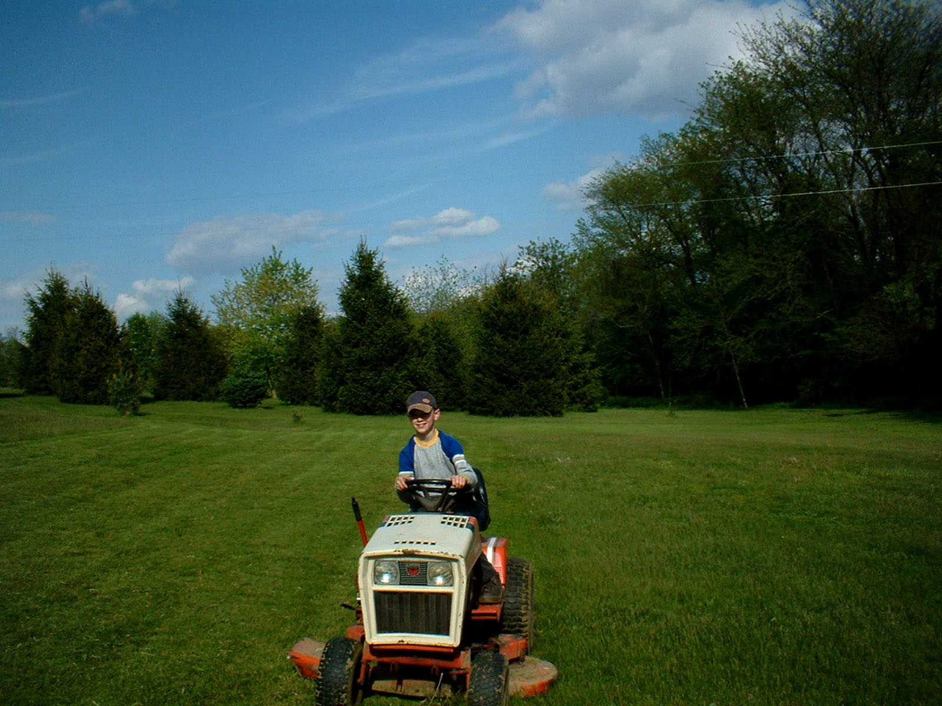
IF ANY WILL NOT WORK
NEITHER SHOULD HE EAT
There was and is no obligation resting on a Christian or a church to help or feed an idle, lazy sponge who is able to work. This is true of both men and women. The obligation is imperative to help the helpless. Christ is personified in these. In so doing we help Christ. But Christ never was personified in an individual, man of woman, able but unwilling to work for a living. Christ has no sympathy for such people. Every true Christian, like Paul, should not want to be a burden upon others when it is possible to help self. Cases present themselves frequently that are difficult to determine what to do. An able bodied, lazy father and husband leaves a worthy and struggling wife and children to suffer. It is impossible to help them without helping him in his laziness. One course seems right in this case to relieve the personal and present needs of the wife and children as far as possible, show a sympathy for them, and withhold from him, while dealing candidly and firmly with him. It will work a cure if anything will.

Slide 12
IF ANY WILL NOT WORK:
Help him all you can
Neither should he eat
Tell him to get a job
Is it the obligation of the church to help or feed a lazy person who will not work?
Should the church help the helpless?
Do we help Christ when we help those in need who can’t work?
Should the church help a lazy able bodied father who want take care of his family?
Should the church help the wife and children who are hurt by this lazy man?

