Slide 1
Cards 38-43
JESUS AROSE FROM THE DEAD ON
FIRST DAY OF THE WEEK
At the end of the Sabbath, as it began to dawn on the first day of the week, Mary Magdalene and Mary the wife of Cleophas came to see the tomb. And, behold, there was a great earthquake, for the angel of the Lord descended from heaven and came back and rolled the stone from the entrance, and sat on it. His face was like lightning and his garments were white as snow.
For fear of him, the guards trembled and fainted away as if they were dead men. But the angel spoke to the women and said, “Fear not. For I know that you seek Jesus, who was crucified. He is not here, for he has risen, as he said. Come, come see the place where the Lord lay.
“And now god quickly and tell his disciples that he has risen from the dead, for, behold, he goes ahead of you into Galilee, where you shall see him. There, I have told you.”
They departed quickly from the tomb with fear and great joy, and ran to bring word to his disciples. And as they went to tell them, Jesus met them, saying, “All hail.” And they came and held him by the feet and worshiped Him.
Then Jesus said to them, “ Be not afraid. Go and tell my brothers to go into Galilee, and there they shall see me.”
Video Link Click Here: https://www.youtube.com/watch?v=kPfC9kSPP_Q

Slide 2
JESUS AROSE FROM THE DEAD ON
A Friday
B. Saturday
C. Sunday =First Day of the week
Who rolled the stone from the entrance of tomb and sat on it?
Were the guards afraid of him?
The angel told Mary Magdalene and the other Mary that Jesus was not there for He had risen? True or False
Did the angel tell the women to go quickly and tell His disciples that He has risen from the dead?

Slide 3
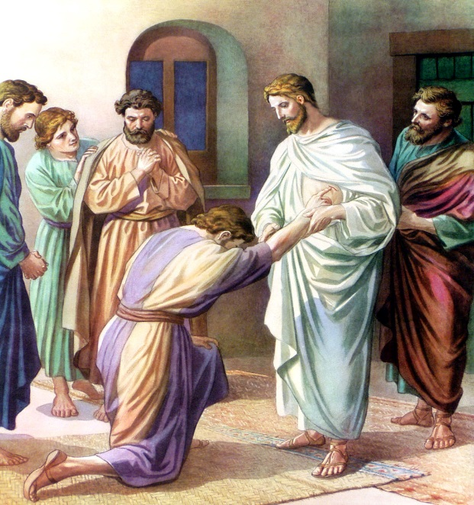
JESUS SEEN AFTER HIS RESURRECTION
AT LEAST 10 TIMES
--To Mary Magdalene
--To apostles with Thomas present
--To apostles without Thomas present
Video Link Click Here: https://www.youtube.com/watch?v=kP3753Pc8-w
--To seven disciples at the Sea of Galilee
Video Link Click Here: https://www.youtube.com/watch?v=nA14i1Bshdo
--To two disciples on the road to Emmaus

Slide 4
THE GREAT COMMISSION GIVEN TO THE APOSTLES TO
- Go to all Nations
- Make Disciples
- Baptize them in the name of the Father, Son and Holy Spirit
- Teaching them to observe all the Commandments of Jesus
The Gospel of Matthew ends with Jesus’ last words to His disciples, spoken just before He returned to heaven. Jesus was like a commander ordering soldiers to carry out an important mission. When we read His words, we realize Jesus was speaking to all believers, not just those first disciples.
Video Link Click Here: https://www.youtube.com/watch?v=GNQ-l_N07oc

Slide 5
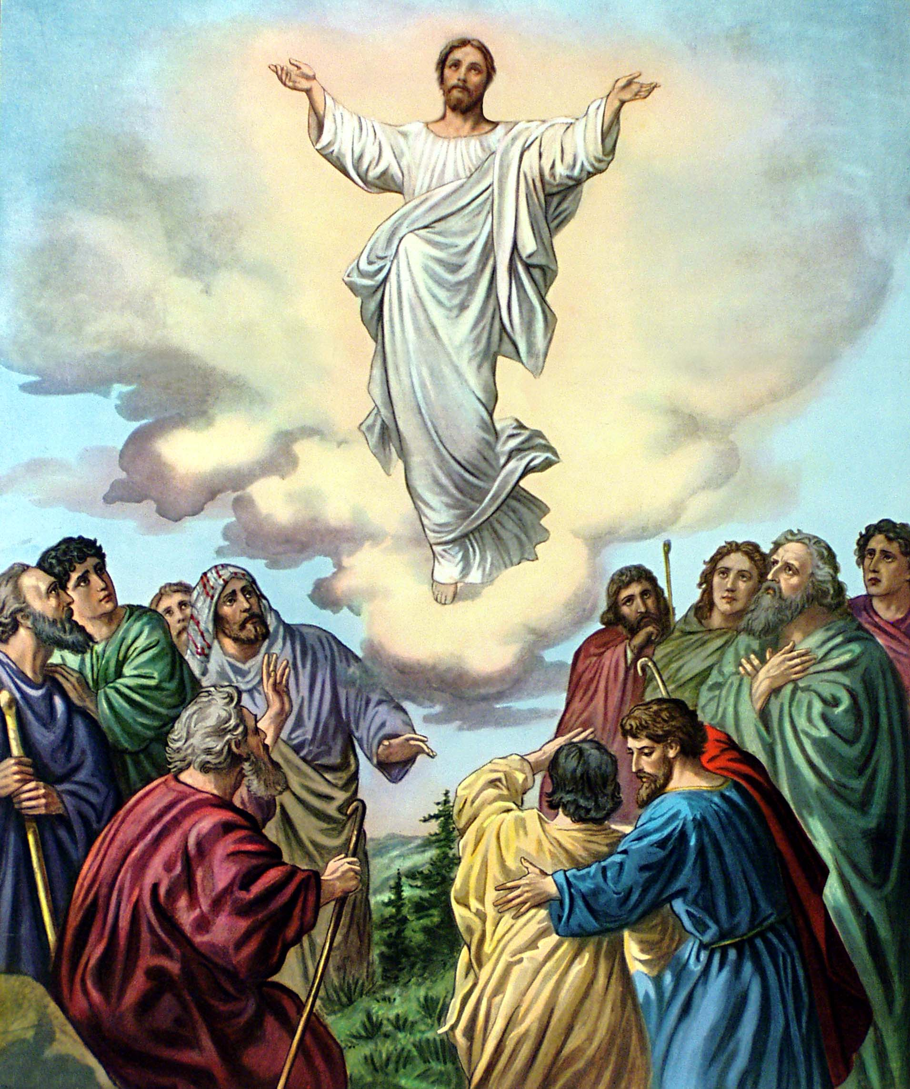
JESUS ASCENDED TO
HEAVEN
After the disciples had been with Jesus for forty days, He led them to a mountain top. The disciples realized Jesus was going to leave them.
“Do not be sad,” Jesus said. “I go to My Father now so that the Holy Spirit can come to you. Then you will receive power to ell everyone about Me—in Jerusalem, in Judea, in Samaria, in all the world!
As the disciples watched, Jesus was lifted into the air and hidden by a cloud.
Video Link Click Here: https://www.youtube.com/watch?v=RD0LNtc1UE4

Slide 6
PRIOR TO HIS ASCENSION, JESUS TOLD THE APOSTLES
- Wait at Jerusalem
- Wait for the promise of the Father
- That they would be baptized with the Holy Spirit
- That they would receive power
- They would witness for Jesus in Jerusalem, all Judea,
Samaria and the uttermost parts of the world.
Video Link Click Here: https://www.youtube.com/watch?v=cF2lK-MAicY

Slide 7
TWO MEN IN WHITE TOLD APOSTLES
JESUS WOULD COME AGAIN
When the Lord Jesus had finished talking with His apostles, suddenly His body began to ascend up into the sky. Up, up, up He went! Higher and higher, until a bright cloud hid Him from their sight. He disappeared! Jesus had returned to Heaven. They all thought, “He is gone forever”.
As they stood quietly, still staring up into the sky, they noticed two white-robed strangers there among them. Who could they be? How did they get there?
“You men of Galilee,” the strangers (who were really angels said, “why are you standing here looking up into Heaven? This very same Jesus who has gone away from you into Heaven will come back again exactly as you have seen Him go!” Suddenly they knew who the strangers were—they were angels, sent by the Master to give them the wonderful promise that someday He would return.
Video Link Click Here:

