Slide 1
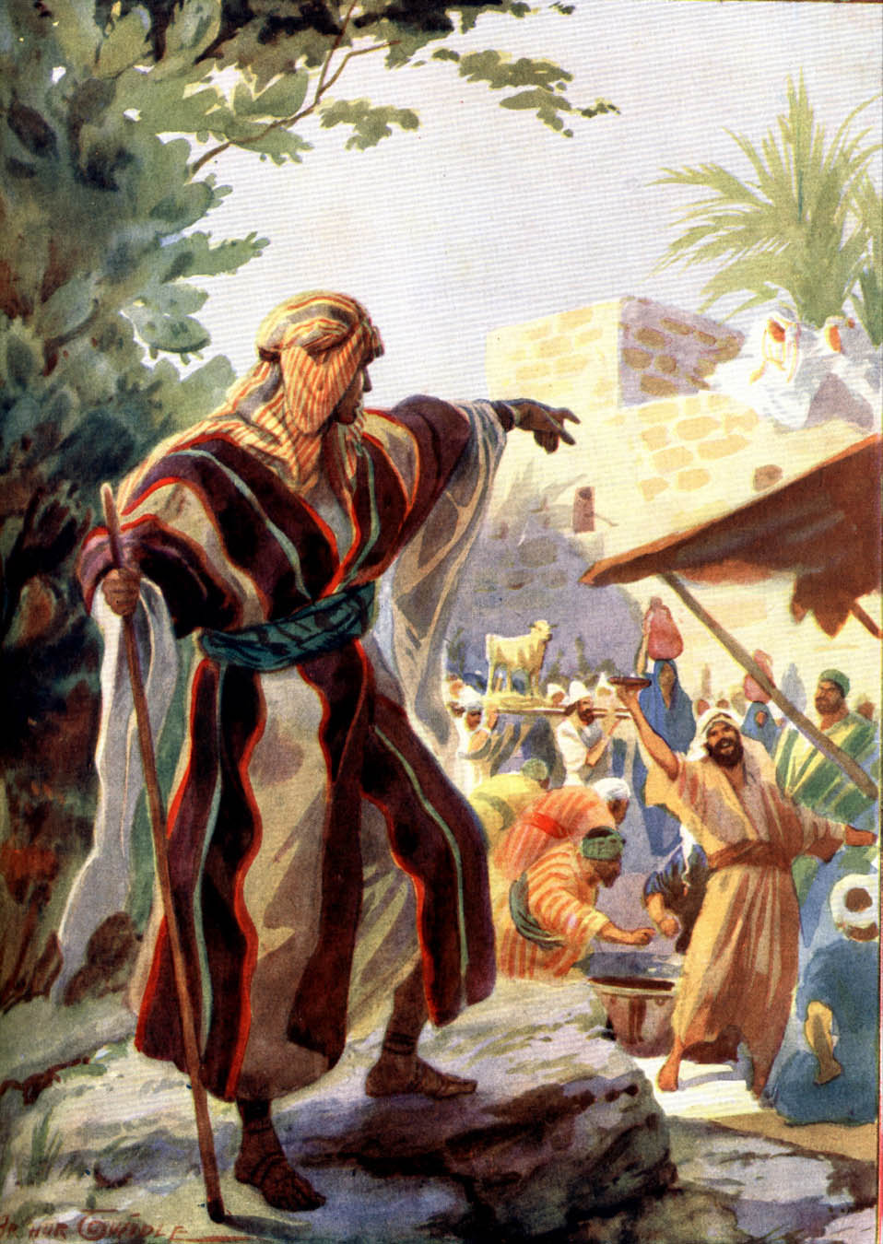
Cards 95-100
QUOTE HOSEA 4:6
My people are destroyed for lack of knowledge: because thou hast rejected knowledge, I will also reject thee……
Hosea a prophet of the Northern Kingdom, was active from about the middle of the eighty century. At the beginning of Hosea’s prophetic ministry, Israel was enjoying the prosperous reign of Jeroboam II. Hosea saw disaster, however, in Israel’s efforts to preserve her position by political machinations instead of reliance on God. Her past and future troubles are attributed by Hosea to her persistent practice of idolatry. The people were offering sacrifices on heathen altars; and adultery was prevalent. The faithless actions of Israel toward God are illustrated by the relationship between Hosea and his worthless marriage partner, Gomer.
The figure which Hosea often uses to describe the spiritual condition of the Israelites is lack of knowledge. He is not speaking simply of intellectual knowledge, but of a relationship of the most intimate sort between man and God.
The knowledge of God is the most excellent of all sciences. Paul counted all things but loss in comparison with possessions; (Philippians 3:8) and our blessed Lord himself ways, “This is life eternal, that they might know thee the only true God, and Jesus Christ, whom thou hast sent”. (John 17:3)

Slide 2
QUOTE HOSEA 4:6
“My p___________ are d______________ for lack of K________________ because thou hast r_____________
K_____________, I will also r____________ thee…”
Was Hosea a prophet?
Hosea saw disaster as Israel was not relying on God? True or False
Israel’s troubles are attributed by Hosea to persistent practice of idolatry? True or False
The people were offering sacrifices on heathen altars? True or False
Hosea had a wonderful marriage partner name Gomer? True of False
Hosea described the spiritual condition of the Israelites as a lack of knowledge? True or False
The knowledge of God is the most excellent of all sciences? True or False

Slide 3
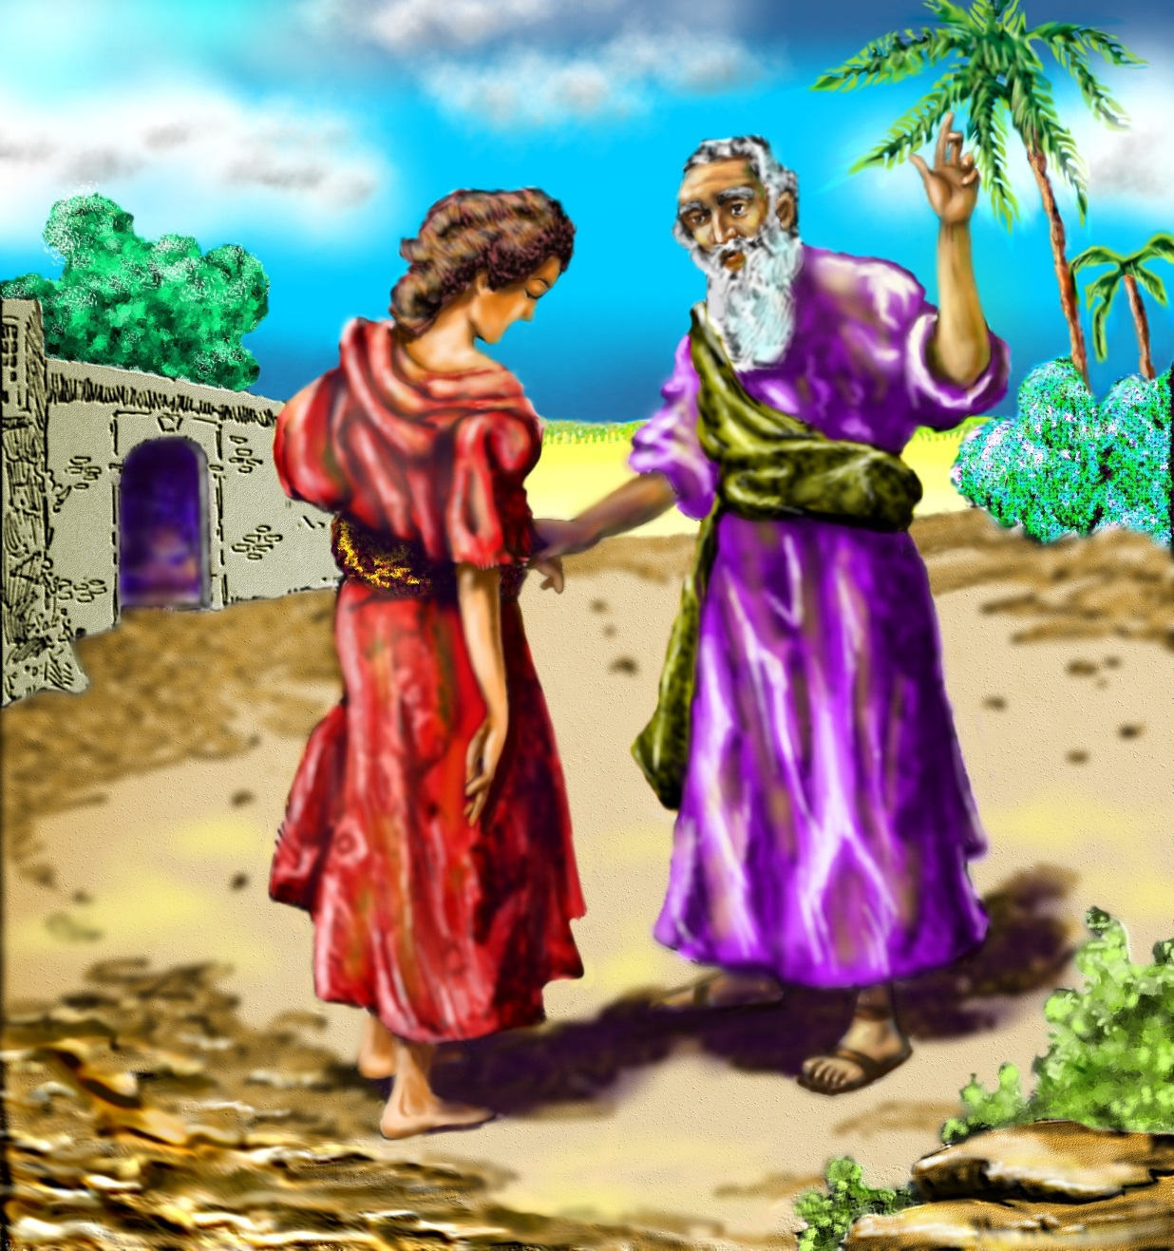
HOSEA’S UNFAITHFUL WIFE LIKE
Hosea is one of the most emotional books in the Bible, an outpouring of suffering love from God’s heart. The book divides into two parts. In the first three chapters, the prophet Hosea briefly describes his marriage to an adulterous woman and makes the connection to Israel’s unfaithfulness to God.
Hosea begins with a love story—painful, personal love story, the prophet’s very own. Hosea had married a woman who acted like a prostitute. Yet the more she went out on him, the more Hosea loved her. He gave her everything a good wife deserved; his love, his home, his name, his reputation. She responded by shacking up with other men. He warned her, he pleaded with her, he punished her. She humiliated him until he wanted to cry, yet still he clung to her.
Why did Hosea begin with his personal life? Because God had expressly told him to relate it to another, more tragic love story: the painful love of God for his people. God could have simply declared, “Israel is like a wife to me—on adulterous wife.” Instead, he used Hosea to act out the treachery in real life—and to show in living color God’s fury, his jealousy, and above all else, his love for his people.

Slide 4
HOSEA’S UNFAITHUL WIFE LIKE
A. A mad dog
B. Heaven
C. Unfaithful Israel
Hosea is one of the most emotional books in the Bible? True or False
The marriage of Hosea to an adulterous woman made the connection to Israel’s unfaithfulness to God? T or F
Hosea was married to an unfaithful woman named Gomer? True or False
Hosea did not gave his wife everything a good wife deserved? True or False
Gomer humiliated him but he still clung to her? True or False
God used Hosea to act out the treachery in real life of Israel’s unfaithfulness to Him? True or False
Did God still have a love for Israel even though they rejected Him?

Slide 5
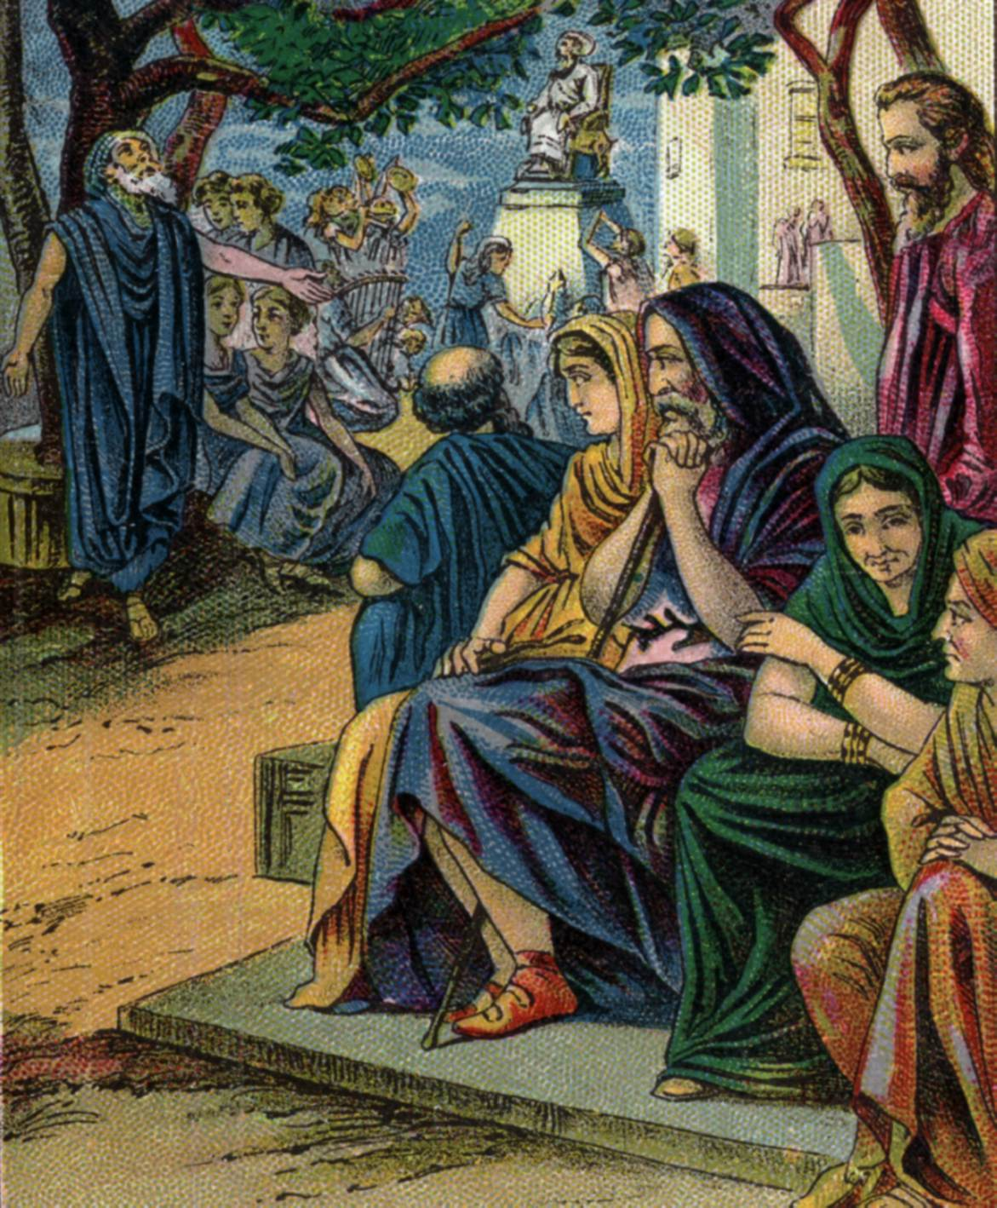
PROMISE MADE OF JOEL
Like a mighty army destroying everything in its path, millions of locusts swarm over the land of Judah. They devour the crops—leaving only barren fields behind. Natural disasters provoke questions. Why did God allow this disaster to happen? Why have I lived and other died? Is there a lesson here? For Joel, a plague of locusts led to deep insights into God’s universal plan. Joel did not devote time to an analysis of Israel’s failings. He concentrated, instead, on a cure. Joel wanted the disaster to turn people’s attention toward something more lasting—to an eternal God.
“What will we do?” the people cry. The prophet Joel answers: “Repent of your sins. Seek God’s help, and he will restore the land.” Joel urged the priests to call a nationwide day of prayer and fasting to lead the people back to God. So it has often proved for God’s people, a disaster had pressed them to a deeper relationship with Him.
Then he adds this promise: “One day God will send His Holy Spirit into the hearts of His people.”

Slide 6
PROMISE MADE OF JOEL
A. Coming of the Holy Spirit
B. Locusts will not come again
C. This disaster was will provoke questions
Millions of locusts swarm over the land of Judah? True or False
For Joel, a plague of locusts led to deep insights into God’s universal plan? True or False
Joel devoted a lot of time to an analysis of Israel’s failings? True or False
Did Joel instead concentrated on a cure?
Joel wanted the disaster to turn people’s attention toward something more lasting—to an eternal God? True or False
The prophet Joel told the people to “R__________of their sins?
Has a disaster pressed people to a deeper relationship with God?
Joel told the people “One day God will send His H_____________ S__________into the hearts of His people”?

Slide 7
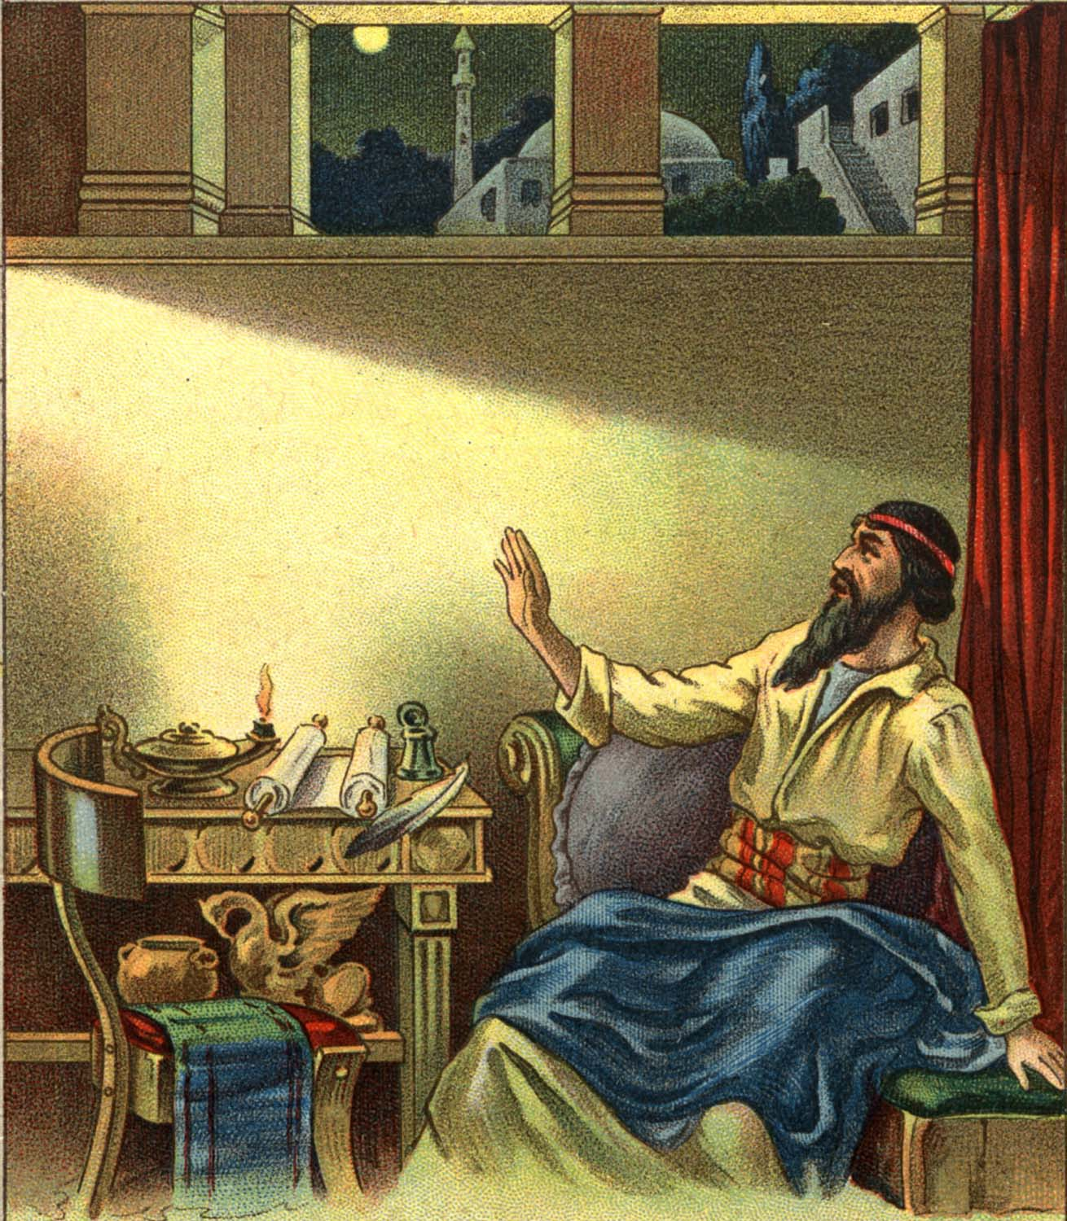
QUOTE JOEL 2:28
Joel wanted God’s people to believe that God controlled the locusts, and even more importantly, that God shaped the entire course of history to his plan. As terribly as the locusts had destroyed, and as wonderfully as God had rolled back their destruction, these events only foreshadowed far more terrible and wonderful things.
Joel’s view from 2:28 rises above the local situation and deals with the far-off future. Joel saw that God’s Spirit would transform his people into those who love him constantly, not just when a disaster catches their attention. After a time of terrible judgment, God would create a renewed, secure city for His people, in which He Himself would live.
“AND IT SHALL COEM TO PASS AFTERWARD THAT I WILL POUR OUT MY SPIRIT UPON ALL FLESH; AND YOUR SONS AND YOUR DAUGHTERS SHALL PROPHESY, YOUR OLD MEN SHALL DREAN DREAMS, YOUR WOUNDG MEN SHALL SEE VISIONS.”

Slide 8
QUOTE JOEL 2:28
“And it shall come to p___________ afterward, that I will p__________out my s__________ upon all f__________;
And your s_________and your d____________shall prophesy, your old m______shall dream d___________,
Your young m________ shall see v__________.”
Joel wanted God’s people to believe that God controlled the locusts? True or False
Joel also wanted the people to believe God shaped the entire course of history to his plan? True or False
Did God roll back the destruction of the locusts?
Joel saw the God’s Spirit would transform his people into those who love him constantly? True or False

Slide 9
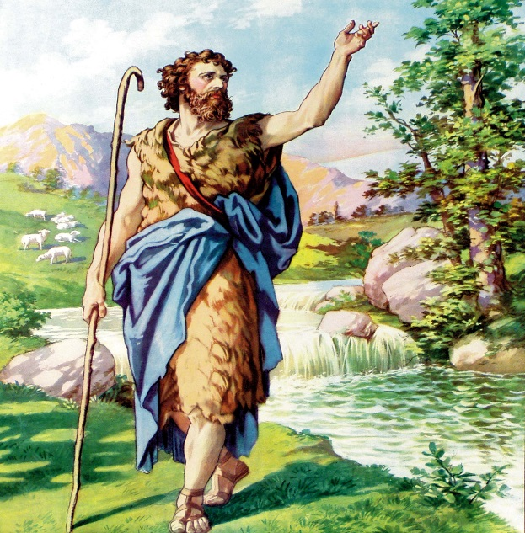
AMOS PROPHESIED FIVE VISIONS OF
ISRAEL’S DESTRUCTION
Amos a shepherd of Judah, is watching his sheep when God calls him to a dangerous job. Perhaps because he was a farmer, Amos used a plain writing style, filled with strong country language, calling the city socialites “cows” (4:1). The organization of his book is clear too; Chapters 1-2 line up the Middle Eastern nations for trial. Amos focused on the facts that met his eyes and ears in every marketplace: oppression of the poor, dishonest business, bribery in court, privilege bought with money. What would Amos say about us and our world today??????
Chapters 3-6 give a series of messages from God (usually beginning with “Hear this word”). “Go”, God says, “To the neighboring country of Israel and tell the people that they are going to be punished for their sins.” Chapters 7-9 convey God’s judgment through five graphic visions: locust, fire, plumb line, basket of summer fruit, and a smitten sanctuary.
Amos predicted that Israel would be destroyed, and his prediction proved right. After King Jeroboam, the government deteriorated, five kings took the throne in the next 13 years; four were assassinated. In 30 years Israel was permanently dismantled by Assyrian armies. The people, their beautiful homes, their sacred altar—all would be destroyed.

Slide 10
AMOS PROHESIDED FIVE VISIONS OF
A. Judah’s destruction
B. Jeroboam’s destruction
C. Israel’s destruction
What was Amos doing when God called him to a dangerous job?
Amos used a plain writing style, filled with country language, calling the city socialites cows? True or False
Amos focused on the facts that met his eyes and ears , oppression of the poor, dishonest business, bribery in court, privilege bought with money? True or False
Do we hear of the same things happening today?
What are the five graphic visions:
1. L____________
2. F__________
3. P_________l________
4. B_________of f_________
5. Smitten s____________
Did Amos predict Israel would be destroyed?
Did his prediction prove right?
In 30 years Israel was permanently dismantled by Assyrian armies? True or False
What would Amos say about our world today??

Slide 11
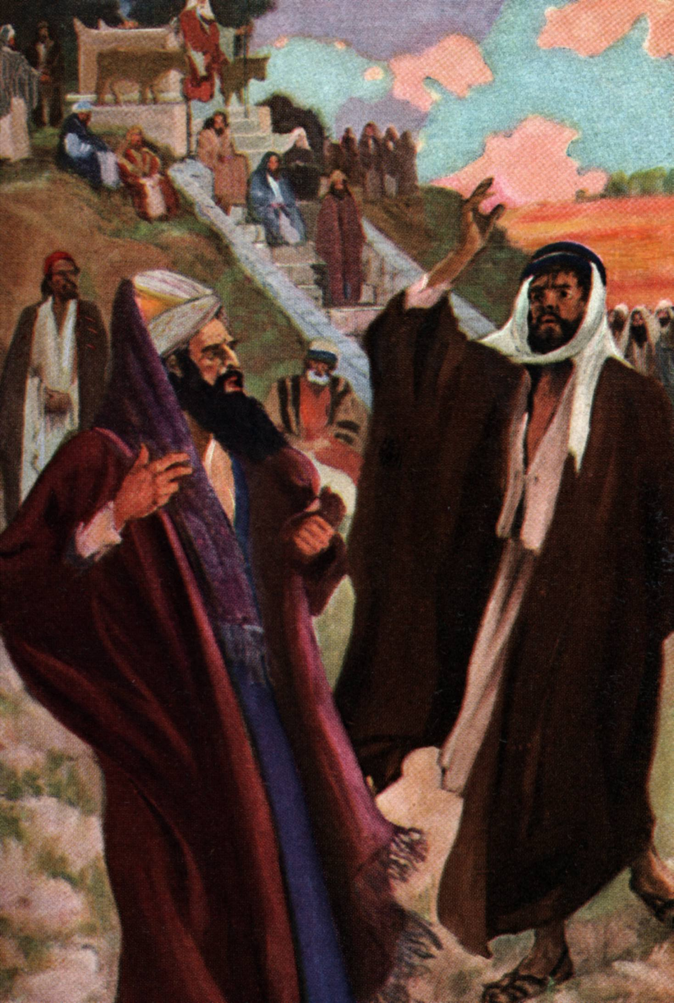
Cards 100-104
TOLD AMOS NOT TO PROPHESY
PRIEST OF BETHEL (AMOS 7:10-13)
Without protesting, Amos accepts the job God gave him and goes to the city of Bethel in Israel, the central seat of idolatry (calf-worship). His mission was to rebuke this iniquity, and to announce to these careless sinners the approach of Divine judgment. “Prepare to meet thy God”, he tells the people of Israel, “For you are like a crooked wall (plumb line) that must be destroyed before a new one can be built.” A plumb line is a weight on the end of a string; builders use it to make certain that their walls stand straight. A wall may look right, but if it doesn’t match a plumb line , it is out of kilter. Similarly God will use a plumb line to judge whether Israel is “straight” by His standards.
Amaziah, Priest of Bethel, told Amos “Get out you seer! Go back to the land of Judah. Don’t prophesy anymore at Bethel, because this is the king’s sanctuary and the temple of the kingdom.”
Amos answered Amaziah, “I was neither a prophet nor a prophet’s son, but I was a shepherd, and I also took care of sycamore-fig trees. But the Lord took me from tending the flock and said to me, ‘Go, prophesy to my people Israel.’ Now then, hear the word of the Lord.” (7:12-16)
What would Amos say about us and the world today?????????

Slide 12
TOLD AMOS NOT TO PROPHESY
A. Daniel
B. Hosea
C. Priest of Bethel—Amaziah
Did Amos protest when God told him to go to the city of Bethel in Israel?
Was Bethel the central seat of idolatry (calf-worship)?
Amos told them to prepare to meet God, as they were like a crooked wall that must be destroyed before a new one
can be built? True or False
A plum line is a weight on the end of a string that builders use to make sure that their walls stand straight? T or F
Similarly God used a plumb line to judge whether Israel was straight by His standards?
Did Amaziah, priest of Bethel want Amos to be in the town prophesying?
Amos told Amaziah he was not a prophet but was a shepherd? True or False
Did God tell Amos to go prophesy to the people of Israel?
Do we need an Amos today?

