Slide 1
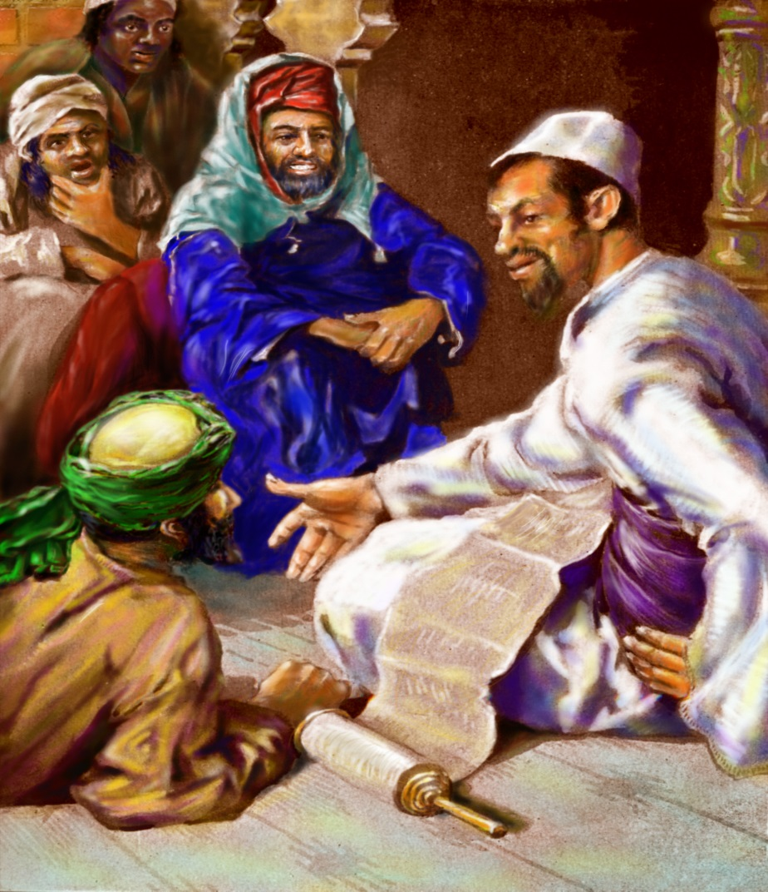
Cards 105-110
MICAH’S PROPHECIES CONCERN
BETHLEHEM
ESTABLISHMENT OF THE CHURCH
BIRTHPLACE OF CHRIST
Instead of reading quickly form start to finish, pause after each short section to see whether you understand what is says.
In general, Micah follows this outline: chapters 1-3 indict both Northern and Southern kingdoms with their leaders; chapter 4 turns to the wonderful future God is planning with the establishment of the church; in chapter 5 comes a prediction that Matthew 2:6 records as fulfilled by Jesus’ birth in Bethlehem 700 years later.
The last two chapters give the trial, punishment, and hope of the guilty nations.
Micah had the big view of history, and thus he covered a lot of ground. His book, only seven chapters, is loaded with pronouncements on the events of several thousand years. Because so much is jammed into so short a space, reading Micah can be confusing. A fragment may deal with the Messiah, for instance, and without warning the next few verses shift to the battle against Assyria.
To grasp Micah’s message, think of his book as a collection of short speeches. One speech doesn’t necessarily lead into the next.

Slide 2
MICAH’S PROPHECIES CONCERN
A. The fall of Israel and Jerusalem
B. Jonah running from God and hiding
C. Birthplace of Christ and establishment of the church
1. Did Micah have a big view of history?
His book, only 7 chapter, is loaded with pronouncements on the events of several thousand years? True or False
You should think of Micah as a collection of short speeches? True or False
Micah in chapter 4 turns to the wonderful future God is planning with the establishment of the church? T or F
Did Micah predict Jesus’ birth in Bethlehem 700 years later?

Slide 3
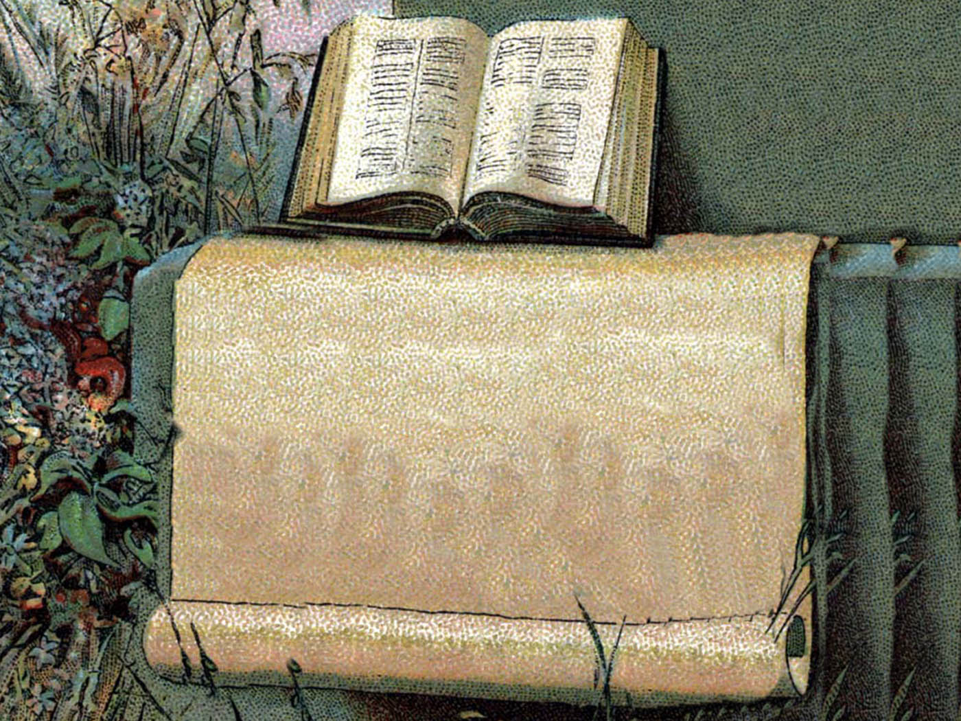
MICAH 6:8 –”WHAT DOES THE LORD REQUIRE OF THEE?
MICAH 6:8
TO DO JUSTLY
TO LOVE MERCY
TO WALK HUMBLY WITH GOD
Micah’s most famous pronouncement summarizes the qualities that matter to God. To act justly and to love mercy and to walk humbly with your God.
Jesus spoke in similar terms to the Pharisees about their religious hypocrisy: they gave a tenth of even their spices to God, yet they neglected justice, mercy, and faithfulness (Matthew 23:23)

Slide 4
MICHAH 6:8 “WHAT DOES THE LORD REQUIRE OF THEE:”
Finish the requirements:
To do J____________
To Love M___________
To Walk H__________with God
Are these pronouncement matter to God?
Did Jesus speak in similar terms to the Pharisees?

Slide 5
NAHUM PROPHESIES THE DESTRUCTION OF NINEVEH
Is life fair? It rarely seems so, especially in international politics. The most vicious dictators thrive, and raw power is the key ingredient in a successful foreign policy—think of Osama bin Laden! Weak people get trampled.
As a citizen of Judah, the prophet Nahum felt the force of such injustice. His message from God concerned the greatest city of the time, Nineveh. This city, the capital of Assyria, represented raw brutal power—”endless cruelty,” as Nahum put it (3:9). Though Nineveh was hundreds of miles northeast of Judah, her power dominated the Middle East. In contrast, Judah was a small, fragile state barely clinging to independence.
Nahum’s Nerve
Judah’s sister nation to the north, Israel, had already been defeated by Assyria and carried into exile. Only God’s miraculous intervention had saved Judah on that occasion. And now, in Nahum’s time, the Assyrians had returned. They dragged Manasseh, the king, with a hook in his nose (2 Chronicles 33:11). Judah was forced to pay tribute as a vassal state.
Few people can stare into the face of such raw power and come away unimpressed. Nahum did so only because he had seen a far greater power--the
As was always true with God’s prophets, Jonah’s condemnation sounded absolute. Actually, it included an escape clause. In Jeremiah 18:7-10, God spelled it: “If at any time I announce that a nation or kingdom is to be uprooted torn down and destroyed, and if that nation I warned repents of its evil, then I will relent…” Hearing Jonah, the Ninevites had repented, and God had spared their city.
The repentance had not lasted, however. By Nahum’s time, Nineveh had returned to her evil ways. God’s anger, while slow to develop was sure. Nahum’s absolute confidence in God is underlined throughout this book.
It took nerve to stand up and predict the downfall of the most powerful nation in the world. Yet, in this book, Nahum sounds unintimidated, almost lordly. He spoke with confidence because he knew God’s character: “The Lord will not leave the guilty unpunished.”
Within a few years, Nahum’s predictions came true. Nineveh did fall, never to rise again. The greatest city in the world became a pile of rubble overgrown with grass.
The name Nahum means “comfort.” Though Nahum describes God’s anger, his message offers comfort to those who live with injustice and evil. “The Lord is good,” said Nahum, “a refuge in times of trouble.
power of God whose wrath could shatter rocks. If God was angry, how could Nineveh stand? God’s anger against Nineveh had not appeared overnight. Assyria had been the dominate world power for at least 300 years. Once before, Jonah had carried a message of condemnation to its chief city, Nineveh.

Slide 6
NAHUM PROPHESIES THE DESTRUCTION OF
A. Jerusalem
B. Israel
C. Nineveh
Nahum’ message from God concerned the greatest city of the time, Nineveh? True or False
This city was a raw brutal power of endless cruelty? True or False
Did Nineveh dominated the Middle East in power?
Did Judah fall by the hand of the Assyrians?
Had Nahum seen a far greater power than the Assyrians?
Was this power the power of God whose wrath could shatter rocks?
Could Nineveh stand if God was angry?
Who was the prophet who once before carried a message of condemnation to Nineveh? (Hint-- he tried to run away from God)
Was God willing to save a city from destruction if they repented?
Did the repentance of Nineveh last?
Did it take nerve to stand up and predict the downfall of the most powerful nation in the world?
Nahum told them “The Lord will not leave the guilty unpunished”? True or False
Did Nahum’s predictions come true?
Is the Lord a good refuge in time of trouble?

Slide 7
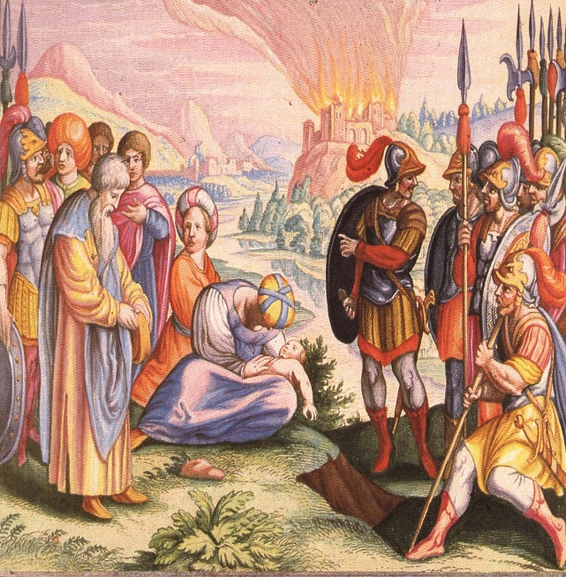
HABAKKUK SHOWES THAT GOD
USED THE WICKED (BABYLONIANS) TO PUNISH OTHERS:
The book of Habakkuk begins with a complaint. The prophet saw injustice, violence, and evil in his own country, yet God remained silent and invisible. Why didn’t God intervene? Why did he give no answer when Habakkuk called out for help? Habakkuk took these questions directly to God, in prayer.
God answered him, but hardly in the way Habakkuk had anticipated. God said he was sending the Babylonians to punish Judah. God’s words described a ruthless, savage army that would tear Israel apart.
So Habakkuk complained again. Could this be justice—punishing Judah through an even more evil nation? Deeply perplexed, Habakkuk waited to see what answer God would give to his second complaint.
How long he had to wait, we do not know. But God did reply, and his answer is perhaps the best explanation we have
of God’s attitude toward evil. It satisfied Habakkuk, so that his book, which begins with a complaint, ends with one of the most beautiful songs in the Bible.
Two Certainties to Live By:
God pointed out two certainties to Habakkuk. First, the violent, proud Babylonians would be paid back with the very weapons they had used on others. Just as they destroyed nations, they would be destroyed. “Has not the Lord Almighty determined…that the nations exhaust themselves for nothing?” (2:13). Evil may dominate the earth, but it always wears itself out.
The second certainty was God’s character. He may be silent for a time, but not forever. “The earth will be filled with the knowledge of the glory of the Lord, as the waters cover the sea” (2:14). In chapter 3, Habakkuk “saw” this powerful glory, and his heart pounded. It changed his attitude from complaining to joy.
Because the future belongs to God, a believer can cling to the truth embodied in 2:2 “The righteous shall live by his faith.” Habakkuk beautifully expressed this attitude of faith in the last three verses of his book: no matter how hard life might become, he would rejoice and find strength in the Lord.
Living by Faith:
Did Habakkuk explain why God allows evil? Not precisely. He did affirm that God has not lost control. Evil is moving toward its own logical end of self-destruction, and God’s glory will someday fill the earth. Habakkuk offers no proof of this, merely the record of God’s communication to him. A believer can find hope and joy through faith in God, regardless of circumstance. Habakkuk’s capsule of faith was quoted at three crucial points in the New Testament: Romans 1:17; Galatians 3:11; and Hebrews 10:38.
Though Habakkuk probably did not live to see it, the Babylonians were destroyed. Today they are merely a memory. Yet we, like Habakkuk, must still wait in faith to see the earth “filled with the knowledge of the glory of the Lord.”

Slide 8
HABAKKUK SHOWS THAT GOD
A. Didn’t care about Judah
B. Was not interested in his prayers
C. Used the wicked Babylonians to punish others
Habakkuk saw injustice, violence, and evil in his own country, yet God remained silent? True or False
Habakkuk took questions of why God did not help him directly to God in prayer? True or False
Did Habakkuk like the way God answered his prayers?
God was going to send the Babylonians to punish Judah? True or False
The two certainties to live by are:
1. Evil may dominate the earth, but always w__________itself o___________?
2. God may be silent for a time, but not f_____________?
Because the future belongs to God, a believer can cling to the truth; “The righteous shall live by his faith.”
True or False
Did Habakkuk explain why God allows evil? Why do you think God does allow evil?
Evil is moving toward its own logical end of self-destruction, and God’s glory will someday fill the earth. T or F
A believer can find hope and joy through faith in God, regardless of circumstances? True or False

Slide 9
QUOTE HABAKKUK 2:4
In chapter 1 we saw the perplexity of the prophet. Now the prophet has learned that God had answers for his questions. He answered his first question, which raised a bigger question, but God has an answer for that also.
If you have a question, don’t smother it in pious phraseology. We often hear people say, “Oh, I’m trusting the Lord,” when they are not trusting Him; they are questioning Him every step of the way. There is no sin in questioning the Lord. Just go to Him and tell Him that you don’t understand. This is what Habakkuk did.
HABAKKUK 2: 4
“…THE JUST SHALL
LIVE BY HIS FAITH.”
This brings us to one of the most important verses in the Scriptures. It is the key to the little Book of Habakkuk. And, actually, it gives the key to the three great epistles in the New Testament that quote this verse: Romans 1:17; Galatians 3:11; and Hebrews 10:38
“The just shall live by his faith.” There have been many ways of attempting to sidestep the tremendous impact of this verse. Some have attempted to interpret “faith” as faithfulness or right dealing—the just shall live by his faithfulness. However, this verse gives us the two ways which are opened up to mankind.
Notice that the verse mentions two groups of individuals which are in the world: (1) the lifted-up or puffed-up soul: and (2) the just man who is living by his faith. In other words, you could call them the lost and the saved, those who have trusted God and those who have not believed God. Or you can call them saints and the ain’ts—that makes a sharp division also.
So here is verse 4 we have a great principle that God had laid down for all mankind.

Slide 10
QUOTE HABAKKUK 2:4
“…THE J__________SHALL L__________BY HIS F_______________
If you have a question, should you go to God in prayer and tell Him you don’t understand?
Is there any sin in questioning the Lord?
Is this what Habakkuk did?
In verse 4 we have a great principle that God has laid down for all man kind…the just shall live by his faith?
True or False

