Slide 1
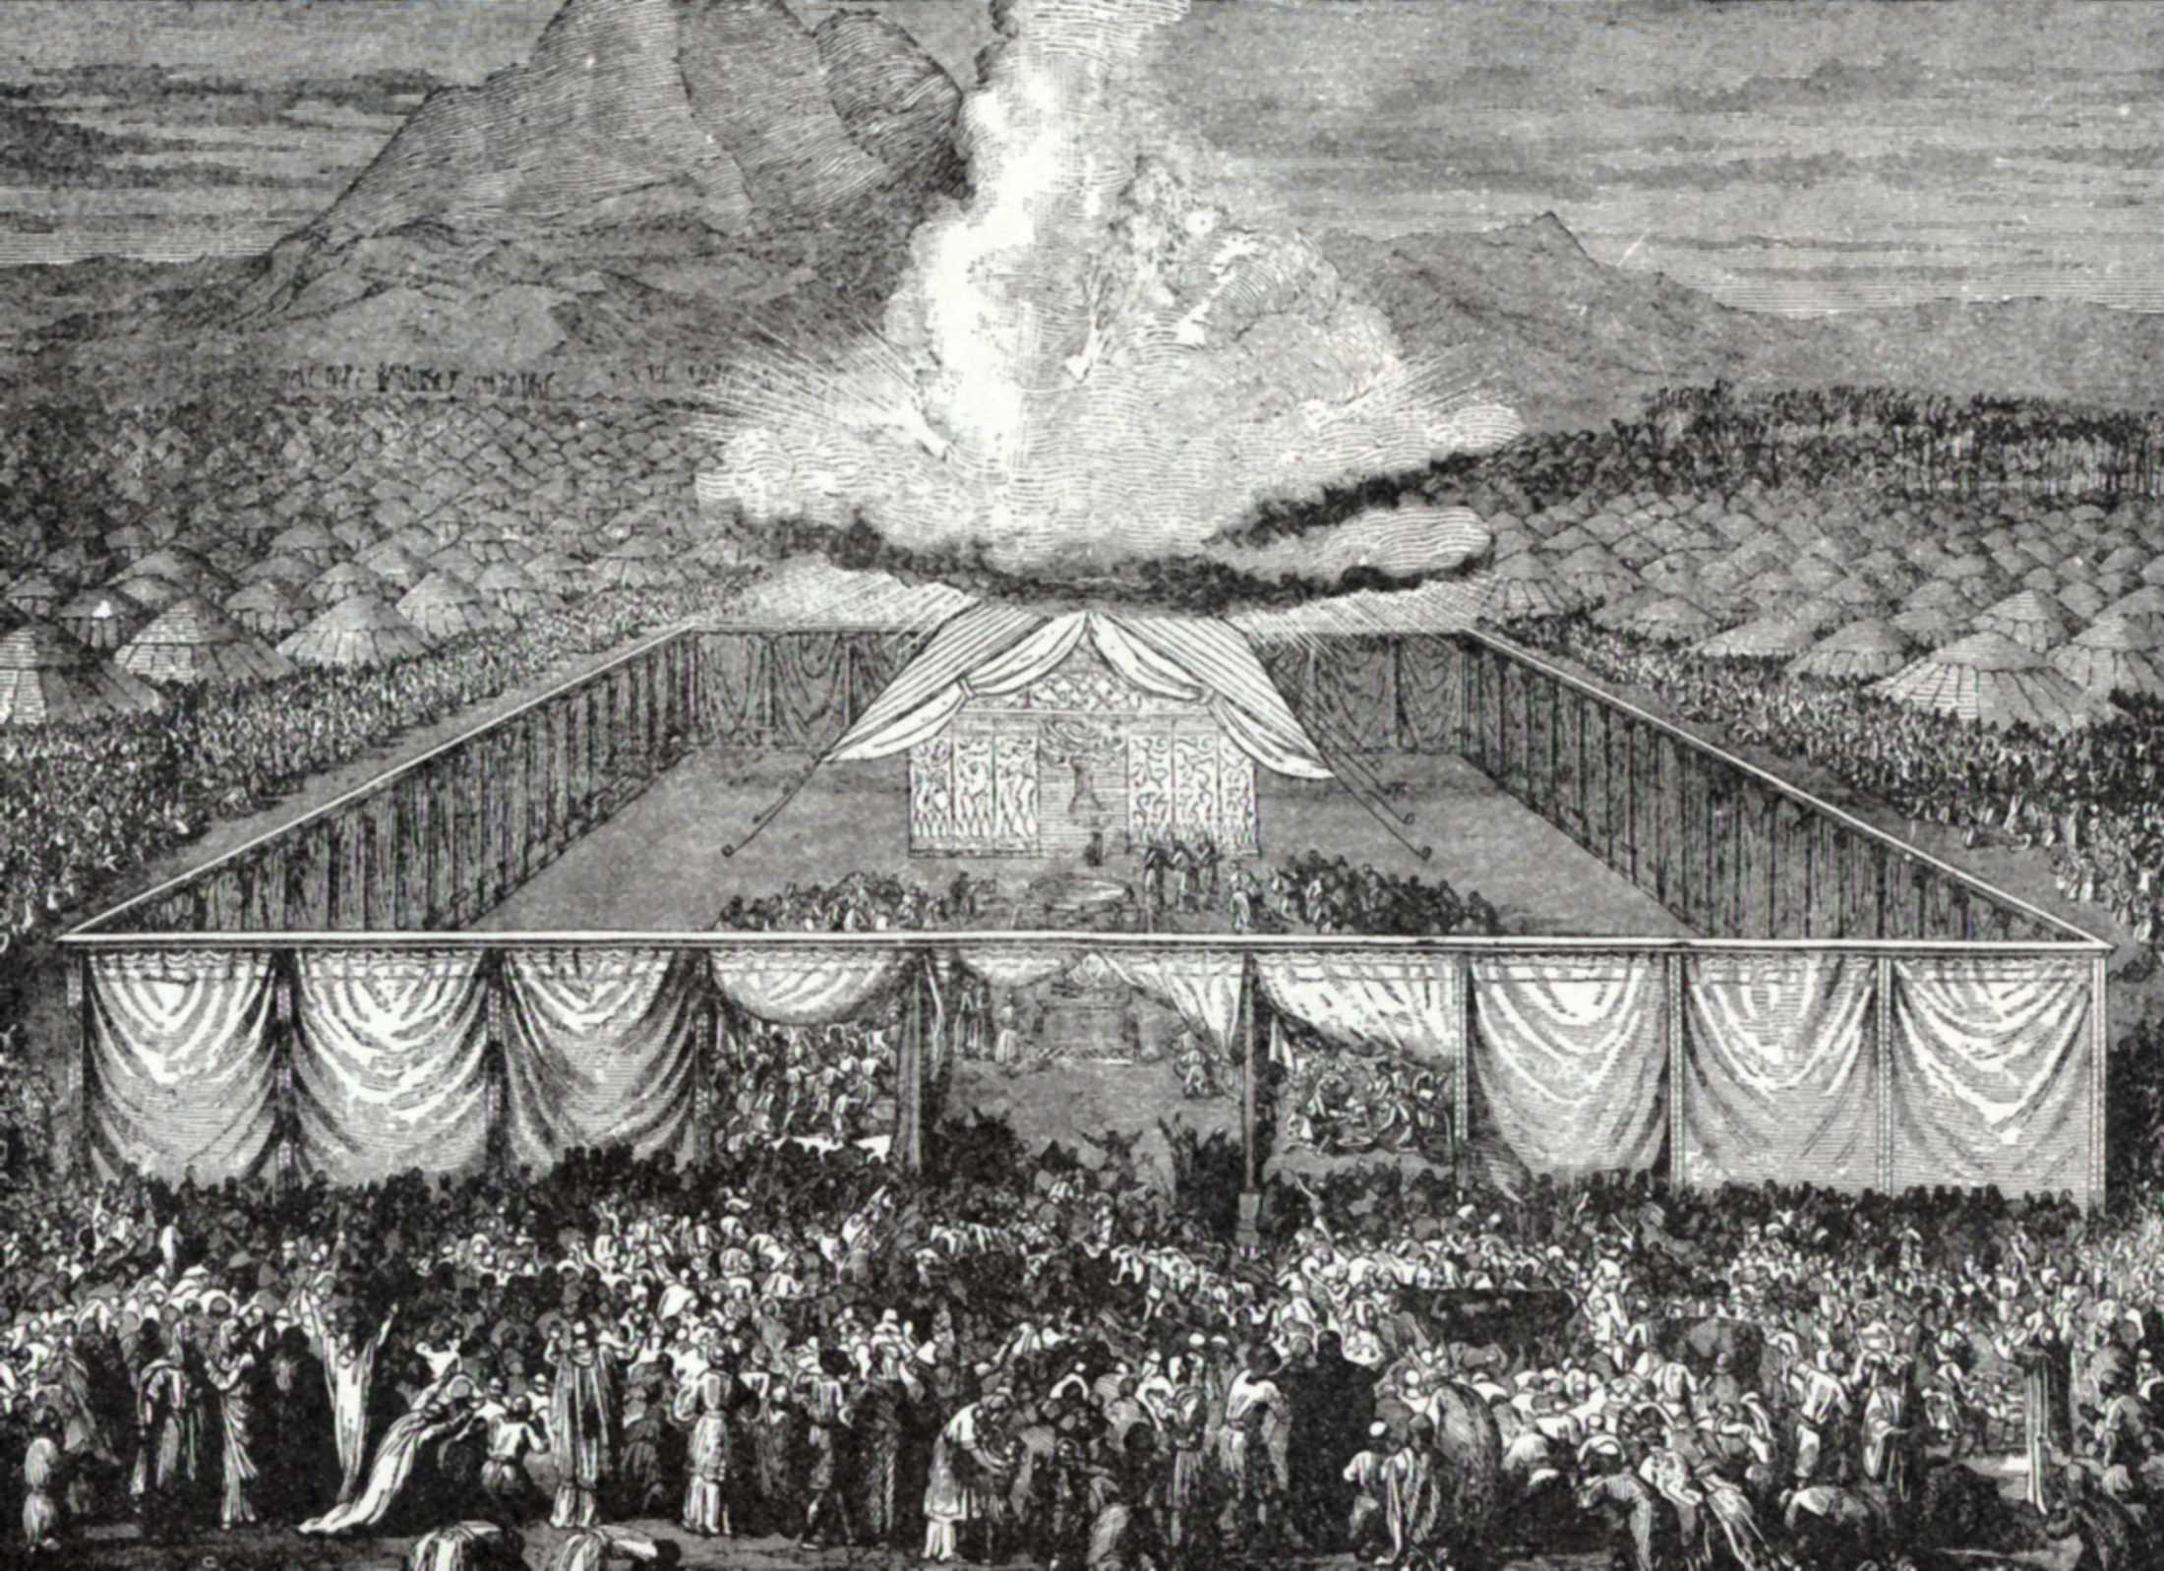
Cards 14-16
1 2 3 4 5
1 2 3 4 5
NUMBERS TELLS ABOUT
Counting of the People
It was now more than a year since the children of Israel had come out of Egypt. All this time they had been in the wilderness of Sinai.
They had been very busy. First of all, God had given them the Ten Commandments and many other laws to tell them how to live. Then they had been working at their Tabernacle.
Very soon God was going to have them continue their journey since they still had to travel far before they could reach the land of Canaan.
God told Moses that he and Aaron should number the people to find out how many men there were who could go to war. For they would meet unfriendly people, whom they would have to fight.
Only those who were twenty years or older were to be counted. Aaron’s tribe, the tribe of Levi, was not counted. None of the Levites were to become soldiers. They were to help Aaron and his sons to take care of the Tabernacle.
The twelve princes of the tribes helped Moses and Aaron to number the Israelites. When the people had been counted, it was found that there were more than six hundred thousand men (603,550) who were able to go to war.
1 2 3 4 5 6 7 8
603,550

Slide 2
NUMBER TELLS ABOUT
A. Counting of the people
B. Counting of the Priest
C. Counting of the animals
How long had it been since the children of Israel had come out of Egypt?
All this time they had been in the wilderness of S___________?
During this time God had given what set of Laws?
They had been working on their house of worship—what was it called?
God told Aaron he should number the people to find out how many men there were who could go to war. True or False?
Were they going to meet unfriendly people, whom they would have to fight before reaching their promise land of Canaan?
What tribe was not to be counted?
Why, what was their job?
They were to count those over what age?
When the people had been counted, how many men were able to go to war?

Slide 3
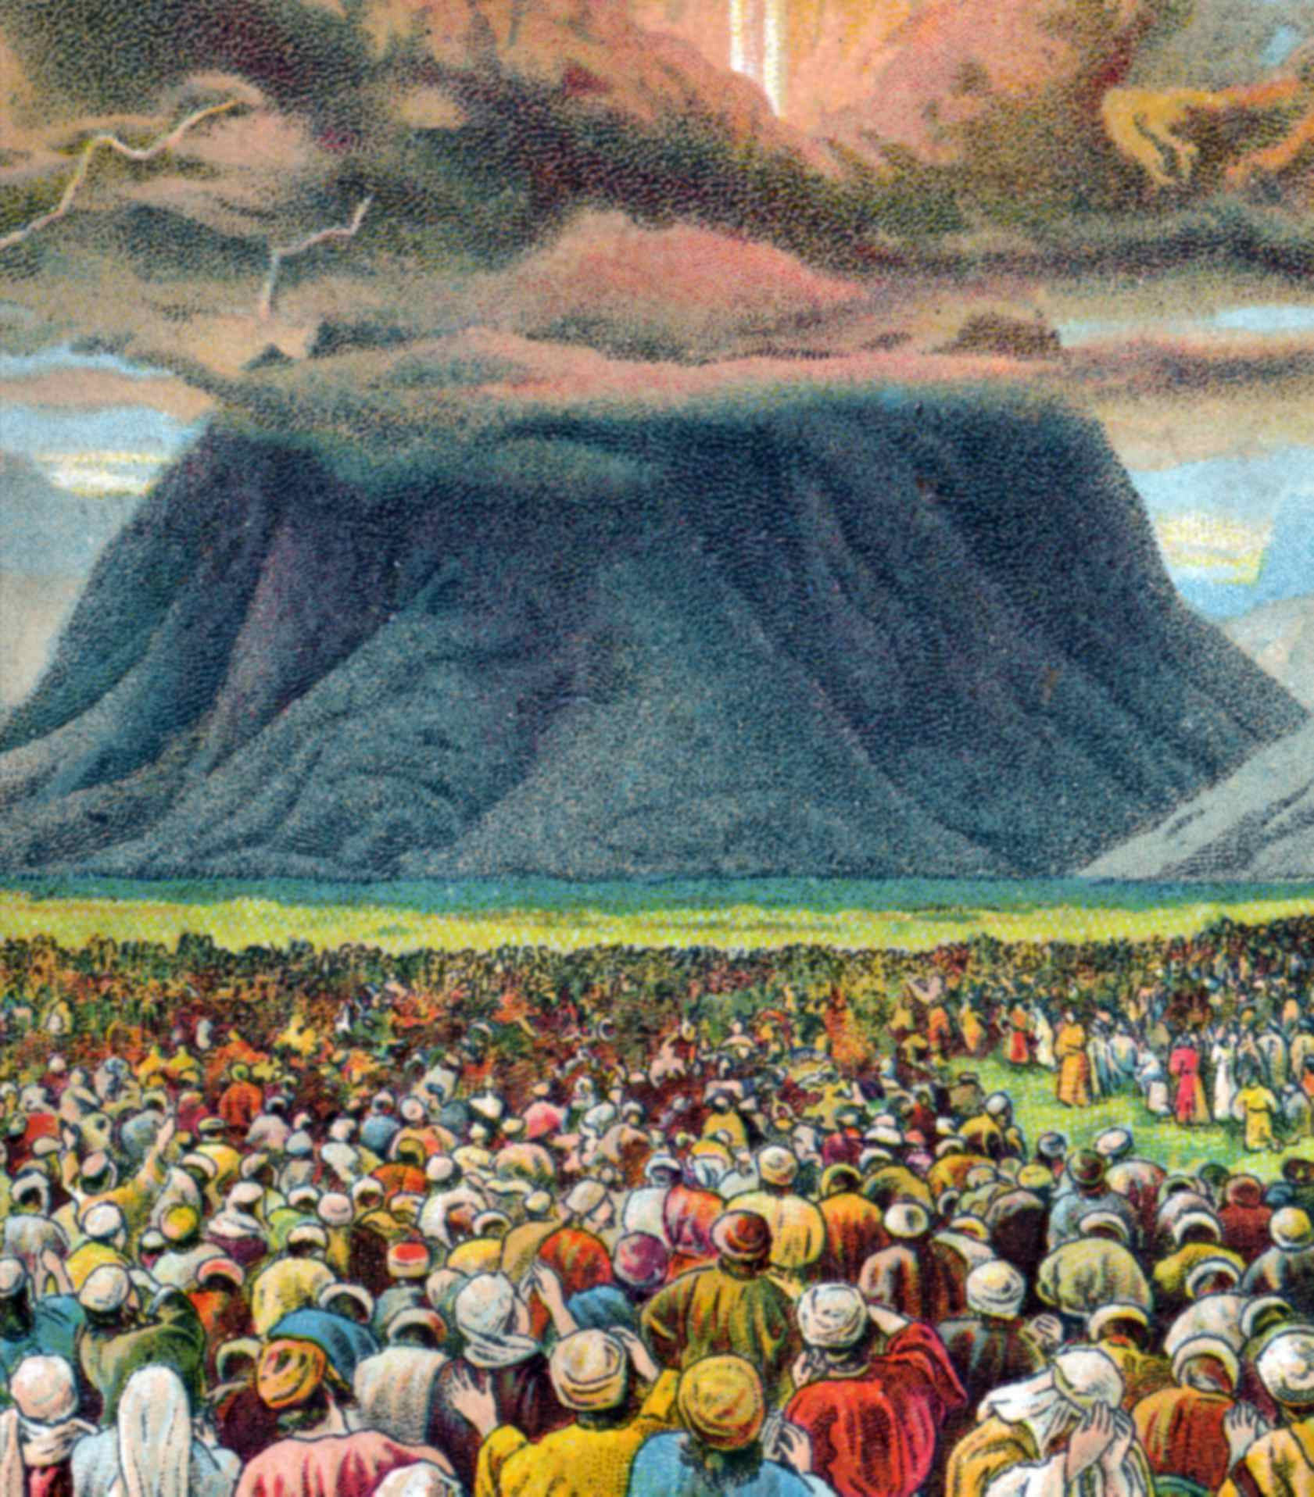
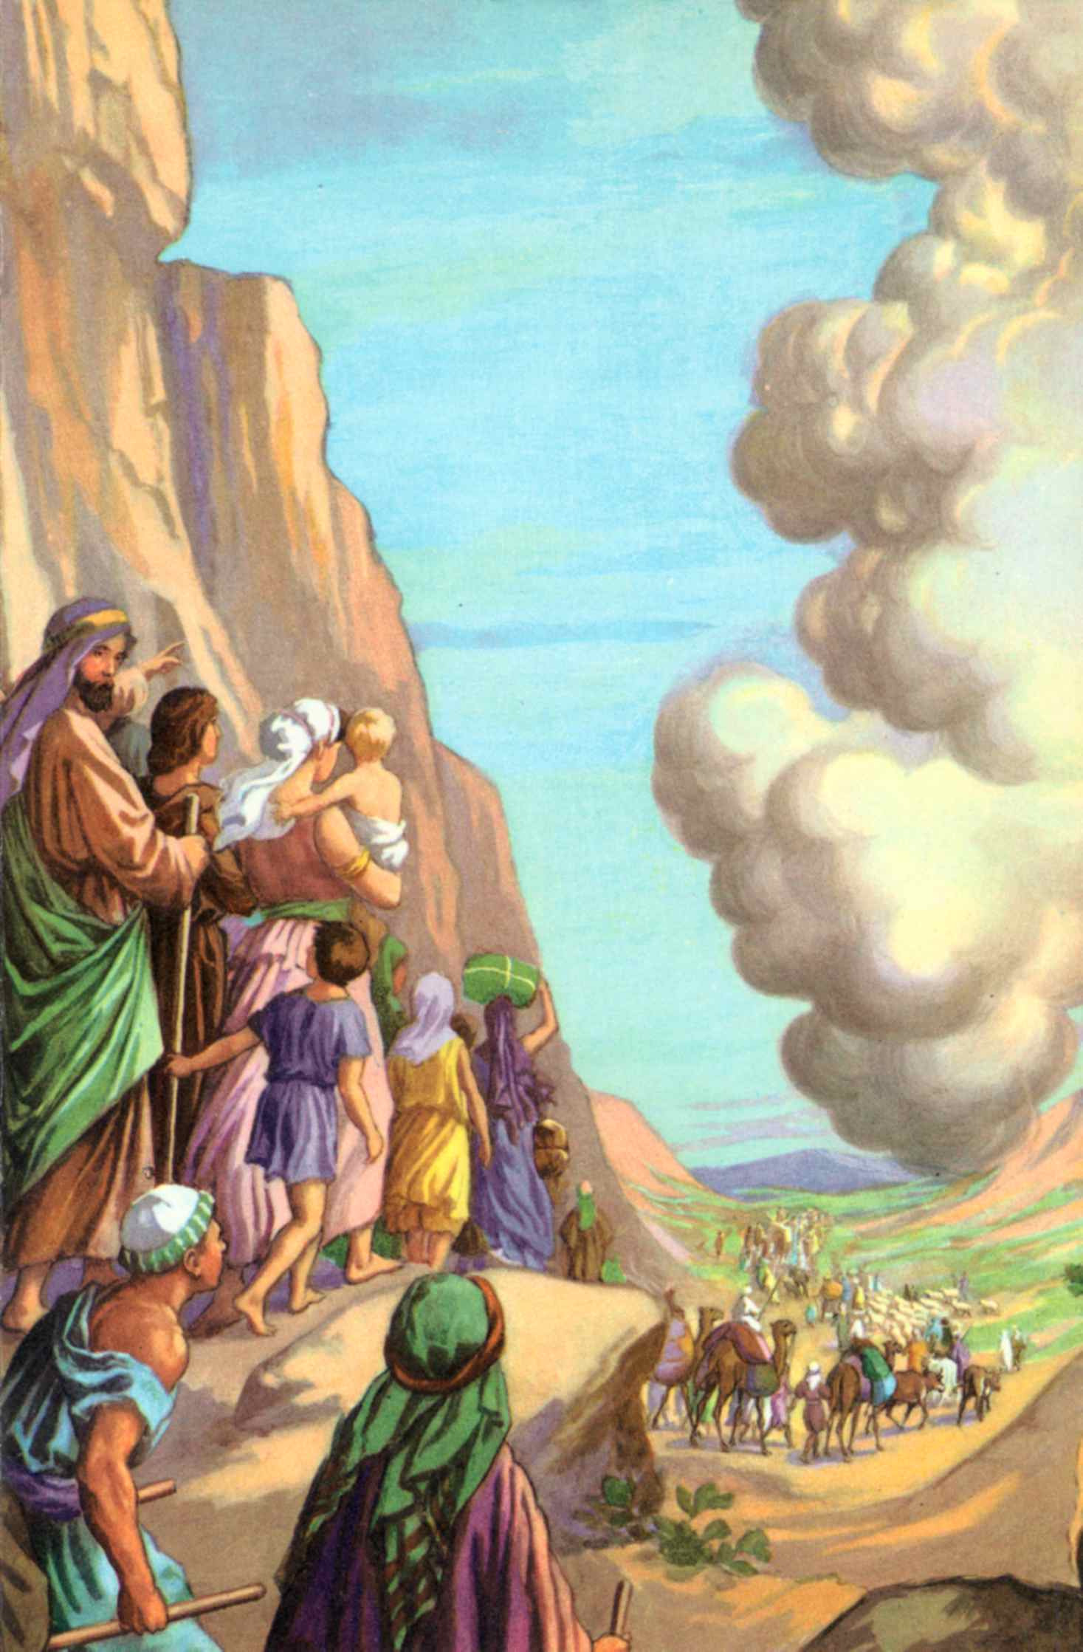
EVENTS IN NUMBERS
The people of Israel spent a whole year at the foot or Mount Sinai, while they built the Tabernacle according to God’s plan, and learned from Moses the laws God had given. It was here at Mt. Sinai that God told Moses to number the people for the first time.
Very soon God was going to have them continue their journey, since they still had to travel far before they could reach the land of Canaan. One morning the Israelites saw that the pillar of cloud had moved from its place over the Tabernacle, they were going to travel again. They began to take down and cover the Tabernacle furnishings in preparation for moving. Their tents were taken down and they were lined up in an orderly fashion as their place around the Tabernacle had been. They were to start off in a way God had told Moses. Each tribe had a captain over it, and a flag of its own
The children of Israel marched for three days, only stopping at nights to sleep. After three days the pillar of cloud stood still. They knew that God wanted them to stay there

Slide 4
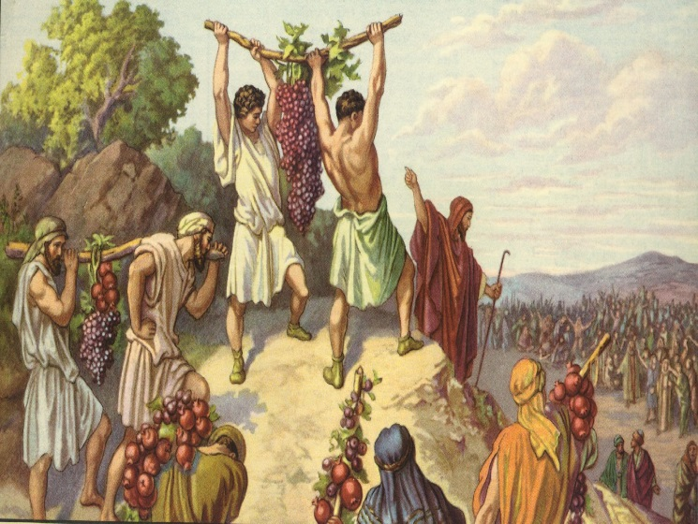
EVENTS IN NUMBERS
God gave instruction to Moses, and Moses chose a leading man from each tribe, twelve men in all, to go ahead to spy out the land of Canaan to find out about its riches, and to see how strong were the enemies they would have to fight in the land. At the head of this little ban Moses place Joshua, the son of Nun. This was dangerous work, but Joshua was a brave man.
Into the land of Canaan slipped the spies and they searched through it from south to north. On their way they passed through the land of the tall people, the giants, the sons of Anak. This was a frightening experience for most of them. On their way back they came to the brook of Eshcol, and there they found a wonderful grapevine. They cut off one branch of grapes from the vine, and it was so heavy that two men were needed to carry it on a pole between them. They took pomegranates and figs as well, to show to Moses and the Israelites. Forty days long they search through the land of Canaan, and then went back to the Israelite camp at Kadesh-barnea in the wilderness of Paran.
There they reported that the land was truly a rich land, but most of them were afraid of the people that lived there. All they could think of were the fortified towns they had seen, and the war like tribes who lived in them: the Amalekites and the Hittites and the Jebusites and the Amorites and the Canaanites and especially the giant children of Anak. They felt they were as tiny as grasshoppers compared to the giant children of Anak, and they were sure the Israelites would not be able to fight against them and win. Only Caleb and Joshua felt they should move into the land straightaway.
As usual the Israelites began to weep and to complain. If they had only stayed in Egypt and died there, or even out in the desert, then they would never had had to face these terrible people. They lost heart so easily. They even wanted to choose another leader and struggle all the way back thought the desert to Egypt.

Slide 5
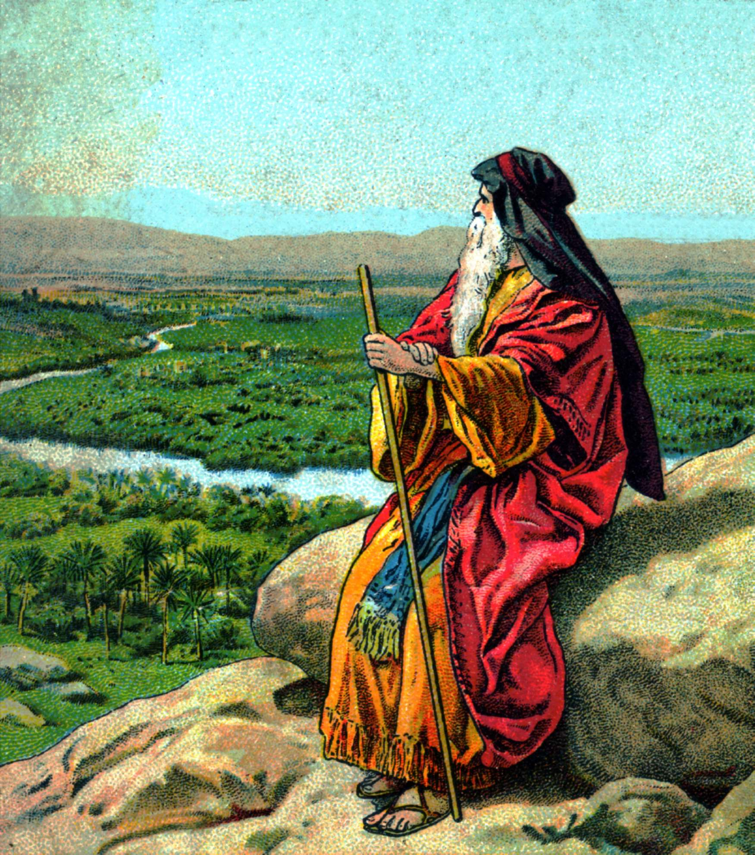
EVENTS IN NUMBERS
When they heard this, Moses and Aaron threw themselves down on the ground and prayed to God for their people; and Caleb and Joshua were so upset they tore their clothes as they pleaded with the people. They begged them to trust in God: Canaan was a good land, and rich, and if they were obedient, God would lead them in safely. But the people tried to stone them to death.
Then God stepped in. He let the people see His glory shining about the Tabernacle, to warn them He knew what was happening, and to remind them of His promises. To Moses He said that He was so angry with them that He wanted to destroy all except Moses and his family. But Moses begged Him to be merciful to them and not destroy them altogether. Then God said that He would not do as He had said but still all the people who had rebelled would not be allowed to go into the land. Of all the grow ups amongst them, only Joshua and Caleb would be allowed to cross into the Land of Promise, with the children of the rest of the people. For every day the spies had spent in the land the Israelites would have to spend a whole year in the desert, forty years altogether.
During this time Numbers reveals the stories of the rebellion of Korah and Aaron’s rod budding (Num. 16, 17). Moses smiting the rock (Num. 20:7-13). The brazen serpent (Num. 21:5-9) and Balaam’s attempt to curse Israel (Num. 22, 23).
But at last the Israelites were encamped east of the Jordan River on the plains of Moab, within sight of the land of Canaan on the other side of the river. Moses and Eleazar, son of Aaron who had died, counted all the people for the second time who were twenty years old or more. When they added together the numbers in all the tribes, they found that there were over six hundred thousand men, not counting the women and children. Of all those men only three were over sixty years old: Moses and Caleb and Joshua.

Slide 6
EVENTS IN NUMBERS
A. Numbering of the People at Mt. Sinai
B. Twelve spies sent out
C. Wilderness wanderings
D. Numbering of the people at Jordan River
E. All the above
The people of Israel spent a whole year at the foot of Mount Sinai, while they built the Tabernacle
according to God’s plan, and learned from Moses the laws God had given? True or False
What was the name of those laws God gave Moses at Mt. Sinai?
Was it here at Mt. Sinai that God told Moses to number the people for the first time?
What led the children of Israel by day? A. snake B. cloud C. wind
Did Moses give instruction for them to spy out the land of Canaan?
What kind of people did they see there? A. Black B. little C. Giants
Did Caleb and Joshua feel they should move into the land?
Why did God send some of the people back to the desert?
When they counted the people over 20 years old how many men did they count? A. 100 B. 1,000 C. 603,550
Of all those men who were the only three over sixty years old?

Slide 7
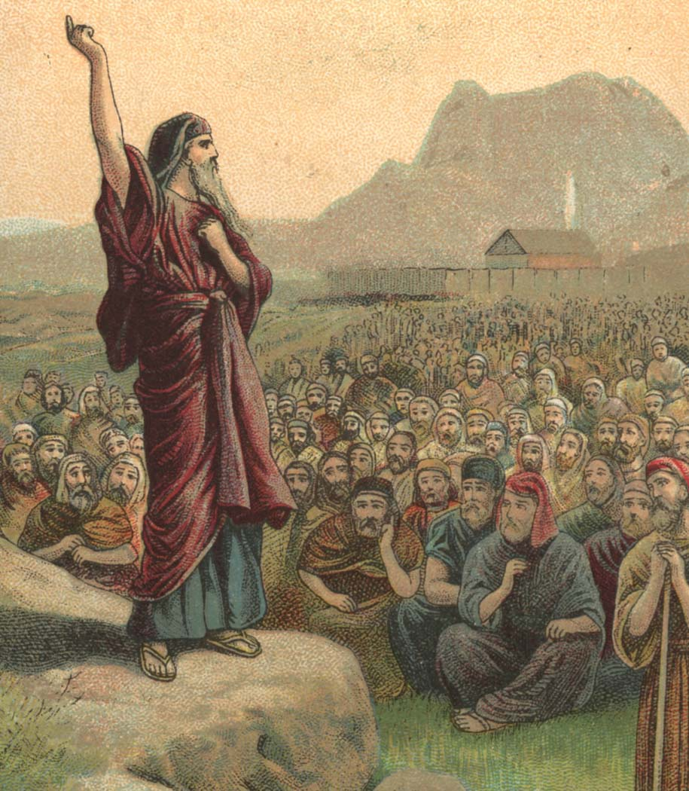
YEARS BETWEEN THE NUMBERING OF THE PEOPLE
For every day the spies had spent in the land the Israelites would have to spend a whole year in the desert, forty years altogether.
God was so displeased with the peoples lack of faith and their complaining He became angry and told Moses He wanted to destroy all except Moses and his family.
But through the pleading of Moses, God said He would be merciful to them and not destroy them, altogether. Then God said that He would not do as He had said but still all the people who had rebelled would not be allowed to go into the land. Of all the grownups amongst them, only Joshua and Caleb would be allowed to cross into the Land of Promise, with the children of the rest of the people.
But at last the Israelites were encamped east of the Jordan River on the plains of Moab, within sight of the land of Canaan on the other side of the river. Moses and Eleazar, son of Aaron who had died, counted all the people for the second time who were twenty years old or more. When they added together the numbers in all the tribes, they found that there were over six hundred thousand men, not counting the women and children. Of all those men only three were over sixty years old: Moses , Caleb and Joshua.

Slide 8
YEARS BETWEEN THE NUMBERING OF THE PEOPLE
A. 40
B. 50
C. 60
Why was God so displeased with the people?
What did he first tell Moses He was going to do?
Did Moses plead for the people?
Of all the grownups among them, only who would be allowed to cross into the Promise Land?
How many years would the rest have to spend in the desert?
Did Moses and Eleazar count the people for the second time?
Of all those counted only what three were over sixty years old?

