Slide 1
Cards 66-68
PSALMS ARE SONGS
Here at the very center of the Bible are songs, rising up like a tune from its heart. They capture the innermost thoughts and prayer of Old Testament people—and they still speak directly to our needs.
For every emotion and mood, you can find a Psalm to match. The Psalms wrestle with the deepest sorrow and ask God the hardest questions about suffering and injustice. Their voice is refreshingly spontaneous. They do not tip flowery compliments toward God: they cry out to Him.
After you read these poems, you can’t think of the Old Testament as dry and rule-bound. Nor is the Old Testament God distant and impersonal. In almost every Psalm you find the presence of God, not as a philosophical principle, but as an active, strong, and loving ruler—a God who makes a difference in life.

Slide 2
PSALMS ARE
A. Stories
B. Laws
C. Songs
The Psalms capture the innermost thoughts and prayer of Old Testament people? True or False
Do they still speak directly to our needs?
Can you find a Psalm to match our every emotion and mood?
The Psalms ask God the hardest question about s_____________and i______________?
The Psalms do not tip flowery compliments toward God: they c_____out to H_______?
After reading the Psalms you can’t think of the Old Testament as dry, or God distant and impersonal? True or False
Is God present in almost all the Psalms?
Does the Psalms show God as someone who makes a difference in life?

Slide 3
WROTE MOST OF THE PSALMS
While almost half of the Psalms are credited to David, at least one was written 500 years after his birth. A number of poets and writers contributed, and about a third of the Psalms are completely anonymous.
How did the Psalms come together? They seem to have been compiled as a hymnbook for use in temple worship. Some Psalms were written from an individual’s experiences, but were adapted for congregational use. Directions for musicians were added, along with a few verses to widen the Psalms’ meaning to everybody.
The Psalms show tremendous variation, reflecting the many personalities who contributed their poems and prayers over several centuries. Yet readers have found an inner consistency in the whole book, so they can move from one Psalm to the next without being particularly aware that one poem is centuries older than another. Some have called the Psalms a Bible within the Bible—different books telling a single story.

Slide 4
WROTE MOST OF THE PSALMS
A. Job
B. David
C. Solomon
Did David write all the Psalms?
Did a number of poets and writers contributed to writing them?
Some of the Psalms are completely anonymous? True or False
Did it seem the Psalms were compiled as a hymnbook for use in temple worship?
Does the Psalms show tremendous variation, reflecting many personalities?
Is there an inner consistency in the whole book so you can move from one Psalm to the next?
Some have called the Psalms a B__________within the B____________?
Are the Psalms different books telling a single story?

Slide 5
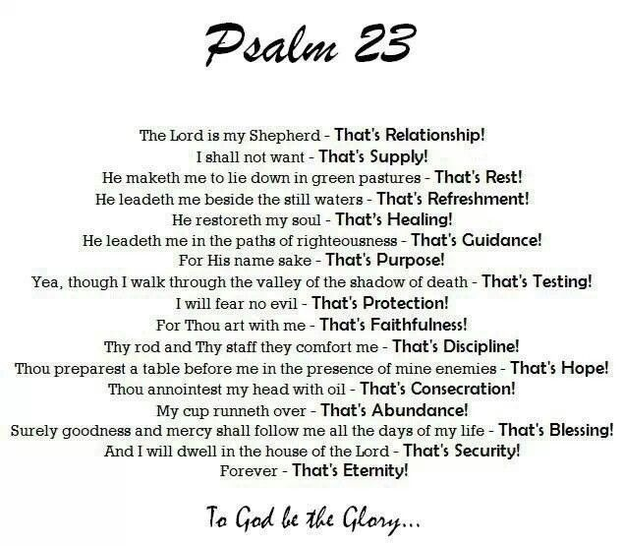
QUOTE PSALM 23

Slide 6
PSALMS CONTAINS SONGS OF
The Psalms reflect, in a hundred moods and experiences, the never-changing reality of strong and loving God, who cares for His people. God is not the only reality in the Psalms. Equally persistent are enemies who sneer and hurt and plot violence. They, too, appear in nearly every Psalm. For the psalmist, faith in God was a struggle against powerful forces that often seemed more real than God.
The Psalm writers frequently asked, “Where are you, God? Why don’t you help me?” Despite their love of God, they often felt abandoned, misused, betrayed. They found no guarantee of safety in their closeness to God. The joy and praise that saturated these prayers came, not from as absence of problems, but from a deep conviction that a great God would overcome them.
Jesus, dying on the cross, twice expressed himself in the words of Psalms 22:1 and 32:5, and His disciples, in trying to explain His life, quoted from Psalms more than any other book. They appear to have meditated on the Psalms often as they considered the meaning of Jesus’ life. In the Psalms they could see that even the best men—even David, the great king—suffer agony and feel abandoned.
Living by faith is not easy. It was not for David; it was not for Jesus either. These powerful poems of praise and worship, some of the most beautiful ever written, offer no magical formulas to make troubles go away. Yet, while real life questions, struggles, and discouragement have a strong voice in these poems, more powerful still is the voice of joy and
security and fortress of Israel: the Lord Himself.
Some of the Psalms are historical, recalling God’s treatment of Israel in the past, while others are prophetic, looking to the future, even to the coming of Messiah. There are psalms of affliction, lamentation and penitence, as well as hymns of thanksgiving and trust. These are divided into five books: 1-41, which witness to David’s life and faith; 42-72, a group of historical
PRAISE THANKSGIVING HISTORY REPENTANCE
PROPHECY
Writings-; 73-89, ritual Psalms; 90-106, reflecting pre-captivity sentiment and history; and 107-150, the captivity and return to Jerusalem. These five books are often regarded as the devotional counterpart to the five books of Moses.
AND OTHERS

Slide 7
PSALMS CONTAINS SONGS OF
Choose the ones that fit: A. Gloom, despair, and misery
B. Untruths, fairytales, and hatred
C. Praise, thanksgiving, repentance, prophecy
The Psalms reflect the never-changing reality of a strong and loving God, who cares for His people? True or False
Is God the only reality in the Psalms?
Are there enemies who sneer and hurt and plot violence in the Psalms?
Did the joy and praise that saturated these prayers come, not from an absence of problems, but from a deep conviction that a great God would overcome them?
Did Jesus and the disciple quote from Psalms more than any other book?
Was living by faith easy for David and Jesus?
What did they use to make their troubles go away?
Are some of the Psalms historical?
Are some of the Psalms prophetic, looking to the future?
Are some of the Psalms hymns of thanksgiving and trust?
Can you think of another word the Psalms represent?

Slide 8
PROVERBS ARE
WISE SAYINGS
“Sesame Street, the educational TV show, changed a lot of peoples ideas about education. It offers a kaleidoscopic mix of gentle fun that seems to have nothing to do with education at all. It showed that teaching kids doesn’t always mean forcing them to sit down and memorize lists. By watching Big Bird, the Cookie Monster, and Oscar the Grouch, children painlessly learn the ABCs as well as colors, shapes and a lot more.
The book of Proverbs does for wisdom what “Sesame Street” does for the ABCs. Much of Proverbs reads like a collection of one-liners, moving quickly (and apparently illogically) from one subject to another. A proverb pleases the ear much as “Sesame Street” pleases the eye, using “shortness, sense and salt” to compress life into a handful of memorable words. But just as with the TV program, Proverbs has an overall objective behind its disorder. If you spend enough time in Proverbs, you will gain a subtle and practical understanding of life.
Proverbs is probably the most down-to-earth book in the Bible. It’s education prepares you for the street and the marketplace, not the schoolroom. (Proverbs 1:20-21 expresses this poetically.) The book offers the warm advice you get by growing up in a good family: practical guidance for successfully making your way in the world. It covers small questions as well as large; talking too much; visiting neighbors too often; being unbearably cheerful too early in the morning.
The first nine chapters, which explain the purpose of Proverb’s wisdom, are spoken from father to son. Fifteen times the fatherly voice says, “My son.” Some of the advice seems particularly well suited to young people: warnings against joining gangs, for instance, or urgent cautions against sext outside of marriage. But the central message of proverbs applied to anyone, old or young: “Get wisdom at all cost.” It is a plea to strain your mind and your ears searching for the wise way to live.

Slide 9
PROVERS ARE
A. Wise Sayings
B. Poems
C. Prophecies
The book of Proverbs does for wisdom what “Sesame Street” does for the ABC’s? True or False
Much of Proverbs reads like a collection of one-liners, moving quickly from one subject to another? True or False
Does Proverbs please the ear by using shortness to compress life into a handful of memorable words?
Proverbs has no overall objective behind it? True or False
Does spending time in Proverbs give us a practical understanding of life?
Proverbs is probably the most down-to-earth book in the Bible? True or False
The first nine chapters, which explain the purpose of Proverbs’ wisdom are spoke from f_________to s______?
Fifteen times the fatherly voice says, “M___s_____?
Is some of the advice particularly well suited to young people?
Can you name some of the warnings Proverbs seems well suited to?
Proverbs is a plea to strain your mind and your ears searching for the wise way to live? True or False

Slide 10
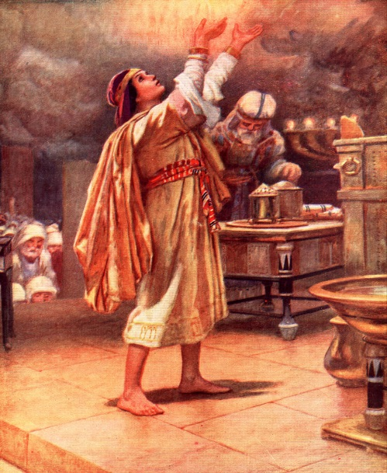
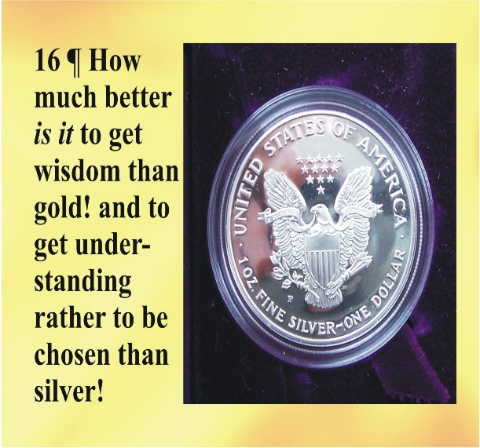
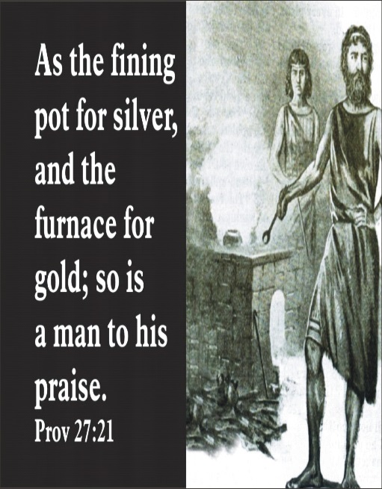
WROTE MOST OF PROVERBS
The title of this book is taken from the assertion in 1:1 that the book is a collection of “the proverbs of Solomon the Son of David, King of Israel.” A proverb is a profound and concise rule of conduct, or a short witty saying. In addition to this opening statement, several other verses indicate that Solomon was chiefly responsible for the material (10:1; 25:1) Chapters 30 and 31 are assigned to Agur and the mother of king Lemuel , respectively, although little is known of either. It ought also to be noted that certain “wise men” are credited with being responsible for some of the sayings (1:6; 22:17; 24:23)
Some think that the designation, “proverb of Solomon, indicate only that they are of the type which originated with Solomon, but were not themselves necessarily his product. While this hypothesis may be true, the information which we have regarding Solomon would certainly lend credence to the view that he would have produced many of the proverbs himself. As a king constantly in touch with his subjects and with other nations, he knew men and events thoroughly. He was blessed with a God-given wisdom supported by humility. I Kings 3;7) This wisdom had been tested in practical matter requiring great diplomacy and was widely recognized the Near East. It is stated that he composed over three thousand proverbs (I Kings 4:32), many more than are contained this book.
Solomon seeking wisdom
Proverbs 16:16

Slide 11
WROTE MOST OF PROVERBS
A. David
B. King Lemuel
C. Solomon
A proverb is a profound and concise rule of conduct, or a short witty saying? True or False
In addition to the opening statement in 1:1, several other verses indicate that Solomon was chiefly responsible for the material? True or False
A lot is known about Agur and the mother or King Lemuel? True or False
Are certain “wise men” credited with being responsible for some of the sayings?
Was King Solomon constantly in touch with his subjects and with other nations?
Did King Solomon know men and events thoroughly?
Was king Solomon blessed with a God-given wisdom supported by humility?
Was his wisdom tested in practical matters requiring great diplomacy?
Was his wisdom widely recognized in the Near East?
It is stated that he composed over three thousand proverbs? True or False
Is that more than is contained in the book of Proverbs?

Slide 12
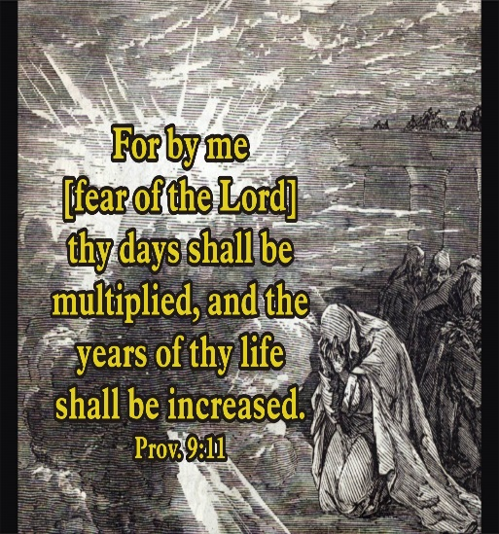
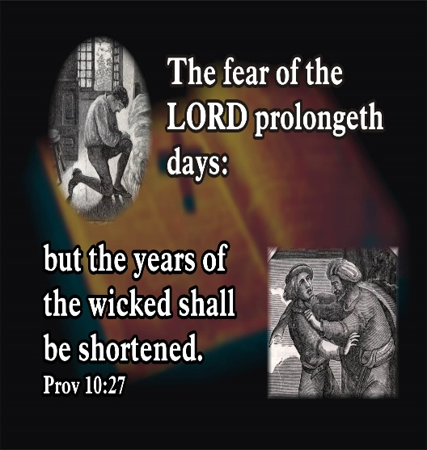

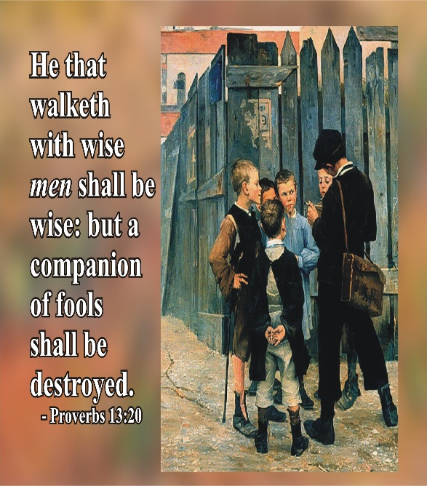
QUOTE PROVERBS 1:7
Anybody with a brain can find exceptions to Proverb’s generalities. For instance, Proverbs 28:19 proclaims that “he who works his land will have abundance food, but the one who chases fantasies will have his fill of poverty.” Yet farmers who work hard go hungry in a drought, and dreamers win $10 million in a lottery.
Proverbs simply tells how life works most of the time. You can worry about the exceptions after you have learned the rule. Try to live by the exceptions, and you court disaster.
The rule is that the godly, moral, hardworking, and wise will reap many rewards. Those who learn the practical and godly wisdom of Provers not only sleep better, they succeed and become able to help their family and friends. Fools and scoffers, though they appear successful, will eventually pay the cost of their lifestyle.
Much of Proverb’s practical advice makes no mention of God, and its’ concern for success may therefore seem quite secular. But if you take the book as a whole, it becomes obvious that the lifestyle Proverbs teaches depends on a healthy respect for God (1:7) affecting every aspect of life (3:5-7). Proverbs frankly concedes that the wise path will not be chosen by many: it is easier to live carelessly and godlessly. But those who choose to live by Provers will get success and safety, and more; they will get to know God himself, “Then you will understand the fear of the Lord and find the knowledge of God” (2:5)

Slide 13
QUOTE PROVERBS 1:7
“The f__________of the L__________is the b________________of k________________.
Does Proverbs simply tell how life works most of the time?
Should you worry about the exceptions after you have learned the rule?
If you try to live by the exceptions, are you courting disaster?
Is the general rule that the godly, moral, hardworking, and wise will reap the rewards?
Will the non-godly eventually pay for the cost of their lifestyle?
Can you name some cases where this is what happened?
Does the lifestyle Proverbs teaches depend on a healthy respect for God?
Will the wise path be choose by many?
Is it easier to live carelessly and godlessly?
If you live by Proverbs will you get to know God Himself?
Then will you understand the fear of the Lord and find the knowledge of God?

