Slide 1
Cards 76-82
NAME THE FIVE BOOKS OF THE MAJOR PROPHETS
During the years when kings ruled Israel and Judah, God spoke through prophets. Though some prophets did predict future events, their primary role was to call God’s people back to him.
ISIAH: The most eloquent of the prophets, Isiah analyzed the failures of all the nations around him and pointed to a future Messiah who would bring peace.
JEREMIAH: Jeremiah led an emotionally tortured life, yet held to his stern message. He spoke to Judah in the last decades before Babylon destroyed the nation.
LAMENTATIONS: All Jeremiah’s warnings about Jerusalem came true, and Lamentations records five poems of sorrow for the fallen city.
EZEKIEL: Ezekiel spoke to the Jews who were captive in Babylon. He often used dramatic stories and “enacted parables” to make his points.
DANIEL: A captive in Babylon, Daniel rose to the office of prime minister. Despite intense political pressure, he lived a model life of integrity and left highly symbolic prophecies about the future.

Slide 2
NAME THE FIVE BOOKS OF THE MAJOR PROPHETS
I_______________
J_______________
L_______________
E_______________
D_______________

Slide 3
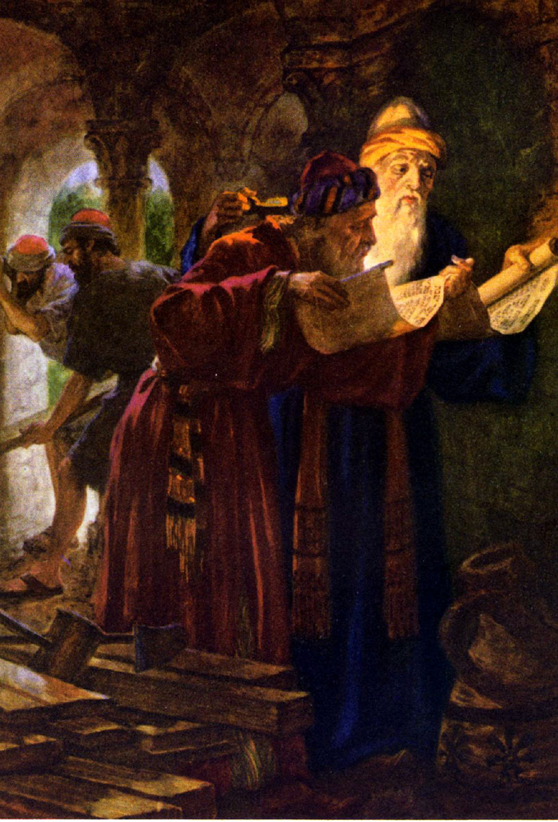
WROTE ISAIAH
Isaiah was one of the foremost of the Hebrew prophets. He was born into the royal family of Judah. His father was the younger son of King Joash. Isaiah probably grew up in the palace and received a good education.
Isaiah was called to be a prophet by God (6:2) when he was about twenty years old, and he began his ministry as a chief prophet in Judah in the year that King Uzziah died” (734BC). Aside from the fact that he was married to a woman called the “prophetess”, little is known of the personal history of Isaiah. Isaiah had two sons. He named his first child Maher-Shalal-Hash-Bas, which means “there will soon be looting and stealing.” This let the people know that Judah would be defeated in battle. The second son had a hopeful name, Shear-Jashub, “a small group shall return.” This name promised that even though the nation would be captured, the Jews would someday regain their land.
Isaiah outlasted four kings, but he finally offended one beyond repair. King Manasseh (notorious for practicing infant sacrifice) found Isaiah’s strong words too much to bear. Tradition records that he had Isaiah killed by fastening him between two planks of wood and sawing his body in half.
Manasseh had long since disappeared into obscurity. But Isaiah, though this book, endures as one of the great authors of all time. Sometimes the pen is mightier than the sword.

Slide 4
WROTE ISAIAH
A. Isaiah
B. Jeremiah
C. Ezekiel
Isaiah was born into the royal family of J____________?
His father was the younger son of King J___________?
Isaiah probable grew up in the palace and received a good education? True or False
Isaiah was called to be a prophet by G___________?
This happened when he was about twenty years old? True or False
He began his ministry before King Uzziah died? True or False
Do we know much about Isaiah’s personal history ?
Was he married? If so what was his wife called?
How many sons did he have?
Isaiah outlasted 4 kings? True or False
Who was the king he offended beyond repair?
What did that king do to him?
Did that king disappeared into obscurity?
Isaiah through this book, endures as one of the great authors of all time? True or False
Does this prove sometimes the pen is mightier than the sword?

Slide 5
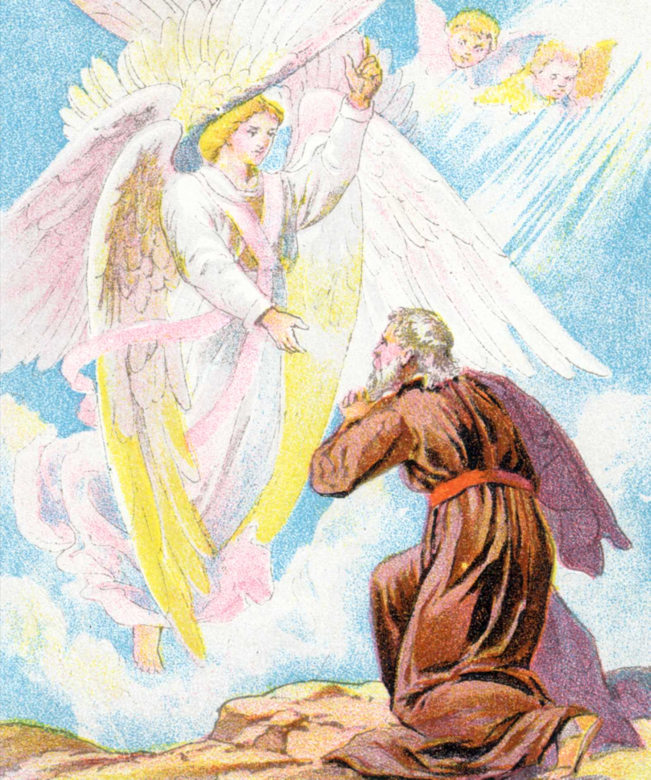
MESSIANIC CHAPTER
MESSIANIC CHAPER=ISAIAH 53
A prophet is a person called by God to deliver His message to the people. In the Old Testament, prophets told about the future, they served as leaders and advised the kings. Some prophets performed miracles and others wrote down God’s words. Several books of the Bible were written by prophets. The prophets not only spoke God’s words, they lived them out in their own lives.
The Old Testament is full of messages from prophets, but where are the prophets today? Some people think that there were prophets only in that time because that was the only way God could talk to His people. Today, we have God’s written word, the Bible, and each of us can read His messages for ourselves.
Isaiah Chapter 53 had words of hope about final deliverance through the “suffering servant”, (Jesus). It tells of a “suffering servant” who will come from Israel to bring light to all nations.

Slide 6
MESSIANIC CHAPTER
A. Isaiah 52
B. Isaiah 53
C. Isaiah 54
A prophet is a person called by G________ to deliver His m____________to the p_____________?
In the Old Testament, prophets told about the f____________?
They also served as leaders and advised the kings? True or False
Did some prophets perform miracles
Did some prophets write down God’s words?
Were several books of the Bible written by prophets?
Did the prophet who spoke God’s words also live them out in their own lives?
Is the Old Testament full of messages from prophets?
Was that the only way God could talk to His people?
Where are the prophets today?
Today we have what to read God’s messages for ourselves?
Isaiah Chapter 53 has words of hope about a “suffering servant”, who was he talking about?

Slide 7
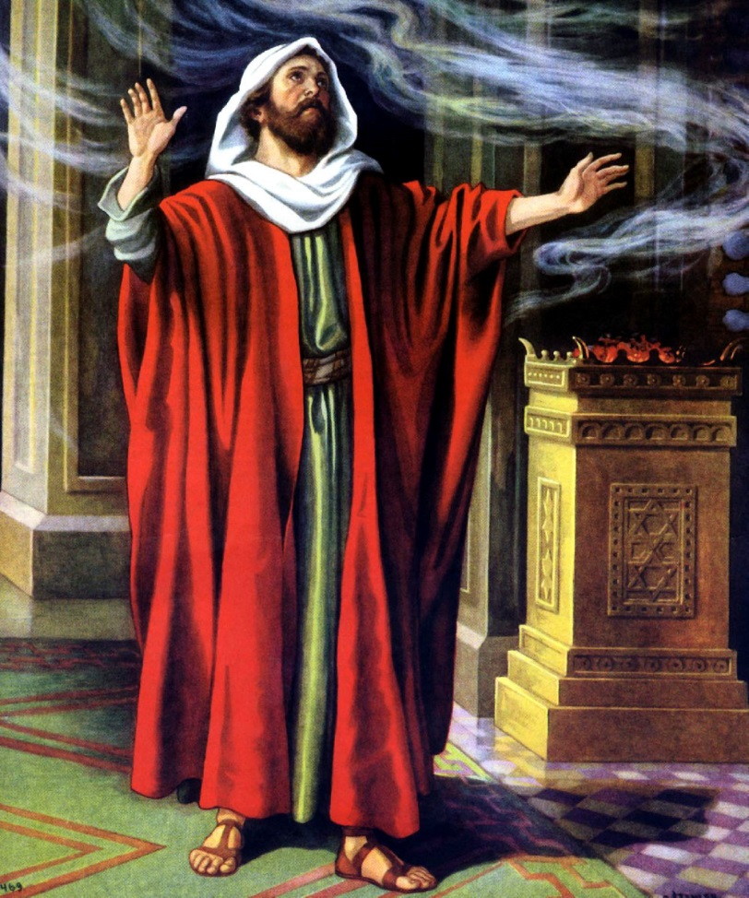
EVENTS PROPHESIED IN ISAIAH
FALL OF NATIONS:
What can a small nation do when facing a military giant? Judah found itself in that predicament early in Isaiah’s career. When two neighboring nations invaded, the tiny kingdom suffered heavy losses. King Ahaz and the people of Judah were shaken, “as the trees of the forest are shaken by the wind” (7:2). Panicked, Ahaz sought Isaiah’s advice. King Ahaz knew Isaiah would deliver a message straight from God, no matter how unpopular. Still. Ahaz was hardly prepared for what Isaiah said: Stay clam, don’t worry, simply trust God.
The attacking kings were mere “smoldering stubs of firewood,” Isaiah declared (7:4). Whatever happens, don’t seek help from an empire like Assyria; if you do, you will invite in the very army that will one day destroy you.
But Ahaz, reeling from the invasion, wanted quick relief. Ignoring Isaiah’s warning, he negotiated a treaty with mighty Assyria, using a bribe the treasury of the temple in Jerusalem.
The prophet Isaiah was furious. He had grown up in a boom time in Judah, under a good king. Suddenly he saw his country become a mere pawn of Assyria, trading away even its great religious heritage.
CAPTIVITY AND RETURN OF JUDAH
There is one easy way to picture the Middle East of Isaiah’s day: simply follow today’s newspaper headlines and project backward in time. Then, as now, one nation would invade it neighbor, leveling cities and devastating the land and its people. The prophet Isaiah longed for an end to the cycle, much as modern-day residents of Lebanon or Israel do today. Isaiah looked at the world with a kind of split vision. Around him, he saw spiritual decay and the dreary cycle of war and death. Yet God had given a clear vision of what his nation could one day become: a pure people, faithful to God, living in peace with “war no more”. Isaiah said that Judah had to endure pain and suffering in order to be purified. He counseled against making political alliance to forestall the punishment. God’s people had to go through the fire, and from the trials a remnant –a small remaining number of person—would emerge that God could then use to accomplish His work. Isaiah went so far as to name his own son “a remnant will return” as a walking object lesson of his message to Judah.
(continued on next slide)

Slide 8
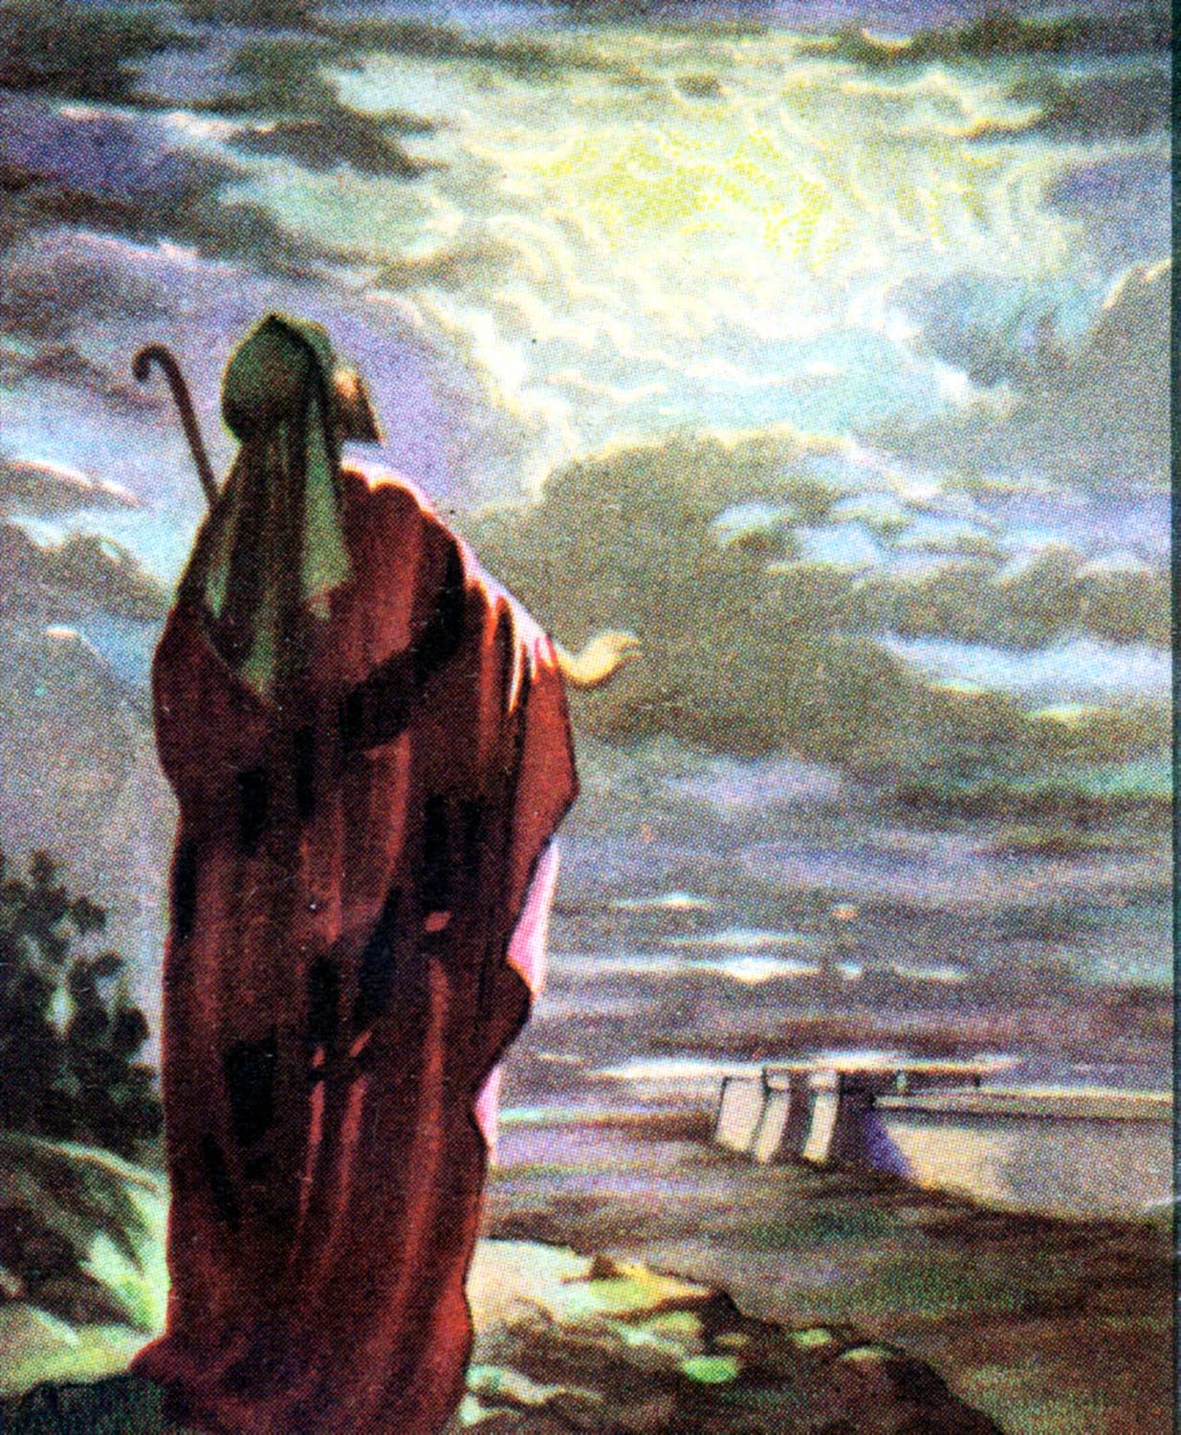
COMING OF CHRIST
Chapters 49-55 of Isaiah tell of a “suffer servant” who will come from Israel to bring light to all nations. Isaiah presents the servant as the deliverer of all humankind. And yet it portrays him more as a tragic figure than as a hero: “He had no beauty or majesty to attract us to him…He was oppressed and afflicted, yet he did not open his mouth; he was led like a lamb to the slaughter” (53:2,7). Some Jewish scholar’s guessed the prophet was describing himself or another prophet, such as Jeremiah. Still others focused their hopes on a Messiah to come. They expected a king from very humble origins, whose power would depend not on swords, but on the spirits of people committed to him.
AN ANSWER FROM THE NEW TESTAMENT The idea of the suffering servant did not really catch among the Jewish nation. They longed for a victorious Messiah, not a suffering one. The image of the suffering servant went underground, as it were, lying dormant for centuries. Then, in a very dramatic scene early in his ministry, Jesus quoted from one of the servant passages in Isaiah (Luke 4:18-19). “Then he rolled up the scroll, gave it back to the attendant and sat down. The eyes of everyone in the synagogue were fastened on him, and he began by saying to them, “Today this scripture is fulfilled in your hearing” (Luke 4:20-21).
Following his example the New Testament writers named Jesus as the servant, at least ten times.
Isaiah 49-55 includes vivid scenes of the servant’s sufferings, prediction that found their fulfillment in Jesus’ death on the cross. Written like an eye witness account, they were actually composed centuries before Christ’s death.
According to Isaiah, the servant died for a very specific purpose: “He was pierced for our transgressions” (53:5). Through his wounds, the suffering servant won a great victory. His death made possible a future when all that is wrong on earth will be set right. Significantly, the book of Isaiah does not end with the suffering servant image. It goes on to describe a wonderful life in a new heaven and new earth made possible the servant’s death.

Slide 9
EVENTS PROPHESIED IN ISAIAH
A. Fall of Nations
B. Captivity and Return of Judah
C. Coming of Christ
D. All the above
Panicked by facing a military giant, King Ahaz sought Isaiah’s advice? True or False
Did King Ahaz know Isaiah would deliver a message straight from God, no matter how unpopular?
Should we worry about being popular at school or worry more about doing what God wants us to do?
Isaiah told King Ahaz to stay calm, don’t worry, simpley trust God? True or False
Is this good advice for us today?
Was Isaiah happy with the trade King Ahaz made with Assyria?
Is the Middle East of Isaiah’s day about the same as it is today?
Did Isaiah say that Judah had to endure pain and suffering in order to be purified?
After going through fire, and trials did God have a small number of persons to emerge that He could then use to accomplish His work?
Does Isaiah tell of the coming of Christ?
Did Jesus quoted from one of the servant passages in Isaiah?
Does Christ death as predicted by Isaiah make possible a future when all that is wrong on earth will be set right?

Slide 10
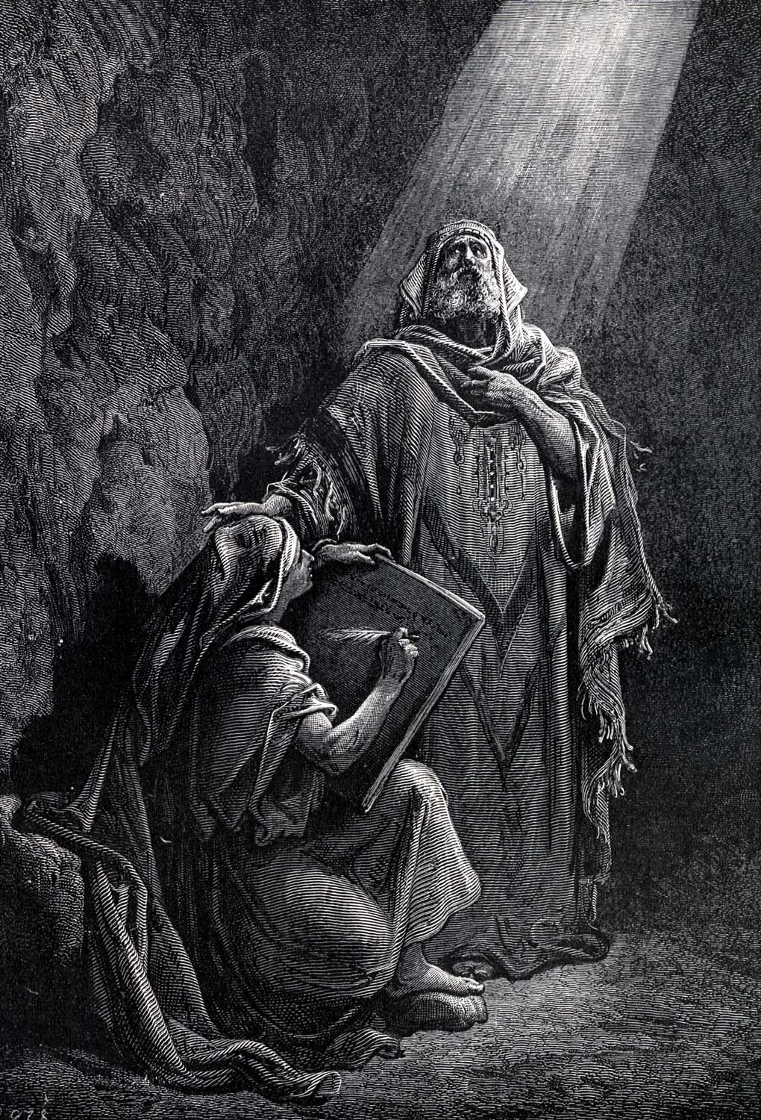
WROTE JEREMIAH
Jeremiah lived during the last days of the nation of Judah. When he was 21 years old, he learned about God’s plan for his life. God told Jeremiah he had been chosen to be a prophet since before his birth. He was to speak the word of the Lord to kings and nations.
Jeremiah lived one of the most dramatic lives in the Bible, and that is saying something. But he never learned to like his role. Through all the excitement he remained reluctant, insecure, and often unhappy.
God chose him to be “over nations and kingdoms to uproot and tear down, to destroy and overthrow, to build and to plant” (1:10). To accomplish that, Jeremiah had only one resource, his mouth. How did he respond to such an awesome challenge? “Ah Sovereign LORD,” he said, “I do not know how to speak; I am only a child” (1:6). He didn’t stride forward; he barely hung on. He wanted out of the job.
His only encouragement was God’s promise; “Today I have made you a fortified city, an iron pillar and a bronze wall to stand against the whole land” (1:18). For 40 years Jeremiah gave top officials a warning they hated to hear and refused to heed. Several times they arrested and imprisoned him; they nearly killed him.

Slide 11
WROTE JEREMIAH
A. Isaiah
B. Daniel
C. Jeremiah
God told Jeremiah he had been chosen to be a prophet since his birth? True or False
Jeremiah liked the role? True or False
Jeremiah had only one resource, his mouth to accomplish such an awesome challenge? True or False
Can we use our mouth to God’s glory today?
Name a person you know who has done this.
For 40 years Jeremiah gave top officials a warning they hated to hear and refused to heed? True or False
Can we speak up when things are said that are not according to God’s word?
Should we do this even though we are not liked by some?

Slide 12
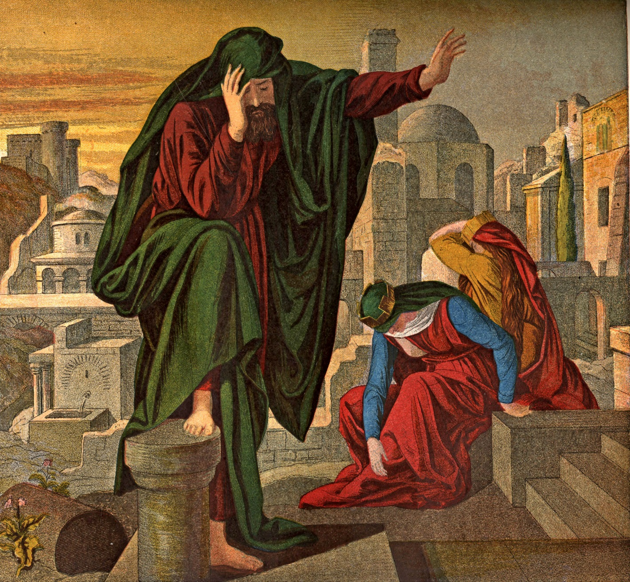
JEREMIAH KNOWN AS
THE WEEPING PROPHET
No prophet exposed his feelings more than Jeremiah. Jeremiah was the “Weeping Prophet” . He had to warn his people all the time of the terrible fate that lay ahead of them, and he could not help sorrowing about it. His relationship with God was streaked with quarrels, reproaches, and outburst. Their relationship, doubts and all, forms one of the best examples in the Bible of what it means to follow God in spite of everything. He was faithful to God Who had called him to be a prophet, and however hard it was he gave God’s messages to the people of Judah—until, four hundred years after Rehoboam had become its first king, the kingdom of Judah can to an end.

Slide 13
JEREMIAH KNOWN AS
A. Weak Prophet
B. Strong Prophet
C. Weeping Prophet
Jeremiah had to warn his people all the time of the terrible fate that lay ahead of them? True or False
Did he feel sorrowful about it?
Was his relationship with God streaked with quarrels, and outburst?
In spite of all this did Jeremiah still follow God?
Should we do the same?
Was Jeremiah faithful to God Who called him to be a prophet?
Even though it was very hard did he give God’s messages to the people of Judah?
Should we do the same today or be worried about hurting someone’s feelings?
Did the kingdom of Judah come to an end as Jeremiah warned them about?

Slide 14
FOUR J’S OF JEREMIAH
Jeremiah’s Fall Foretold:
Jeremiah spoke to a nation about to be destroyed by war. Three hundred years before him, the Israelites had split into two countries, Israel in the North and Judah in the South. About 100 years before Jeremiah, Assyria had conquered the Northern Kingdom. This disaster was “World War I” in Old Testament history.
Now during Jeremiah’s life, World War II threatened. Another fierce kingdom, Babylon assembled troops against the remaining Southern Kingdom. Would God save his chosen people? Jeremiah loudly insisted for more than 20 years that God would punish Judah just as he had Israel by letting Babylon take them into captivity. He lived to see predictions come true.
Many passages in Jeremiah refer to the five kings he know. When you see their names, use them as a reference point in figuring out the order of events: Josiah (17 years of a 31 year reign); Jehoahaz (3 months)
Jehoiakim (12 years); Jehoiachin (3 months); Zedekiah (11 years)
Jehoiakim Burns Jeremiah’s Writings:
Jeremiah spoke the Lord’s words to the people of Judah, but they did not listen. So God told the prophet to send a scroll to King Jehoiakim. Jeremiah’s friend, Baruch, worked many hours writing down the messages that God had given Jeremiah. Perhaps now the king would pay attention!
One winter’s day the king’s officer came and snatched the parchment roll away from Baruch, and took it to the king, who was sitting warming himself by the fireside. Section by section the officers took the scroll and began reading it out loud before Jehoiakim. As he listened, the disobedient king took each section the officer read and cut it into pieces with his knife, throwing the pieces into the fire. One by one, God’s words to his people landed in the fire.
(continued on next slide)

Slide 15
Jeremiah Imprisoned:
Even some of the princes were horrified, with what the king had done, and asked the king not to do this, but he would not listen to them. Instead he sent some of his officers to throw Jeremiah and Baruch into prison; but the Lord hid them. While they were hidden away, Baruch wrote down again what the Lord had said through Jeremiah, so that we still have those words in our Bibles today.
Not long afterward the Babylonian armies returned to Judah, and Nebuchadnezzar the king of Babylon took Jehoiakim prisoner. Three years later the Babylonians let Jehoiakim free, but he died in disgrace a short while afterward.
Zedekiah was made king of Judah by the Babylonians and he promised to be faithful to Nebuchadnezzar, the king of Babylon, but it was not long before they had persuaded his princes that they should rebel. Zedekiah had heard that Pharaoh’s army was moving out of Egypt to make war against the Babylonians. So he planned to break his promise to Nebuchadnezzar and fight on the Egyptian side in the war. But Jeremiah warned him not to break his promise. God had told him that the Egyptians would turn back to their own land, and that the Babylonians would come and destroy Jerusalem. They must not deceive themselves into thinking that the Babylonians would leave the land of Judah: They would not.
When they heard this, Zedekiah and his princes were very angry. They said that Jeremiah was a traitor, and must be killed. Zedekiah told the princes to do what they like with Jeremiah, so they took him and let him down with ropes into a muddy dungeon under the floor of the palace prison. There was a kindhearted man in the palace, though. An African called Ebed-melech, was upset over the thought of Jeremiah lying there in the mud, starving. He went to the king, and asked permission to move the prophet to another part of the prison. The king allowed him to move Jeremiah to a warm and dry place.
(continued on next slide)

Slide 16
JERUSALEM’S FALL:
By this time Nebuchadnezzar and his armies were hammering at the walls of Jerusalem. Soon the walls came tumbling down, and the fierce soldiers swarmed into the city. The king and his family tried to flee out of the city, but the Babylonians soon overtook them and made them prisoner. Zedekiah was dragged in front of Nebuchadnezzar and had to watch the Babylonians kill his own sons. Then they blinded him, fastened him with chains, and took him away to Babylon. In the meantime, all the buildings in Jerusalem were burned down and all the people, except the very poorest, were driven like a flock of sheep, toward Babylon, far away in the east. That was the end of the kingdom of Judah. Zedekiah was the last king, and there were none to follow him.
Nebuchadnezzar was friendly toward Jeremiah, because he had warned Zedekiah not to side with the Egyptians, and Jeremiah chose to stay amidst the ruins of Jerusalem. A short while afterward though, enemies of the king of Babylon captured Jeremiah and carried him away to Egypt; and that is where he died.

Slide 17
FOUR J’S OF JEREMIAH
A. Jerusalem’s Fall Foretold
B. Jehoiakim Burns Jeremiah’s Writings
C. Jeremiah Imprisoned
D. Jerusalem’s Fall
E. All the above
Jeremiah spoke to a nation about to be destroyed by wars? True or False
Jehoiakim burned Jeremiah’s writings but was that the end of what the Lord had said through Jeremiah?
The king sent some officer to throw Jeremiah and Baruch into prison but what did the Lord do?
Baruch wrote down again what Jeremiah had said, do we still have these in our Bibles today?
The princes took Jeremiah and let him down into a muddy dungeon, how did he get out?
Did the walls of Jerusalem come tumbling down as Jeremiah tried to tell them?
What did Nebuchadnezzar do with King Zedekiah?
Where did the enemies of the king of Babylon take Jeremiah?
Did he die there?

