Slide 1
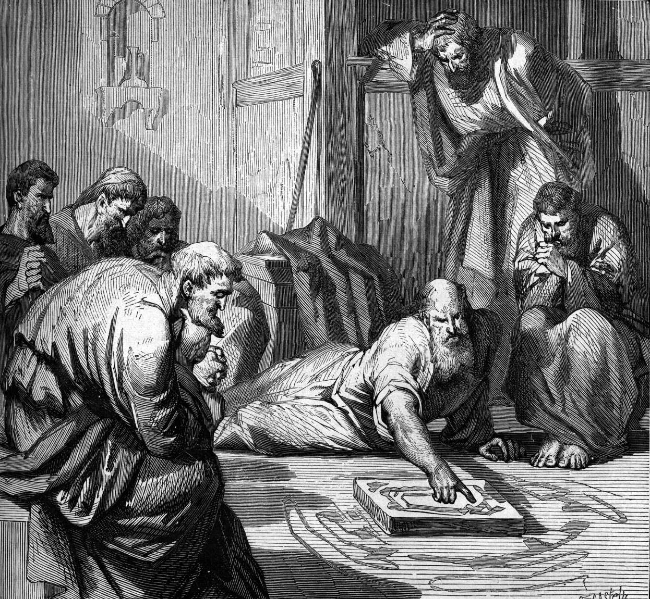
Cards 86-91
WROTE EZEKIEL
Ezekiel begins with a description so unearthly that some have suggested the prophet saw a UFO. Indeed, there are similarities: glowing lights, quick movements, inhuman figures shrouded with fire. But at least one critical difference sets Ezekiel’s story apart. UFO’s typically appear in remote places and then mysteriously zoom off, never to be heard from again. The majestic being Ezekiel described was not rushing off to disappear. He wanted to be known—by everyone.
For Ezekiel was quite sure that he had seen and heard the God of the Bible. While few have been privileged to see him as Ezekiel did, this God had been speaking plainly for generations. His words were on record.
Before such splendor Ezekiel felt utterly weak and inadequate, just as Isaiah had during a similar vision (Isaiah 6). He fell on his face, repeatedly. But God raised Ezekiel to his feet and gave them a message to deliver.

Slide 2
WROTE EZEKIEL
A. Jeremiah
B. Daniel
C. Ezekiel
Was Ezekiel’s description of his vision similar to a UPO?
Was Ezekiel quite sure he had seen and heard God?
Even though we have not seen God as Ezekiel did, God still speaks to us today how?
Is God’s word our guide on how to live?
God raised Ezekiel up and gave him a message to deliver? True or False

Slide 3
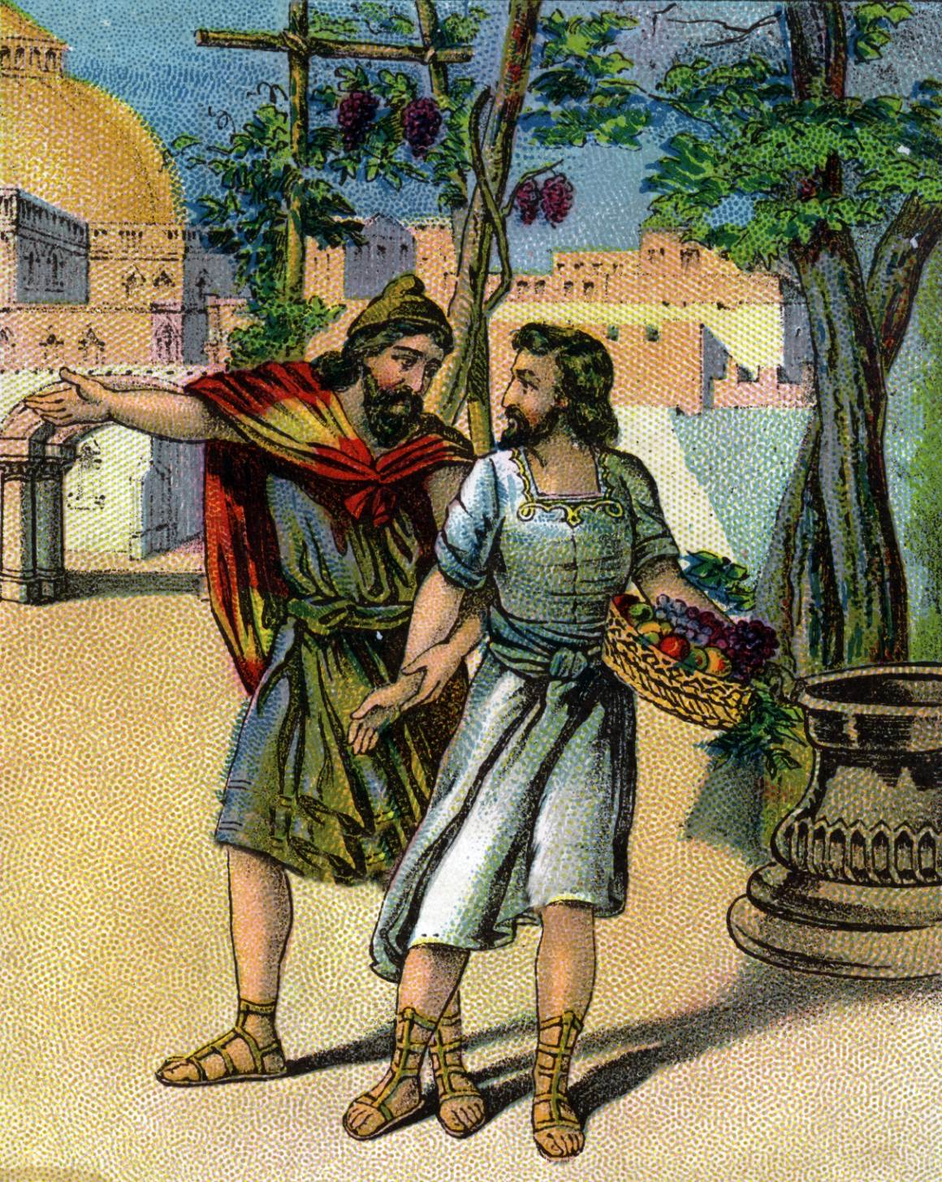
QUOTE EZEKIEL 18:20
“THE SOUL THAT SINNETH, IT SHALL DIE….”
The fundamental principle of how God deals with man is stated here. The son, Ezekiel argued, is not affected by the evil deeds of his father. This eliminated the doctrine of inherited sin. Only the person who sins will die.
There is no need, nor is there any biblical teaching, for infants to be baptized for the forgiveness of sin. A child has no sin and therefore has no need for the forgiveness that baptism provided (Acts 2:38; 22:16; I Pet 3;21; Mk 16:15; Mt 28:18-20). This is why every biblical example of conversion involves adults who were ca pable of believing, repenting, and making a conscious choice to be baptized. An infant, who has no sin, is incapable of believing or repenting. Babies cannot make the mental choice to declare Jesus as Lord and to be immersed in the water of baptism.
Further, the doctrine unconditional election is proven false by these verses. If God predetermined one’s eternal destiny, then the discussion in these verses would be a waste of time. Ezekiel showed that the person who sins will die, while the righteous person will live. If such choices were scripted for them by God, without their being able to decide on either course, then this entire chapter would be unnecessary.

Slide 4
QUOTE EZEKIEL 18:20
Finish the verse “ The _____________that ____________, it shall ____________.
Is a son or daughter affected by the evil deeds of their father or mother?
Is there any Biblical teaching for infants to be baptized for the forgiveness of sin?
Does a baby have any sins?
What are the steps of salvation: H________B__________R__________C__________and be B____________.
Can babies do those?
Ezeliel showed that the person who sins will die, while the righteous person will live. True or False

Slide 5
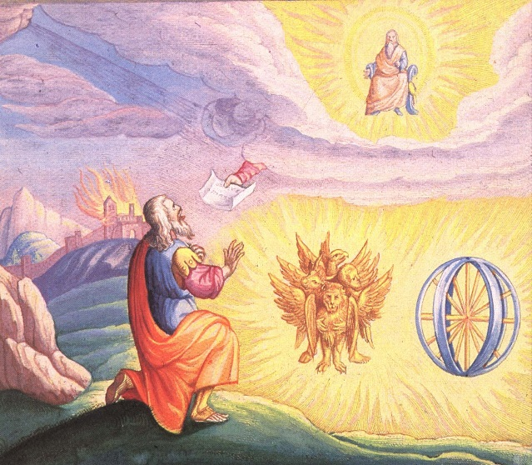
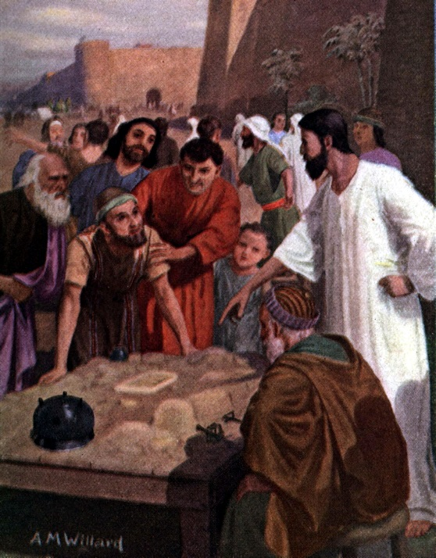
NAME THE V’S IN EZEKIEL
The special difficulty in reading Ezekiel is the dizzying variety of forms he used to get his message across. The book is like a multimedia package---mix of visions, messages, dramas, poems. But three remarkable visions of God bracket the package.
Vision of God’s Glory Leaving the Temple: Ezekiel’s people tempted fate for generations, ignoring God’s messengers like Isaiah the prophet, who warned that if they didn’t listen to God, they would be destroyed along with their temple. Since Judah had ignored God’s repeated warning, God would use another means to get their attention: suffering.
Vision of the Valley of Dry Bones: Once in a vision, Ezekiel was carried away into a wide valley; and when he looked around, he found there were men’s bones scattered all around. (See card for more on this story) God told Ezekiel that these bones represent the whole house of Israel. They feel that there is no hope for them any longer, but, as life has come into these dead bones, I will bring life into the house of Israel again. When Ezekiel told his people that wonderful message from God, they took courage and looked forward with joy to the day God would lead them home once more.
Vision of God’s Glory Returning to the Temple: Ezekiel ends with hope. The final chapters (40-48) show a new Jerusalem rising from the ruins of the old. The renewed city would never die, for it would be built on an unshifting reality: “They will know I am the Lord.” These last nine chapters are a unit which describes a vision of the new temple and all of its buildings, walls and sacrificial implements, along with priestly allotments of the land. This time, Ezekiel saw the Lord returning to dwell with His people.
Vision of God’s Glory Leaving the Temple
Vision of the Valley of “Dry Bones
Vision of God’s Glory Returning to the Temple

Slide 6
NAME V’S IN EZEKIEL
Vision of God’s Glory L_____________ the T______________
Vision of the V____________of Dry B___________
Vision of God’s G____________Returning to the T____________
Had God warned Judah for years that they, along with their temple would be destroyed if they did not listen to God?
Was Ezekiel also one of the weary band of prisoners in the land of Babylon after the Babylonian armies swept through Judah?
Tell the story of the Vision of the Valley of Dry Bones. (See back of card)
Does Ezekiel end with hope?
Did Ezekiel see the Lord returning to dwell with His people?

Slide 7
WROTE DANIEL
Like Ezekiel, Daniel was one of the Jews who was taken to Babylon when Jerusalem was attacked, and the temple was destroyed. As a young man, Daniel could have anticipated an outstanding future in Jerusalem. He came from a prominent family, and he had a first-rate mind (1:4). But, when the Babylonian army dragged him captive to a faraway country, they didn’t ask about his plans and dreams.
While Ezekiel worked at hard physical labor, the Babylonians recognized Daniel’s potential and put him into a top civil service training program. Daniel lived out his life in the palace, advising the Babylonian leaders. But even the study material was distasteful to a Jew: it covered sorcery, magic, and a pagan, multigod religion. After graduation Daniel was put to work for the Babylonian king, who continued to war against Daniel’s people for nearly 20 more years.
Anyone far from home feels lonely. But Daniel was one of those whose lives get lost in the shuffle of history—refugees, captives. He was destined to spend his life as an alien in Babylon. We have no record that he ever married or had family members nearby.
He started out as a prisoner, but ended up second only to the king. Even in a pagan place, Daniel remained true to the Lord. Daniel never compromised his faith. He would not bend, even when threatened with death. The Bible offers no better model of how to live with and serve people who do not share or respect your beliefs.

Slide 8
WROTE DANIEL
A. Jeremiah
B. Daniel
C. Ezekiel
Daniel was one of the Jews taken to Babylon when Jerusalem was attacked, and the temple was destroyed?
True or False
Daniel did not come from a good family? True or False
Daniel had a good mind? True or False
Daniel was put into a top civil service training program? True or False
Daniel lived out his life in the palace, advising the Babylonian leaders? True or False
He started out as a prisoner, but ended up second only to the king? True or False
When Daniel was threatened with death in the lions den, and the fiery furnace, he did not remain true to the Lord? True or False
The Bible offers no better model of how to live with and serve people? True or False

Slide 9
MAIN EVENTS IN DANIEL
Refused the King’s Food
Fiery Furnace
Handwriting on the Wall
Can you tell the stories of the events in Daniel? See back of card to review them.
Explained the King’s Dream
Daniel in the Lion’s Den

Slide 10
MAIN EVENTS IN DANIEL
Finish the event:
Refuse the King’s F___________
Explained the King’s D________
Fiery F______________
Handwriting on the W_________
Daniel in the L_________ D________
After all these events did the king respect and honor the God of Daniel??

Slide 11
KINGDOMS SPOKEN OF BY DANIEL
The images of Nebuchadnezzar’s dream was a glimpse into the future, telling him about the different kingdoms that would rule the world after him. What God told Nebuchadnezzar in that dream was a preview of what would take place, and we can see from history that it had come to pass just as the dream predicted. King Nebuchadnezzar’s Babylonian Empire, the head of gold, ruled the known world for more than 80 years. Then Medes and Persians (the silver breast and arms) overcame Babylon and became a world power for more than 80 years. That kingdom was followed by the Grecian Empire, represented by the iron legs. The two legs represent the eastern and western divisions of the Roman Empire. It was the Roman Empire that ruled the world when Jesus was here on earth. Since the fall of the Roman Empire, no nation had ever ruled the whole world though many have tried to do so.
The rest of Nebuchadnezzar’s dream had not yet come to pass; it is still future. But as surely as the first part came to pass exactly as God predicted, so the latter part of the dream will also come to pass exactly as God said. The toes of the stature represent a ten-nation confederation of the last days that will be reigning when the great Stone cut without hands, which is Jesus Christ, the Rock of ages, will come back to earth and take the righteous to live with him. The planet Earth will be destroyed, but God’s kingdom will continue forever and ever

Slide 12
KINGDOMS SPOKEN OF DANIEL
Name the kingdoms:
B__________________
M____________and P______________
G_____________
R______________
G______________
Has the last kingdom come yet?
Will this kingdom continue forever and ever?

